Slide 1
Household Survey Using Mobile Phones in Mali
Methodological Workshop on Measuring Impacts of Refugees and IDPs on Host Countries and Host Communities (November 20-21, 2015)
Alvin Etang Ndip (Economist, Poverty & Equity GP)

Slide 2
Background: Events of the Current Crisis in Mali
April: Main cities in the North fall
March: Coup d’etat
2013
January: French-led intervention
February: Islamist held territory is retaken by Malian Army
2012
Summer: Fighting between various rebel groups
January: Attacks by MNLA in the North
2014
Renewed fighting between rebels and Army
Continued insecurity and fighting in the North
Peace talks
September: IBK elected President
June-ongoing: Peace talks
July: Deployment of MINUSMA
2015
Continued fighting in the North
May: Signing of Algiers Peace Accord by Government
Terrorist attack in Bamako
Continued peace talks

Slide 3
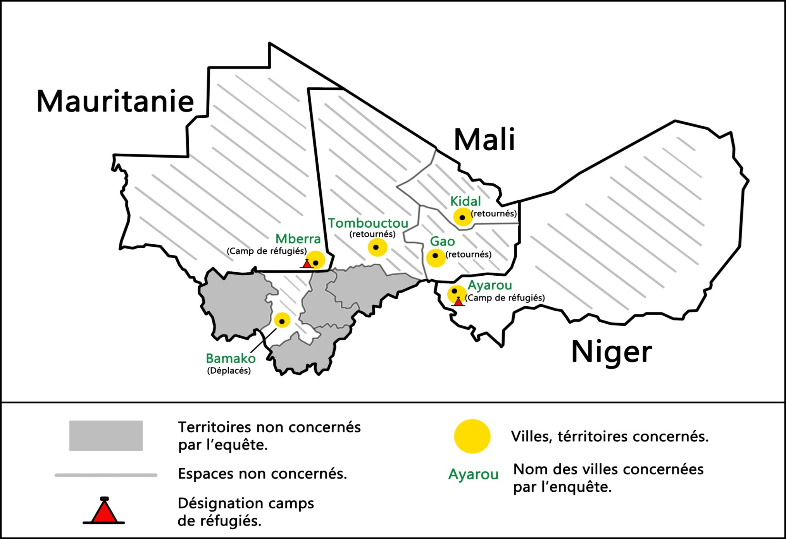
Background: Mali Displaced people
500,000 people displaced
at the height of the crisis
Refugees as of May 2015
52,300 in Mauritania
70,000 in Niger
13,000 in Burkina Faso
￼

Slide 4
The Challenge: Obtaining information in a fragile environment
Mobile population
Socio-economic data on refugees and IDPs are rare
Longer-term consequences of displacement on household welfare are not well researched and understood
Data often limited to the economic impact of refugees on host states and the ways in which refugees and IDPs engage in income-generating activities.
Information on returnees, once back in their place of origin, is hardly available.
Challenges for decision-making
So…
How can we track a moving populations over time?
How can we collect welfare information that is relevant, reliable and timely?
Notes:
Providing data on the welfare of IDPs, refugees and returnees that goes beyond economic impact and includes security, social cohesion, education, levels of trust in the government and its institutions, the potential for conflict resolutions as well as income, and employment. By analyzing both the impact of the crisis as well as the impact of returning home versus remaining in displacement
The paper combines data from a face to face baseline survey, with information collected during mobile phone interviews from respondents identified during the baseline. In this way we are able to collect data on a monthly basis. It allows us not only to measure changes over time, it also permits following displaced and refugee households after they have returned
Field work is being conducted by GISSE, a local research institute
$$$: Innovation Grant and the Global Program on Forced Displacement (GPFD)

Slide 5
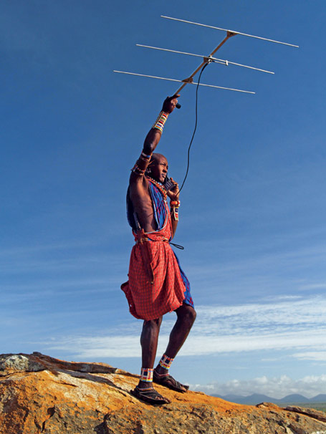
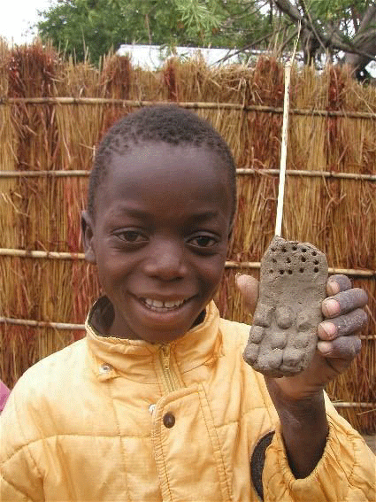
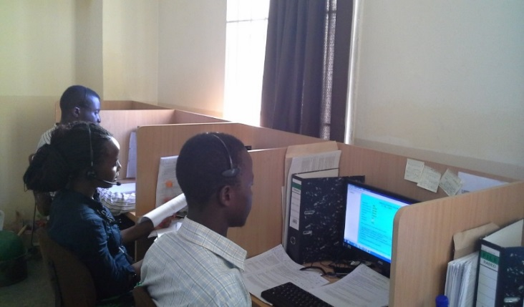
Mobile phones offer new possibilities for collecting information from the displaced
What does it take?
Notes:
Mobile phones offer new possibilities for household data collection ….
... but don’t get carried away by the technological possibilities; live calls are the way to go in Africa

Slide 6
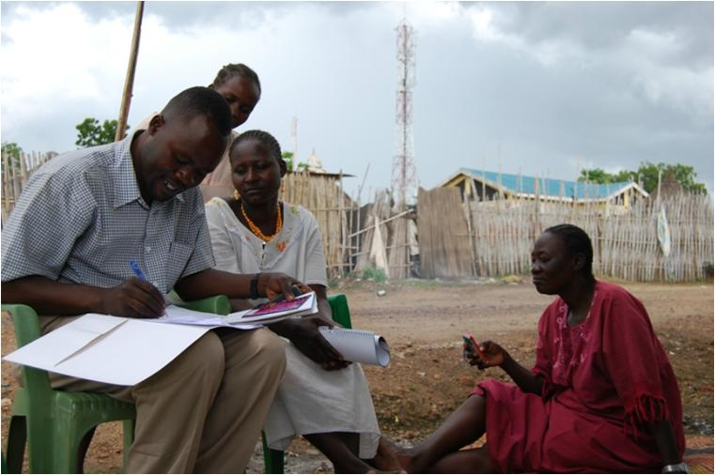
The Approach: Listening to Displaced People Survey – Mali
(1) Face-to-Face Baseline Survey
Combine a face-to-face baseline survey with monthly mobile phone interviews to:
Understand characteristics of the displaced
Collect information on incentives and challenges for return
Track welfare
Understand changing perceptions on social and political issues
(2) Monthly phone interviews
SMS
IVR
USSD
Live calls
... but don’t get carried away by the technological possibilities; live calls are the way to go
Notes:
Baseline as an elaborate interview
Monthly – not more than 20 minutes
We aim to observe a trend by proaching the same subjects every month
But we all so leave felxibility to enter into depth in case there is an issues that needs deeper understanding
Finally, monthly questions change every month to touch upon important political, social securty related developments

Slide 7
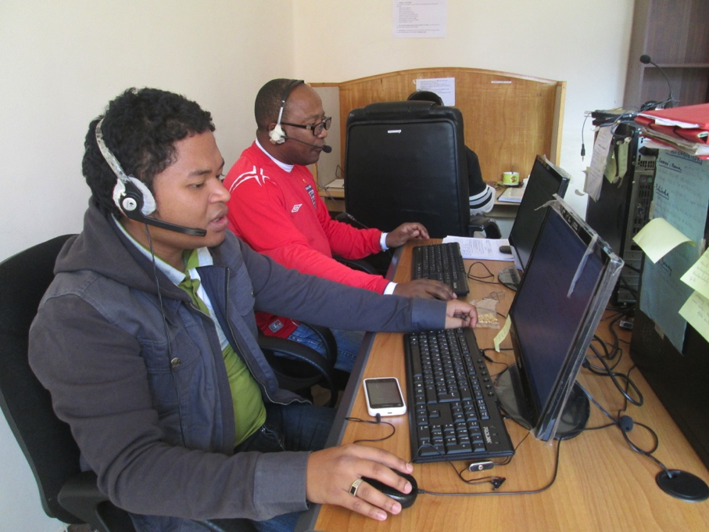
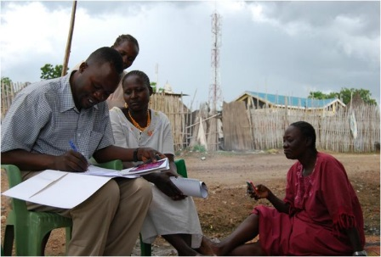
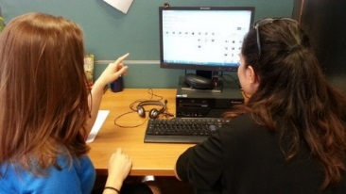
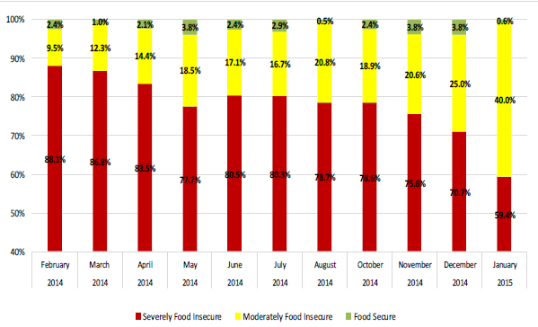
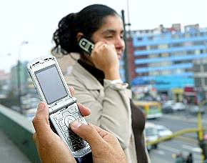
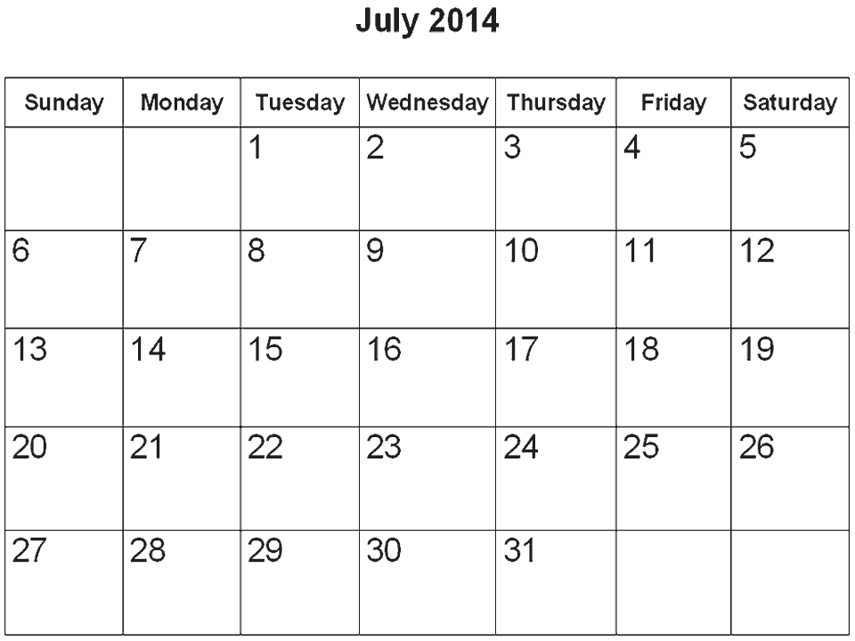
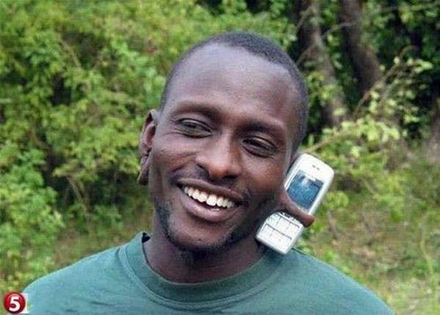
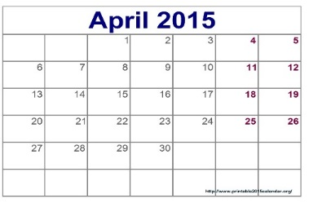
How does it work?
Call Center
Baseline survey

Slide 8
The Sample
500 individuals
Target groups: IDPs, refugees and returnees
51% male; 49% female
Random selection of households and individuals
Representative of IDPs in Bamako, refugees in Niger and Mauritania and returnees to the regional capitals in the North
Doesn’t include those who were not displaced by the crisis & those who returned to places other than the three regional capitals in the North.
Sub-sample of IDPs includes exclusively IDPs in Bamako
Refugee sub-sample only refugees in Niger and Mauritania
Returnee group includes people who were displaced elsewhere (33%)
Notes:
- Bamako was selected because it is home to a large number of IDPs. The two refugee camps in Mauritania and Niger were selected to obtain a sample of refugees. Returnees were identified in the regional capitals of Timbuktu, Gao and Kidal because this was feasible with the available funds.
- Our sample does not cover those that were never displaced and those that are returning to other places besides the regional capitals. While our IDP category focuses exclusively on IDPs in Bamako, and the refugee category only includes refugees in Niger and Mauritania our returnee category does include people who were displaced elsewhere (43%).

Slide 9
Sampling method
Bamako: Listing information of all households with IDPs was available from the International Organization for Migration (IOM). Based on this data 10 districts were selected and in each district 10 households were randomly identified.
Gao, Timbuktu and Kidal: No listing data was available and the cities were divided into different sectors. Enumerator assigned a starting point in a sector, a direction (North, South, East, West) and based on the code of the day selected the first household. Max 6 houses interviewed from one starting point.
Mauritania: same method was applied as in Gao, Timbuktu and Kidal
Niger: Listing data was available, thus a similar methodology to that of Bamako
Selecting an individual in the household: all adults (18 years +) in the hh assigned a random birthdate using a prefabricated table. The person whose artificial birthday was closest to the actual date was selected as the individual to participate in this study
Notes:
- Bamako was selected because it is home to a large number of IDPs. The two refugee camps in Mauritania and Niger were selected to obtain a sample of refugees. Returnees were identified in the regional capitals of Timbuktu, Gao and Kidal because this was feasible with the available funds.
- Our sample does not cover those that were never displaced and those that are returning to other places besides the regional capitals. While our IDP category focuses exclusively on IDPs in Bamako, and the refugee category only includes refugees in Niger and Mauritania our returnee category does include people who were displaced elsewhere (43%).

Slide 10
Questions
Migration
Violence and Insecurity
Social Cohesion
Nutrition and Food Security
Employment and Education
Perception of well-being
Governance
Questions of the Month
Notes:
- Bamako was selected because it is home to a large number of IDPs. The two refugee camps in Mauritania and Niger were selected to obtain a sample of refugees. Returnees were identified in the regional capitals of Timbuktu, Gao and Kidal because this was feasible with the available funds.
- Our sample does not cover those that were never displaced and those that are returning to other places besides the regional capitals. While our IDP category focuses exclusively on IDPs in Bamako, and the refugee category only includes refugees in Niger and Mauritania our returnee category does include people who were displaced elsewhere (43%).

Slide 11
Challenges/Lessons Learnt
Due to difficulties with authorities in the camp in Burkina Faso, it was replaced by the camp in Niger. This delayed the fieldwork by a few weeks
Difficulty accessing the North – Using a local firm (GISSE) was helpful
Challenge of attrition/non-response ---not a concern
Was becoming hard to reach all respondents in the Mauritania camp ---resolved
Mobile phone surveys can be useful for tracking welfare of a moving population
This combination was found to present a good and robust way to monitor the impact of conflict on hard-to-reach populations who at times live in areas inaccessible to enumerators.
Details in:
Etang A., Hoogeveen J, Lendorfer J. (2015) “Socioeconomic Impact of the Crisis in North Mali on Displaced People” World Bank Policy Research Working Paper No. 7253 (May 2015). Washington, D.C. : World Bank Group. Available online at http://documents.worldbank.org/curated/en/2015/05/24436850/socioeconomic-impact-crisis-north-mali-displaced-people
Notes:
- Bamako was selected because it is home to a large number of IDPs. The two refugee camps in Mauritania and Niger were selected to obtain a sample of refugees. Returnees were identified in the regional capitals of Timbuktu, Gao and Kidal because this was feasible with the available funds.
- Our sample does not cover those that were never displaced and those that are returning to other places besides the regional capitals. While our IDP category focuses exclusively on IDPs in Bamako, and the refugee category only includes refugees in Niger and Mauritania our returnee category does include people who were displaced elsewhere (43%).

Slide 12
Thank you

