Slide 1

Socio-economic Assessment of the Impact of
Syrians under Temporary Protection (SuTPs) on Turkish Hosting Communities
Presented by: Anna Gueorguieva
Joint work by the Turkey Social, Urban, Rural and Resilience (SURR), Social Protection and Labor (SPL) and Poverty teams
Key contacts: Joanna De Berry, William Wiseman and Holly Benner

Slide 2
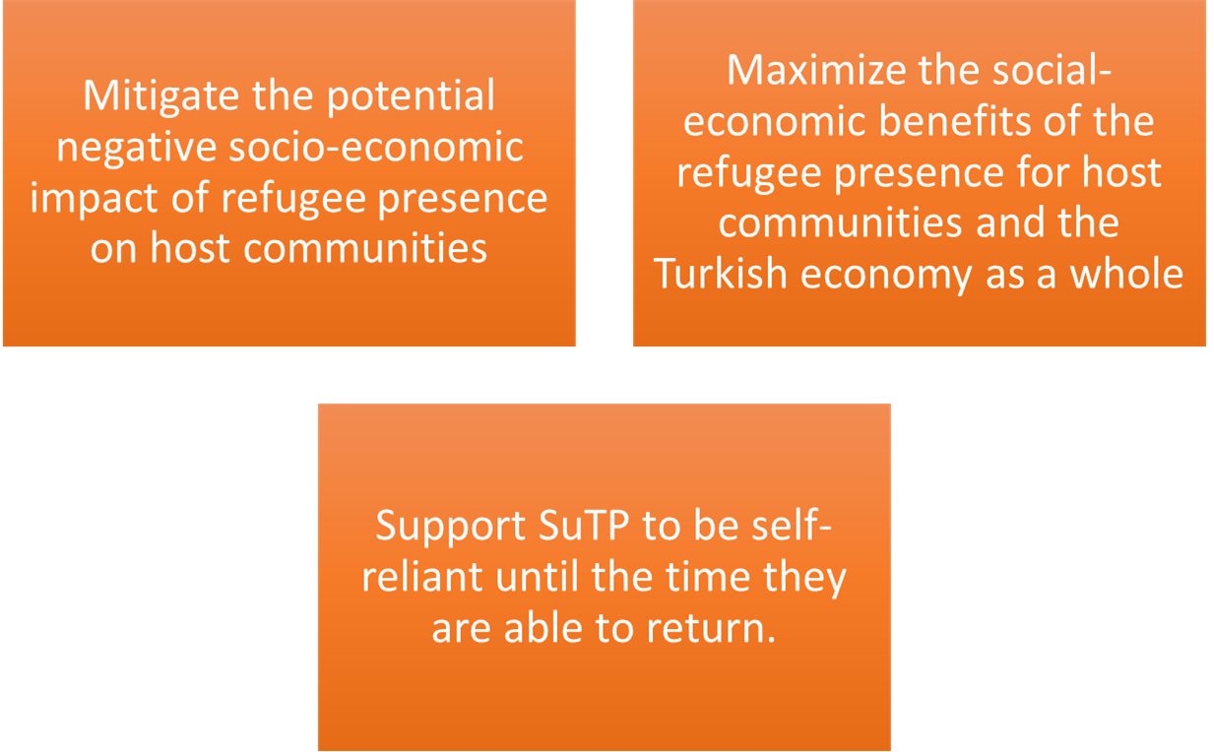
Objectives of the study
Identify the socio-economic impacts on host communities

Slide 3
Research Design
Quantitative assessment - a nationally representative household survey with SuTP and local Turkish households.
Qualitative assessment
Perceptions, experiences, priorities of the informants
Trends identified through the quantitative work.
(i) focus groups
(ii) semi-structured and open-ended interviews
Notes:
Focus groups -- where prompts are used to promote open-ended discussion and conversation in a group of approximately 8 – 12 people
Semi-structured interviews -- where conversation is encouraged with one or two respondents around a structured set of topics.

Slide 4
Case study
Country: Turkey
Both camp and out of camp
Focus on urban but both settings

Slide 5
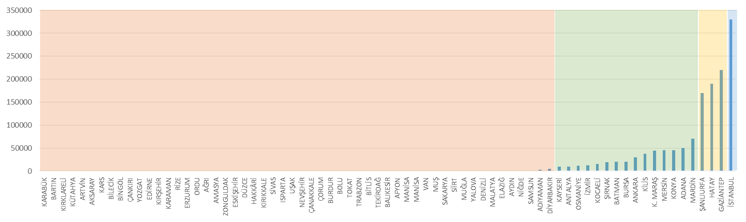
Sampling methodology
Sample size: 3700 households
Dwelling sample of both SuTPs and non-SuTPs Stratified cluster sample with 4 geographic domains Istanbul, with a focus on the areas with high numbers of SuTPs Areas with high densities of SuTPs, particularly in the southeast of the country Areas with low predicted numbers of SuTPs Remaining areas of the country Oversamples SuTPs and non-SuTPs living in areas with a high SuTP density |  | SuTPs living in Camps Clustered design in which camps are primary sampling units Based on camp lists complied by AFAD
Notes:
Camps: For the estimated 15 percent of the SuTP population living in camps in Turkey. in which the camps are clusters. Using the camp administrative lists held by AFAD as a sampling frame, camps will be selected as the primary sampling unit, and households in the second stage.

Slide 6
Questionnaire
Syrians and Host Communities
Labor Market & skills
Municipal Services
Other
Education
Welfare

Slide 7
QUANTITATIVE SURVEY TOPICS
Household Roster
Provides basic information about all household members and describes their relationships.
Household conditions – housing type, size, and quality
Household assets (e.g. TV, internet access, refrigerator, cell phone)
Household income vs. expenses – e.g. salary, pensions, social assistance, rental income vs. housing, food, services, education, transport expenses
Welfare
Municipal Services
Standard of housing
Rental and sale prices for housing
Utilities, power and water -- quality, access and cost
Sanitation facilities and services -- quality, access and cost
Public transportation and roads -- quality, access and cost
Distance to key services – e.g. hospitals, doctors, schools
Comparison of the above to one year ago and four years ago
Future plans for household moves and rationale

Slide 8
QUANTITATIVE SURVEY TOPICS
Labor
Employment and jobs of household members
Type of employment (e.g. formal/informal; full time/part-time)
Number of hours worked per week
Compensation received/salary levels
Type of workplace
Job content (e.g. skilled/unskilled)
Aspirations for employment (work hours, responsibilities, workplace)
Experiences with unemployment and job searching
Employment situation compared to one year ago and four years ago
Education
For each member in the household:
Level of schooling achieved
Attendance rates
Cost of education-related expenses
Type of curriculum
Language of instruction
Ease/quality of transport to school
Perceptions of learning experience of child
Degree to which Turkish/SuTPs joint attendance in school
Perceptions of improvements/challenges in education services compared to one year ago and four years ago

Slide 9
QUANTITATIVE SURVEY TOPICS
Networks
Frequency of social contact within and outside of nationality/ethnic group
Type of support received from nationality/ethnic group
Level of connection to communities in Syria
Levels of trust within Turkish communities
Quality of Life
Satisfaction levels on issues such as food, housing, health, income/employment, education, security, justice, municipal services
Satisfaction levels with overall quality of life
Satisfaction levels compared to one year ago and four years ago

Slide 10
TIME AND COST INVOLVED
Field implementation commencing January 2016
Expect Cost $600,000 for both quantitative and qualitative work

Slide 11
QUALITATIVE METHODS
Target groups:
Syrian and Turkish families
Same sample as quantitative work
Sub-sets of special interest groups --women, children, youth, community leaders
Service providers to SuTPs -- teachers, municipal authorities, Social Solidarity Foundations, employers and shop keepers
Notes:
The primary respondents for the qualitative work will be
Syrian and Turkish families, drawn from the same sample used for the quantitative work. Sub-sets of special interest groups from within the refugee and host population – such as women, children, youth, community leaders – will be identified and also approached. There will also be targeting of those who provide services in connection with SuTP including: teachers, municipal authorities, Social Solidarity Foundations, employers and shop keepers.

Slide 12
QUALITATIVE SURVEY TOPICS
Turkish Families
Services
Labor market
Household stresses
Positive and negative impact of SuTP
Interactions with SuTP
Priority areas where policy and services need to change
Syrian Families
Additional questions:
Household decision making dynamics and coping resources
Employers
Labor market
Preferences and demand for SuTP/Turkish employees
Trends in job creation over time
Notes:
Perceptions of and experience of changes in … over time

Slide 13
QUALITATIVE SURVEY TOPICS
Frequency of social contact within and outside of nationality/ethnic group
Type of support received from nationality/ethnic group
Level of connection to communities in Syria
Levels of trust within Turkish communities
Teachers/School administrators
Municipal Authorities
Satisfaction levels on issues such as food, housing, health, income/employment, education, security, justice, municipal services
Satisfaction levels with overall quality of life
Satisfaction levels compared to one year ago and four years ago
Social Solidarity Foundations
Services over time
Applicants and needs
Household stresses over time
Priority areas where policy, services or resource allocation needs to change

Slide 14
KEY IMPLEMENTATION ISSUES
Access to the camps via AFAD
Finalization of sampling strategy with DGMM
Finalization of quantitative survey modules with line ministries
Choice of implementing university/research institution

Slide 15
THANK YOU!
Key corresponding contacts:
Joanna De Berry jdeberry@worldbank.org
William Wiseman wwiseman@worldbank.org
Holly Benner hbenner@worldbank.org

Slide 16
ANNEXES

Slide 17
KEY POLICY DECISIONS AND NEXT STEPS
1. Employment
  Whether permits should be granted to SuTP and how this can be done with positive consequences for Turkish workers
  Improved quantification of skills amongst SuTP workers to understand what they bring to the Turkish labor market
  What employment and training services will SuTPs need to integrate into the Turkish labor market?
  Improved quantification of current impact of SuTP workers on the Turkish labor force
  Improved analysis of the potential impact of work permits for the Turkish labor force and necessary mitigation measures
  Whether to keep three systems in place for education of SuTP children (integration into Turkish schools, Temporary Education Centers, Community-Based Education) or to prioritize one over the others
    And how to respond to SuTP preference on this issue and aspirations for their children
  How to support Turkish schools to take in more SuTP children without compromising the quality of education
  Need to understand the main barriers for accessing schools for SuTP and how to address them
  How to strengthen mechanisms – such as Turkish language classes – that facilitate SuTP children’s entry into the Turkish education system.
  How to respond to the psycho-social challenges of SuTP children, which affect their learning
  Improve data on skills, capacity and training demands by Syrian teachers leading to increased regularization of their work and support.
2. Education

Slide 18
KEY POLICY DECISIONS AND NEXT STEPS
3. Municipal Services
  Need to fully understand the demand placed on municipalities by SuTP and level of access among SuTP to municipal services including what constrains that access
  Need to understand how increased SuTP is affecting municipal services for Turkish hosting communities
  Decide whether and how to give municipalities more financing to extend their services in line with the population increases caused by SuTP
  How to improve coordination between municipalities and NGOs delivering services to SuTP
  Need to quantify the housing conditions of SuTP, especially the numbers and vulnerabilities associated with living in poor and exploitative conditions.
  Need to quantify the quantify the impact of SuTP housing and utility demand on Turkish communities and devise mitigation measures including looking at affordability
  Decide whether to start a new (but still non-camp) response to SuTP housing needs such as housing vochures and increased social housing
4. Housing

