Slide 1

Refugee Economies in Uganda
Methodological Workshop on Measuring Impacts of Refugees & IDPs on Host Countries and Communities
November 20-21, 2015
Naohiko Omata

Slide 2
Humanitarian Innovation Project (HIP)
Research project based at RSC, Oxford
Initial research focus: understanding the role of innovation, technology and the private sector in refugee assistance
Pilot case study across 3 research sites in Uganda between 2012 and 2013
Mixed methods approach: from qualitative to quantitative methods
Participatory approach: worked with more than 40 local and refugee research assistants

Slide 3





















Uganda research team
Rashid Mwesigwa
Ugandan Research Coordinator
Clarissa Tumwine
Ugandan Research Coordinator
Hope Zainab Natukunda
Ugandan Research Coordinator
Nakivale Settlement
Kampala
Kyangwali Settlement
HIP Researcher
Hired on a sub-project basis to carry out research tasks.
Osman
Somali RA
William Bakunzi
Congolese RA
Robert Hakiza Ngirwa
Congolese RA
Abdirahman Sheik Mahi, Somali RA
Wardo Omar,
Somali RA
Ntakamaze Nziyonvira
Congolese RA
Angelique Kabami
Congolese RA
Bernadette Muhongaiyre Burundian RA
Sada Faiz
Kenyan RA
Gemus Ngirabakunzi
Rwandan RA
Seniya Bekele
Ethiopian RA
Hussein Ahmed Abukar, Somali RA
Cosomos Lugala
S.Sudanese RA
David Bachy
Congolese RA
Demou-Kay
Congolese Filmaker
Caesar Bishovu
Rwandan RA
Abdullahi Mahi
Somali RA
Kiflu Hussain
Ethiopian RA
+ more than 20 survey enumerators

Slide 4
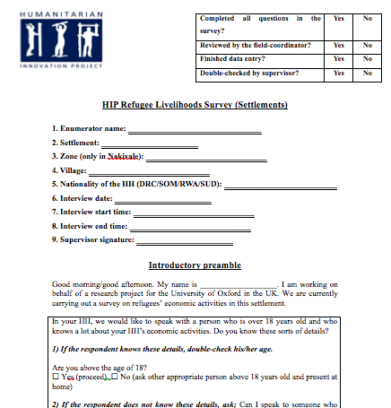
Survey designing
Aim of HIP survey: NOT hypothesis-testing but exploratory
Main research questions
What types of refugee economic activities and behaviours can be observed in each research site?
What kinds of variation in economic outcomes can be observed across refugee households?
How do refugees engage with the local private sector through their livelihoods?
What roles do innovation and technology play in refugees’ livelihoods?

Slide 5
N = 1,593 surveys across 3 sites with 4 different nationalities
Location/target refugee populations |  | Number of registered refugees | % | Target sample number | Actual sample number
Kampala Total |  | 50,646 | 100% | 507 | 577
Origin | DR Congo | 23,190 | 46% | 169 | 193
 | Somalia | 12,662 | 25% | 169 | 181
 | Rwanda | 3,885 | 8% | 169 | 203
 | Ethiopia | 1,843 | 4% | - | -
 | Other countries | 9,066 | 18% | - | -
Nakivale Total |  | 62,849 | 100% | 629 | 732
Origin | DR Congo | 32,659 | 52% | 210 | 252
 | Somalia | 11,007 | 18% | 210 | 237
 | Rwanda | 9,452 | 15% | 210 | 243
 | Burundi | 7,875 | 13% | - | -
 | Eritrea | 1,329 | 2% | - | -
 | Other countries | 527 | 1% | - | -
Kyangwali Total |  | 20,847 | 100% | 209 | 284
Origin | DR Congo | 17,681 | 85% | 105 | 142
 | South Sudan | 2,903 | 14% | 105 | 142
 | Other countries | 263 | 1% |  | -

Slide 6
3-step sampling: 1) Stratified by refugees’ country of origin;
2) Randomly selected the villages they live; and
3) Conducted interval sampling in each selected village
 | DR Congo
 | Sub-zone | Village
1 | Nyakagando | Nyakagando A | 1,978
2 | Base Camp | Base Camp II | 1,822
3 | Byakatonda | Kankingi A | 1,670
4 | Lake view zone | Isanja B | 1,289
5 | Nyarugugu | Nyarugugu B | 1,283
6 | Kisura | Kisura C | 995
7 | Byakatonda | Kankingi C | 984
8 | Juru | Kajurungusti | 952
9 | Kahirimbi | Kahirimbi A | 883
10 | Ngarama | Ngarama A | 864
11 | Ngarama | Ngarama B | 834
12 | Ngarama | Kakoma | 822
13 | Byakatonda | Kankingi B | 805
14 | Byakatonda | Kankingi D | 763
15 | Nyarugugu | Nyarugugu C | 753
16 | Kashojwa | Kashojwa B | 688
17 | Nyakagando | Nyakagando B | 686
18 | Kabazana | Kabazana A | 653
19 | Lake view zone | Isanja D | 642
20 | Kahirimbi | Kahirimbi B | 624
21 | Kisura | Rwoma | 568
22 | Nyakagando | Mirambira | 560
23 | Lake view zone | Isanja A | 550
24 | Ruhoko | Ruhoka B | 546
25 | Lake view zone | Isanja C | 502
26 | Kiretwa | Kiretwa C | 498
27 | Kisura | Kyeibare B | 487
28 | Kabahinda | Kityaza B | 433
29 | Karintima | Karintima A | 424
DR Congo | St = 241
Sub-zone | Village | Pv | Sv=[Pv/P(tot)]St
Nyakagando | Nyakagando A | 1,978 | 50
Base Camp | Base Camp II | 1,822 | 46
Nyarugugu | Nyarugugu B | 1,283 | 32
Juru | Kajurungusti | 952 | 24
Ngarama | Ngarama B | 834 | 21
Lake view zone | Isanja D | 642 | 16
Kahirimbi | Kahirimbi B | 624 | 16
Lake view zone | Isanja C | 502 | 13
Kiretwa | Kiretwa C | 498 | 13
Kabahinda | Kityaza B | 433 | 11
 | P(tot) | 9,568 | 241

Slide 7
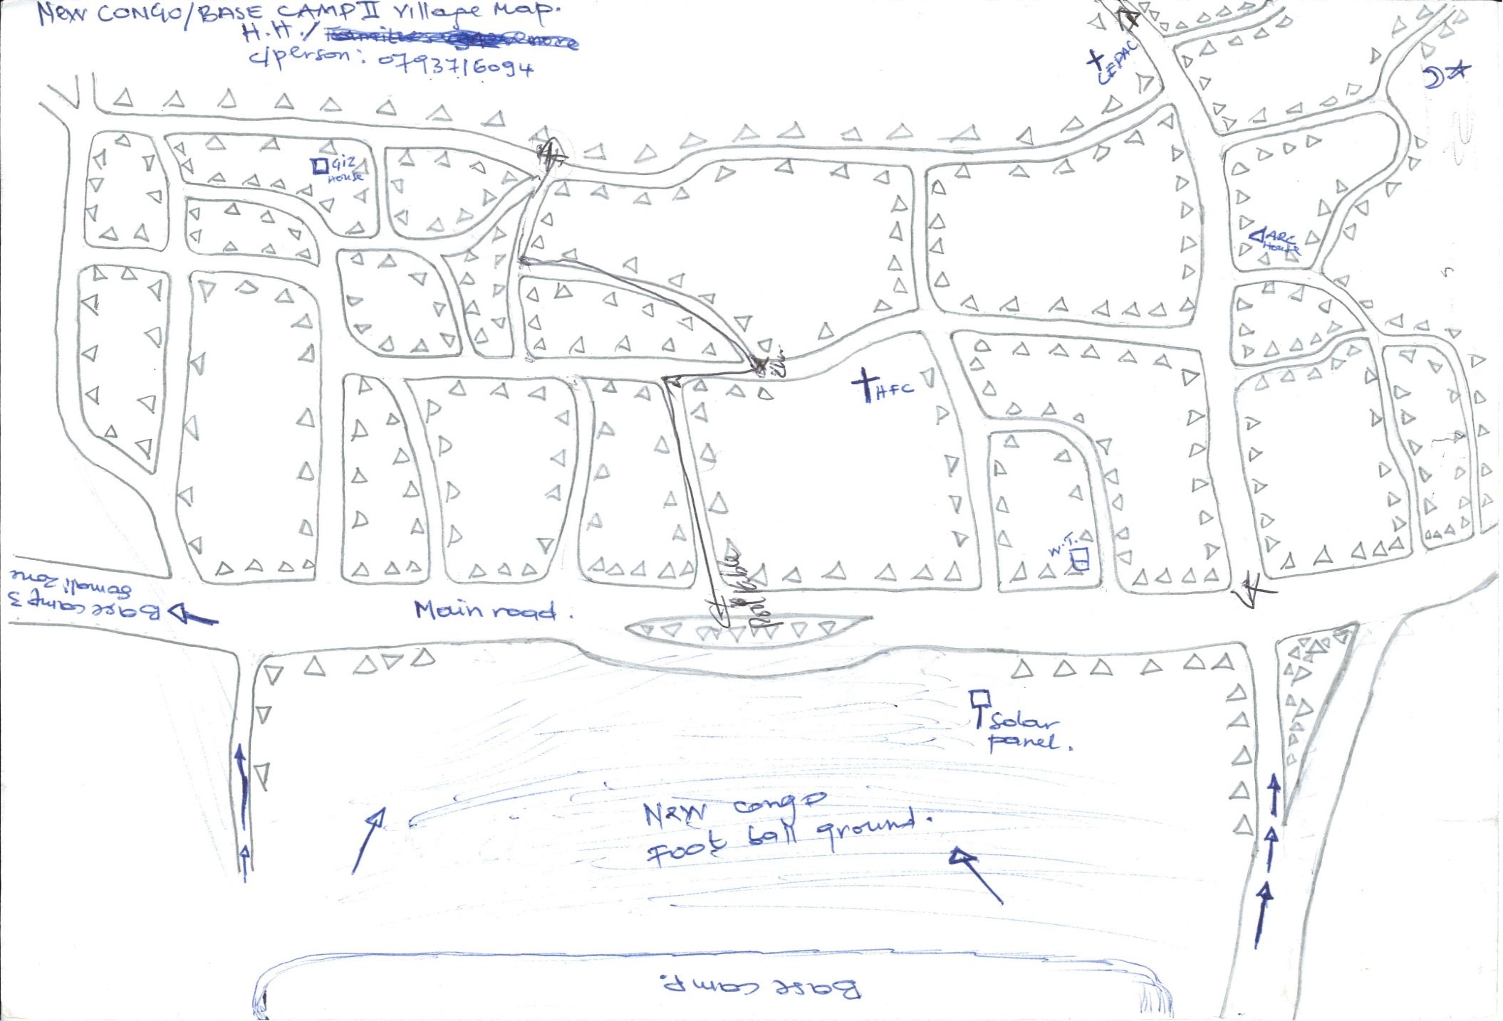
Village mapping in the settlement

Slide 8
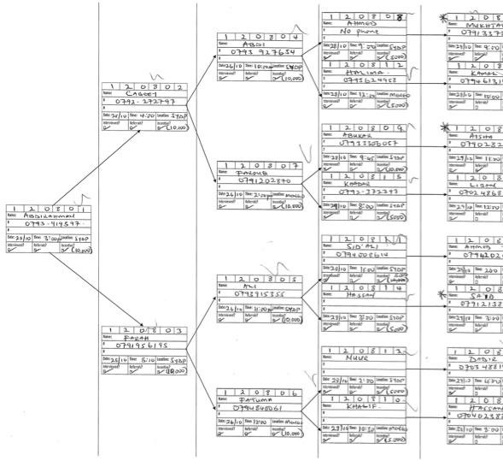
Respondent-Driven Sampling (RDS)
Example: RDS ‘Tree’ for Somali refugees

Slide 9
RDS: Asking Social Network Size of Respondents
D. Social Network Size
Thank you for your patience. This is our final question.
D.1 | Approximately how many other [refugees of your nationality] do you know? Tick only one. If the respondent has trouble specifying a number, prompt with categories. | ◻ 0 to 5 ◻ 6 to 10 ◻ 11 to 20 ◻ 21 to 50 ◻ 51 to 100 ◻ More than 100

Slide 10
Summary
Total survey implementation period: 9 months
Involved more than 50 people in this survey project
Attempted to do the best with the given conditions
Produced reasonably good dataset from 1,600 refugee households
Our data: ‘imperfect but valuable’ (Jacobsen & Landau 2003)

Slide 11


www.oxhip.org

