Slide 1
Profiling Urban Displacement
Methodological Workshop
on Measuring Impacts of Displacement on Host Countries and Communities
Natalia Krynsky Baal, November 20 – 21, 2015
Joint IDP Profiling Service
Informing Solutions Together

Slide 2
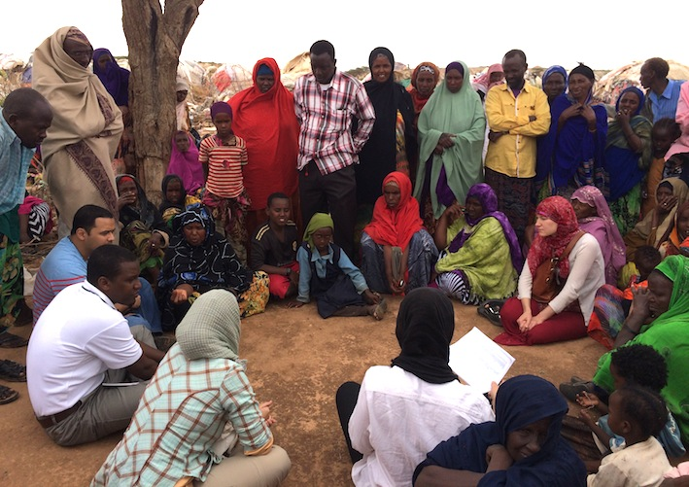
Profiling displacement situations
Collaborative process
Evidence-based response/strategy
Mixed methods approach
Comparative analysis of groups
Core data and solutions orientation
Notes:
1 minute
Quick introduction to JIPS profiling approach

Slide 3
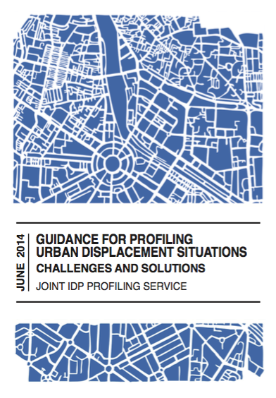
Profiling urban displacement
Specific complexities:
Multiplicity of actors
Political visibility
Questionable baseline data
Identifying target populations
Low density and dispersed target population
Peri-urban areas and informal settlements
Dynamic context
Logistical challenges
Notes:
1 minute
Highlight fact that urban profiling faces specific challenges.
Do not explain challenges at this point as they will come through the case study!
------------------
Follows same principles of profiling: a collaborative process to compare displaced and non-displaced populations to provide disaggregated data to contribute to solutions to displacement.
The multiplicity of actors in urban settings makes it especially important to create a broad coordination platform of a mix of local, national and international actors involved in every stage of the process. This ensures the buy-in of a variety of stakeholders that might be interested in the final results.
The questionable baseline data makes it necessary to conduct enumerations or community-mapping in order to get a more robust sampling frame, especially important in dynamic urban contexts.
Sampling challenges: if the number of IDPs/refugees is low as a proportion of the total population (as was the case in Delhi and Quito), difficult to locate the target populations because they are not registered (“invisible refugees”). Even more challenging if the populations are dispersed, or if the populations are highly mobile. Registration numbers and administrative records tend to be quickly out of date in urban settings and typically do not cover informal settlements.

Slide 4
Case study: Urban refugee profiling in Quito
Collaboration between JIPS and FIC/Tufts University to support UNHCR and partners in Ecuador, 2013
Photo credit: Cayambe (Own work) [CC BY-SA 3.0 (http://creativecommons.org/licenses/by-sa/3.0) or GFDL (http://www.gnu.org/copyleft/fdl.html)], via Wikimedia Commons

Slide 5
What?
Profiling of Colombians with different migratory statuses living in Quito
Partners: Foreign Ministry, NSO, municipal authority, Ecuadorian research institutions, UNHCR, JIPS, Feinstein/Tufts
Objectives: To obtain updated and agreed-upon information by target population on
Living conditions
Access to rights
Degree of social integration
How registered Colombian refugees compared with Colombians not registered
Notes:
1 minute
Collaboration between JIPS and Tufts University, 2013 to support UNHCR Ecuador
Coordination platform:
Ecuadorian institutions = foreign ministry, national statistics institute, municipal authorities of Quito, Latin American Faculty of Social Sciences
Local partners = Instituto de la Ciudad, Perfiles de Opinion (managed data collection, analysis, reporting)
Other = UNFPA, Norwegian Refugee Council (led by UNHCR)
Funds: BPRM
Objectives designed to:
Fill information gap since little was known about Colombians not registered as refugees.
2/3 of Colombians living in Ecuador settle in urban areas, especially Quito.
Population is diverse, with different migratory situations: more than half of asylum-seekers have had their claims rejected or abandoned. Many Colombians do not apply for asylum, others naturalize in other ways.

Slide 6
Research Design
Target populations:
Registered refugees and asylum-seekers
Rejected asylum-seekers and non-seekers
Other types of migratory situations
Geographic coverage:
urban and peri-urban areas
Mixed methods approach:
Household survey
45 semi-structured individual interviews
4 focus group discussions
Notes:
1 minutes

Slide 7
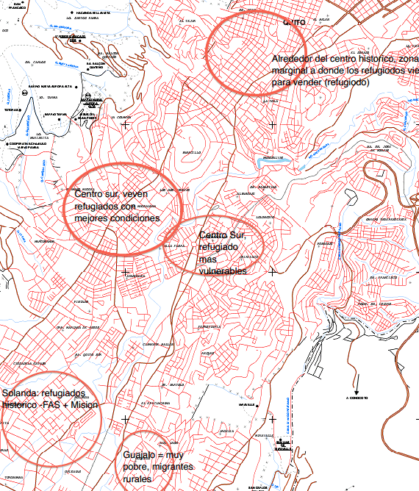
Sample Size and Methodology
Mapping of relevant areas
Multi-staged random sampling design
Survey administered to 1,856 households
1,059 registered refugees and asylum seekers
394 rejected asylum seekers and non-seekers
403 other types of migratory situations
Notes:
1 minute
Mapping – identifying relevant areas and households through enumeration within them

Slide 8
Key Challenges
Hard to find the households!
Colombians only 3% of total population and are geographically dispersed
Incomplete sampling frame; use of purposive methods to complement random sample
Focus on areas with higher-than-average density of Colombians (23/167)
LOW bias found through analysis
Notes:
2 minutes
In short: hard to find the households! (Colombian population just 3% of total inhabitants of Quito; pop of Quito 1.8 million, pop of Colombians 55,000)
Because the Colombian population is relatively small and dispersed amongst the local population, there was no complete sampling frame. Additional households were surveyed to complement the random sampling. These were identified through local organizations and in common meeting places, as well as with purposive methods (snowballing). Final sample selected 24% through probability sampling, 42% through snowballing; 34% through purposive selection of interviewees or referrals.
Ultimately, data collection was concentrated in 23 out of the 167 neighborhoods with higher-than-average density of Colombians.
Potential bias: found to be LOW, as main demographic characteristics of households selected by each method turned out to be very similar.

Slide 9
Questionnaire
Enumeration form
Household (HH) Questionnaire:
HH characteristics
Individuals characteristics
Health and education
Occupation
Migration experience
Local integration and future intentions
Assets and economic resources
Notes:
1 minute
First a basic enumeration form was used to collect information on the migratory history was for households with at least one Colombian.
Later in the process, the household questionnaire was used to collect information on household and individual characteristics.
The questionnaire included 7 sections, and a total of 88 separate questions (37 of the questions are collected for each individual within a household). The questionnaire also starts with asking for the consent of the respondent and ended with asking the interviewer to record observations and issues that took place during the interview that could bias the results.
Here is an excerpt from the section on migration experiences. Note that the survey was done only in Spanish; this is a translated version.

Slide 10
Qualitative Methods
45 semi-structured interviews
Balance between men and women, and by migratory situation
4 focus group discussions
Female headed households
Men between 16 – 22 years old
Girls between 12 – 15 years old
Persons of Ecuadorian nationality
Notes:
Only if time
In order to analyse the quantitative indicators together with the specific experiences reflected in the interviews and focus groups, three key themes were defined: i) migration patterns and experiences; ii) living conditions; and iii) integration in the urban setting.
Indications that most households with Colombians feel semi or totally integrated into their neighborhoods, but this was attributed to the length of residency in the city rather than the migratory situation.
Challenge of incorporating qualitative data into final analysis

Slide 11
Time and Costs Involved
Timeline April-November 2013
Scoping mission in April
Methodology in June
HH Survey in July-August
Qualitative data Sep-October
Report published November
Costs:
Implementation costs: 75,000 USD
In-kind contributions (JIPS and UNHCR)
Notes:
1 minute
Household survey – 50,000
Qualitative data – 20,000

Slide 12
MAIN FINDINGS
Households with refugee status or pending asylum claims had better access to education, housing and employment, higher levels of socioeconomic integration, and better living conditions.
Notes:
Only if time
Findings:
Main differences between households in different migratory situations had to do with access to education, housing and employment.
Lack of documentation, lack of economic resources, and discrimination reported as the key obstacles to access.
Example: 75% of children from refugee households had greater access to primary and secondary education as compared to 29% of children from non-asylum-seeking households. Less than 20% of young adult refugees are in higher education.
Those with rejected asylum claims and who never applied were worse off than those recognized as refugees or even as pending asylum-seekers.
Also had lower socioeconomic integration and living conditions than Colombians with documentation or status.

Slide 13
CONTACT US
WEBSITE www.jips.org
CONTACT info@jips.org
TWITTER @JIPS_profiling
FACEBOOK JointIDPProfilingService
LINKEDIN JIPS
Joint IDP Profiling Service
Informing Solutions Together

