Slide 1
Syrian Refugee and Host Community Survey
Poverty Global Practice
11/20/2015

Slide 2
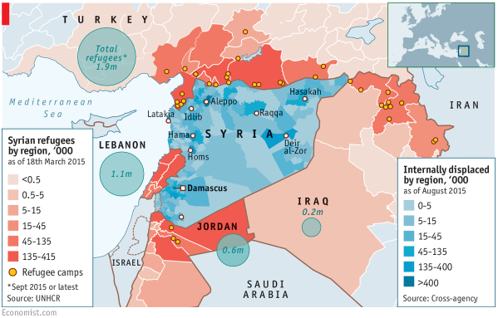
Context
Notes:
These

Slide 3
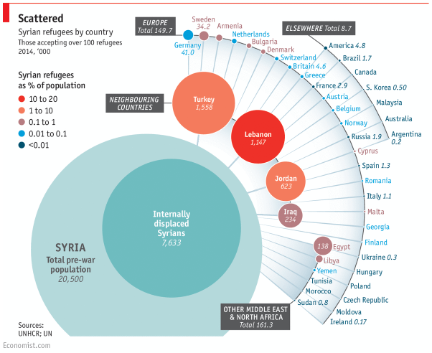
Context

Slide 4
Objectives
Assess the impact on host communities and the displaced on various dimensions of welfare:
  Jobs and employment
  Ownership and loss of assets
  Coping mechanisms
  Food security
  Access to school and health care
  Physical security
  Subjective well-being
Cross-country comparison – heterogeneous policy regimes
Within-country comparison (camp versus non-camp )

Slide 5
Research design
Multi-country sample: Jordan, Lebanon, and Iraqi Kurdistan
Nationally representative surveys
Sampling strategy
  First stage sample: Stratified by density of refugees (by merging UNHCR registration data with national sampling frame)
  Refugees and IDPs excluded from the sampling frame
  Rectification of household weights post listing operation

Slide 6
Questionnaire
Multi-topic questionnaire:
  Household roster
  Access to school, health care, and other public services
  Ownership and loss of assets
  Source of income and public transfers
  Income shocks, prices, and food security
  Movement into and within-the host country
  Labor market outcomes (Employment, wages, earnings)

Slide 7
Qualitative Component
Intrahousehold issues
  Gender-based violence
  Autonomy in decision making
  Early marriage
Community relations
Coping strategies
Plans for movement

Slide 8
Risks
Erroneous sampling weights
Unit nonresponse
  Refusal to respond
  Failure to locate the household – the displaced are highly mobile
Item nonresponse
  Elicitation of politically and psychologically sensitive information
  Second respondent for labor market modules
  Survey fatigue

Slide 9
Policy Response
Shift from short-term humanitarian response to long-term economic development
  Expand the supply of public services and strengthen the delivery of services
  Provide support to build skills, assets, and livelihoods
Right to work
  Impact on the displaced households
  Impact on host community households and the local economy
Economic integration versus social integration
  Policies for social cohesion

