Slide 1
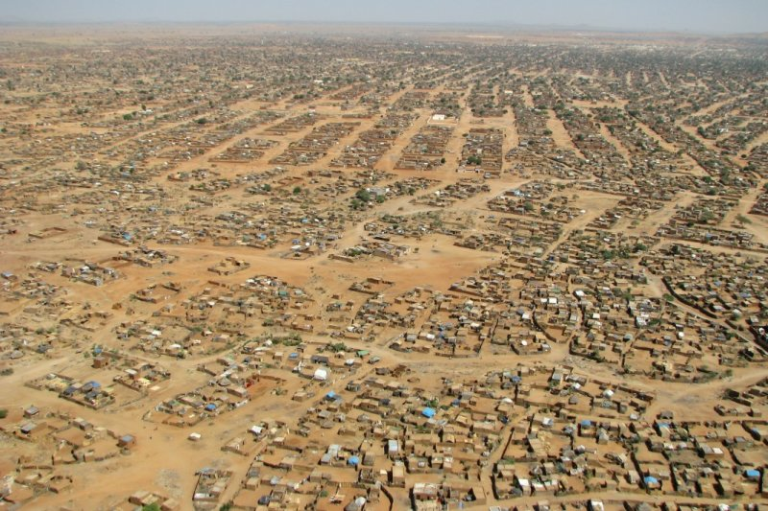
Impacts of Refugees and IDPs on Host Countries and Host Communities
Case Study: Darfur
Anne Bartlett
UNSW, Australia

Slide 2
Nyala, South Darfur

Slide 3
Country, Camp or Out of Camp; Urban or Rural Setting
Sudan, camp and non-camp, urban setting, IDPs.
During the conflict Nyala was a logistical nerve center due to presence of the airstrip and large humanitarian infrastructure. Rail linkages, which started in 1962, were non-functioning 2003 to 2013.
Study involved camp and non-camp residents because IDPs are located in camps that encircle the town as well as living in the city. Camps are either just outside city boundaries or are structurally intact yet the city has grown out to reach them. Those who live within the city often live with relatives or they live in makeshift housing at the peri-urban edge.

Slide 4
Goals of Nyala Project
To understand the effect of inflows of aid and IDPs on the host community paying particular attention to:
Changes to prices and markets: Grain and other staples, labor markets, housing markets
Urban Morphology – Changes to urban form and function
Environmental effects
While not originally a goal, we also noted major effects due to the presence of aid-workers, notably on house prices, host community dispersion and the emergence of niche markets.

Slide 5
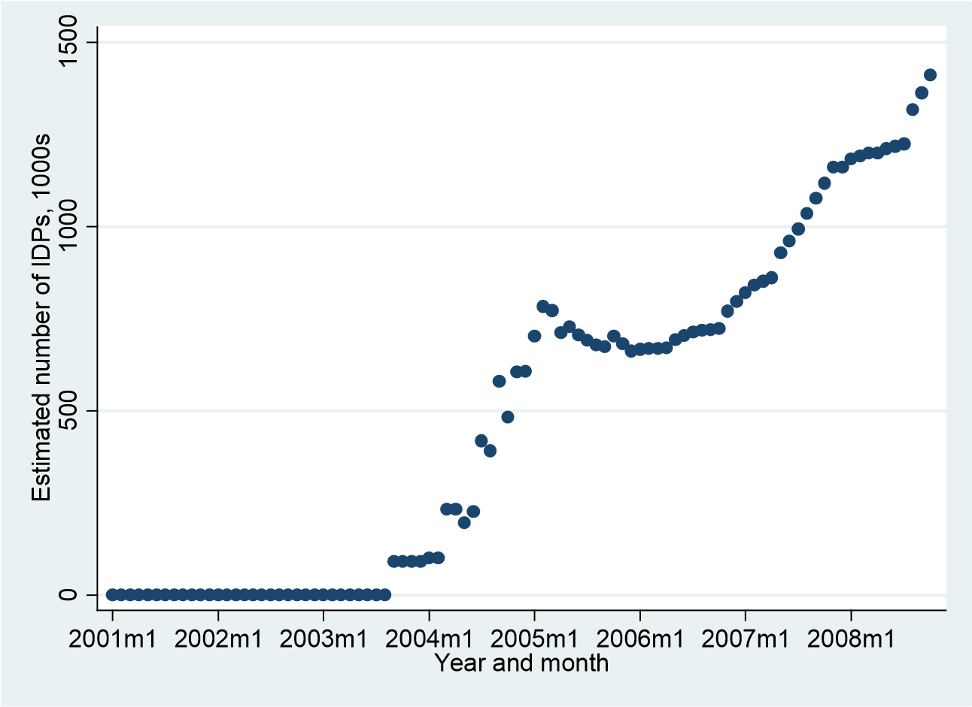
Inflows of IDPs

Slide 6
LANDSAT Data, Nyala

Slide 7
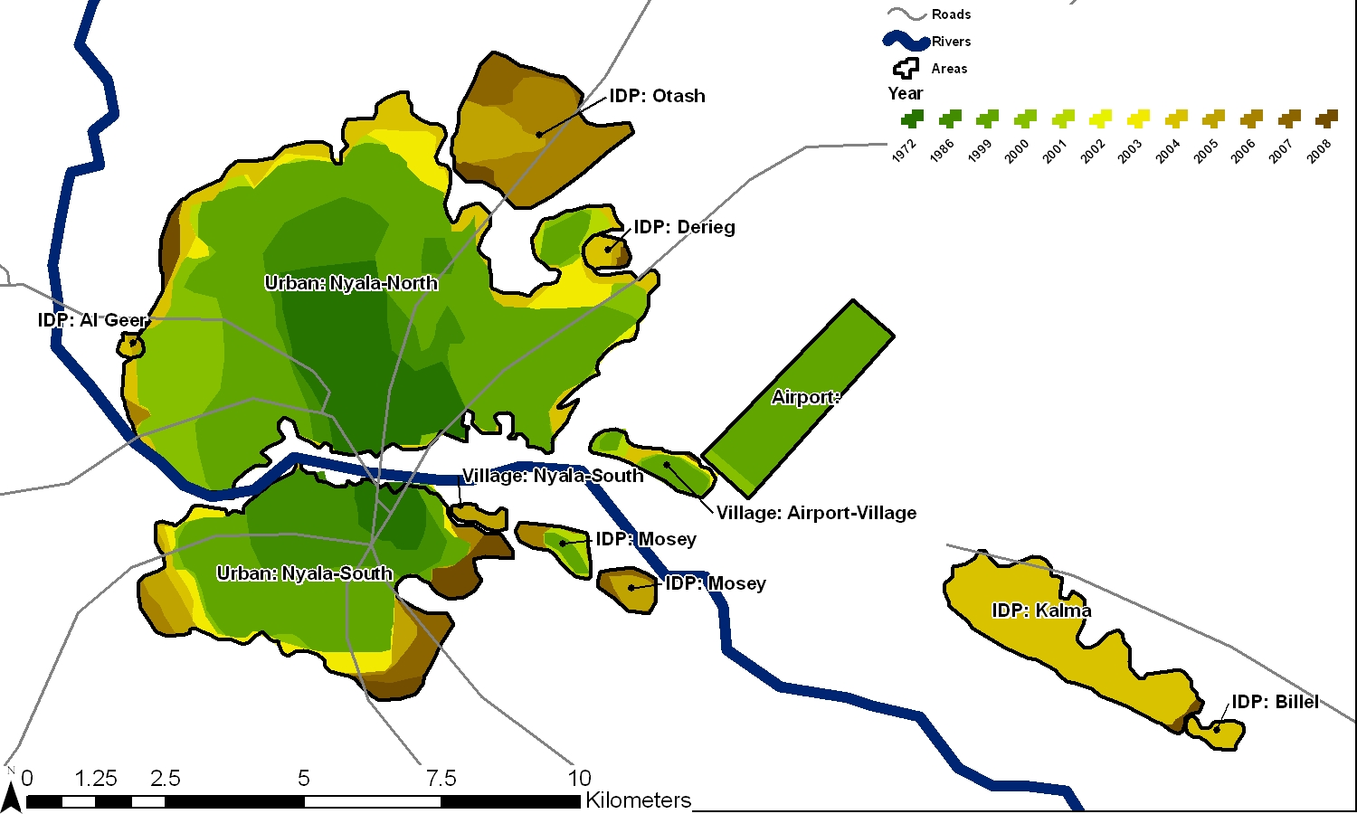
Camp and Town, Nyala

Slide 8
Data
Types of data used:
Qualitative fieldwork in Nyala in 2008, that involved interviews in the main suqs and with business owners. We also interviewed residents and IDPs that were working in the town, together with NGO workers.
Survey data
WFP annual reports (for NGO worker data)
WFP data food aid delivery data
FAO price data from 2005 to 2007
Landsat satellite images (1972, 1986, 1999-2008)
MODIS satellite images 2000-2007 (Used to produce bi-weekly Enhanced Vegetation Index [EVI]). This measure is more sensitive to canopy cover.
OCHA data

Slide 9
Access
Quantitative data can be patchy, not digitized, not accessible due to Sudanese government constraints or just plan unreliable. We used satellite data points in quadrants of the city to generate random sampling markers.
Qualitative access is very difficult, relies on teams of researchers and needs extensive networks of contacts. There are multiple issues which include generalized insecurity, potential issues with security agents and militias, danger in random sampling situations, difficulty with collecting data, training difficulties and so on.
Difficulties with conducting interviews and issues related to recall. Usual problems with the potential to fabricate survey data, kidnapping of data, corruption, theft of hardware and so on. Needs close, well-trusted key-informants to manage enumerator pool.
In this case we input the data ourselves so we could scrutinize the surveys carefully. In other surveys elsewhere, we have uploaded data each night.

Slide 10
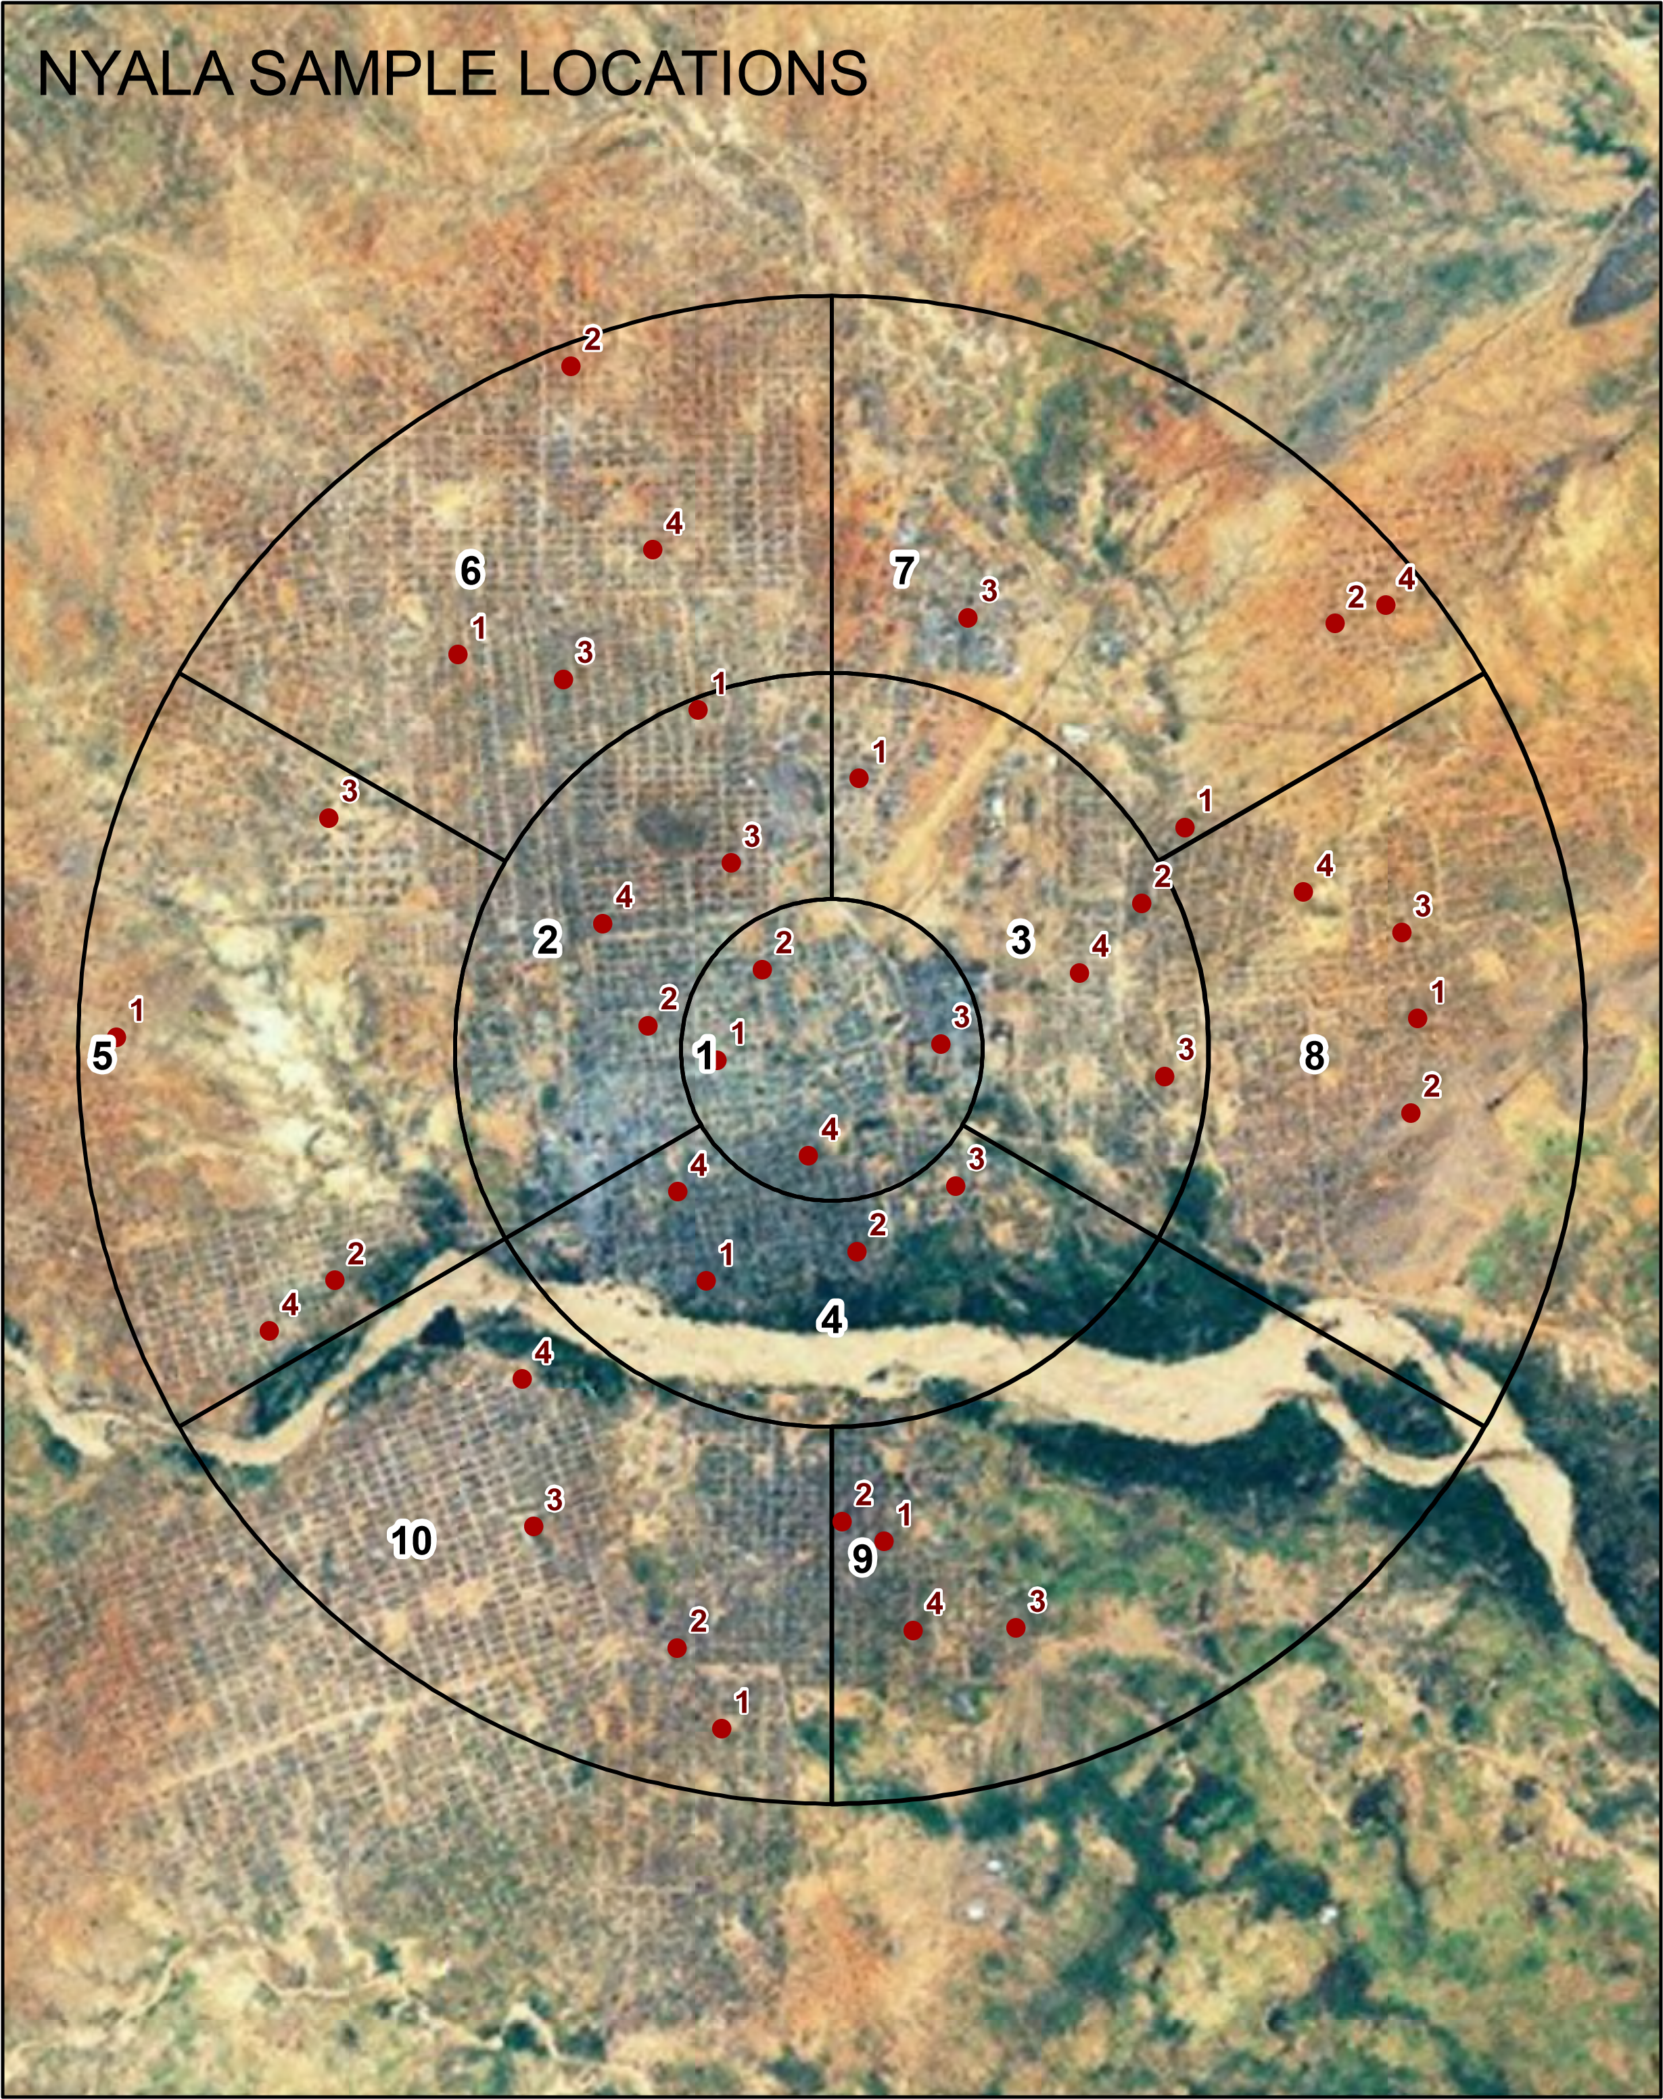

Slide 11
Reliability & Validity
Reliability is always an issue in conflict settings like Darfur. Lots of issues with replicability of data – particularly qualitative data. Can triangulate with multiple sources to resolve some of these issues.
We used control cities – such as El-Obeid (before fighting starting in South Kordofan in 2011) for labor-market studies.
Found an unintended, qualitative control for the housing price data in Nyala.
Finding a control for price data more difficult since it would necessitate finding a similar city in Sudan where there are no IDPs or aid deliveries and where data is available on prices and markets.

Slide 12
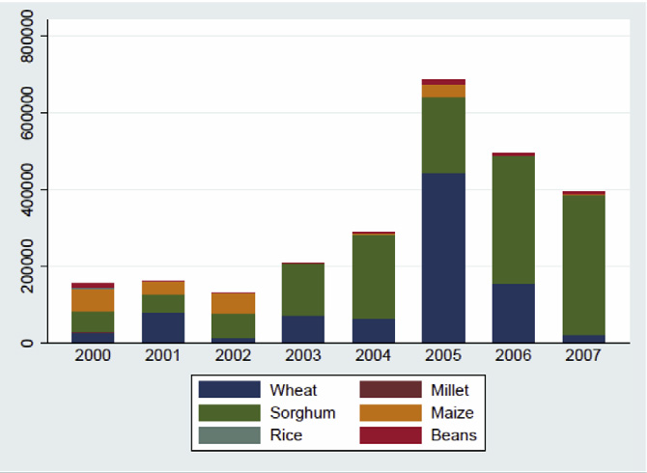
Markets and Prices
Food Aid Deliveries
Source: WFP

Slide 13
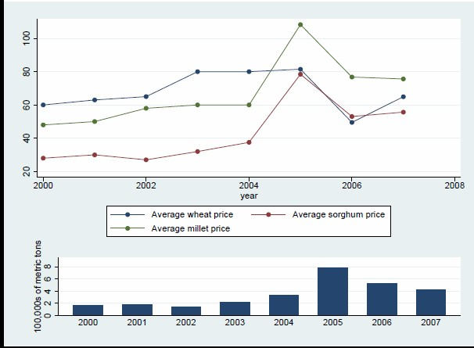
Markets and Prices
Grain prices and Preferences
Source: WFP

Slide 14
Markets and Prices
Housing
District Name | Before the Conflict | After the conflict | Number of rental
 | (in Sudanese Pounds) | (in Sudanese Pounds) | INGO properties
El-Matar | 250-600 | 2000-6000 | 61
El-Cinema | 400-600 | 2000-4000 | 44
Sham Elnasim | 300-600 | 2000-5000 | 27
El-Nahadah | 250-500 | 2000-4000 | 24
El-Jamhuria | 300-500 | 1500-3000 | 23
El-Mtidat | 400-500 | 1500-3000 | 13
El-Mazad | 300-500 | 1500-2500 | 5
Table 3: Rental property pricing and location
Source: USF, Economic Geography of Conflict in Darfur Research Project

Slide 16
Methods and Lessons learnt
No methodological magic bullet, but … considering the potential impacts of large scale flows of people (markets, prices, informal remittances, security, land use and environmental effects) there are some methods we found helpful:
Markets and Prices
Quantitative analysis - regression , descriptive stats (SECONDARY)
Household Surveys (PRIMARY)
Interviews and Ethnography to obtain information about aid substitution effects, changes to prices of housing, niche markets (PRIMARY)
N.B. Remote management of fieldwork teams an option in poor security situations, where teams can be brought outside for training.
Remittances
Qualitative fieldwork and surveys (PRIMARY)

Slide 17
Methodological Lessons learnt
Changes to Land Use and Environment
For understandings of spatial change and land use, analysis of Landsat images (SECONDARY)
Enhanced Vegetation Indices (EVI) (SECONDARY)
Land Use, Land Cover, Landsat and MODIS satellite. ( MODIS more sensitive to canopy change and more useful for arid areas) (SECONDARY)
Qualitative Fieldwork to fill in gaps about why this is happening (i.e. land abandonment, brick making, firewood collection, political changes, presence of aid workers and so on)(PRIMARY)
Morphology, Population Dispersal and Security Issues
Landsat Analysis for Morphology (SECONDARY)
Qualitative Fieldwork for population dispersal and understandings of changes to security (general) and risk (individual) (PRIMARY)

