Slide 1

The Peculiar (?) Dynamics of the
Kakuma Refugee Camp
A macro, micro, and social assessment
A macro, micro, and social assessment
Apurva Sanghi
Lead Economist
World Bank Kenya Office

Slide 2
Background
A growing consensus on the need to reorient the refugee program for better outcomes.
The Turkana Initiative on the Integration of the Refugee and Host Community Economies
  The Turkana round table on the integration of Refugees and Host Community Economies – November 2014
  The Peculiar (?) Dynamics of the Kakuma Refugee Camp: Macro, Micro, and Social Assessment – November 2014 to April 2015
  New refugee settlement in Kalobeyei – June 2015
  Brainstorming Session on the Development of the Kalobeyei Site – July 2015

Slide 3
Objectives of the study
1. Assess macro, micro, and social impact of refugees on host communities
2. Inform policy discussions on integrating the refugee and host community economies by clarifying the concepts of:
  integrating refugee and host community economies;
  characteristics of an integrated economy;
  socio-economic impacts (both positive and negative) of the presence of refugees in Turkana and by extension all of Kenya; and
3. To inform the development response to displacement induced macro-fiscal, environmental and social impacts through existing or stand-alone operations.

Slide 4
Analysis: Focus on Channels of Impact
Interactions Driven by Market Forces
Interactions Driven by Non-Market Mechanisms
Interactions driven by the Social Context

Slide 5
Analysis – Interactions Driven by Market Forces
  Flow of goods & services
  Flow of labor
  Flow of money

Slide 6
Analysis – Interactions Driven by Non-Market Mechanisms
Interactions Driven by Non-Market Mechanisms
  Refugees’ access to publicly provided goods and services
  Refugees’ environmental impacts

Slide 7
  Analysis –Interactions driven by the Social Context
  Refugees affecting traditional Turkana culture
  Economic imbalances increase “social” distance

Slide 8
A schematic of these interactions

Slide 9
But what is “impact”?
Neutral assessment requires considering both +ive and –ive dimensions
  There are many “impacts”
  But cannot simply add them up!
  Need cogent framework for assessing and aggregating impacts

Slide 10
Methodological innovation
3 track methodology
  Evaluating the channels of impact
  Seeing the big picture
  Zooming in on stumbling blocks

Slide 11
Methodological innovation
3 track methodology
  Evaluating the channels of impact
  Seeing the big picture
  Zooming in on stumbling blocks

Slide 12
Methodological innovation: C-1 Evaluating channels of impact
  Obj: Model / estimate changes in prices due to presence of refugees
  Innovation: establishing a “counterfactual”
  Innovation: estimation strategy for prices
Notes:
.

Slide 13
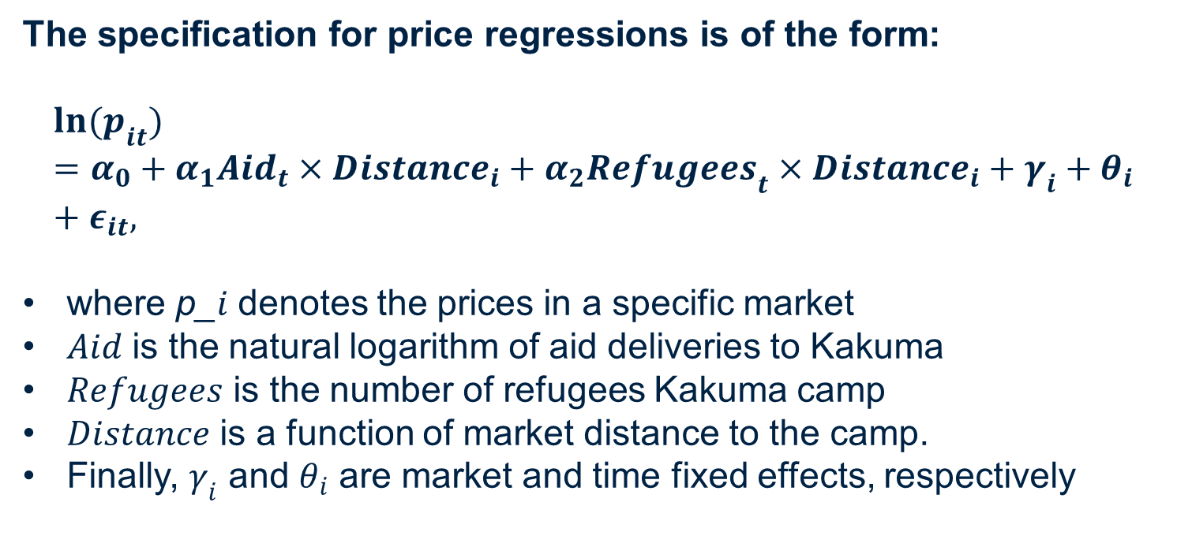
Methodological innovation: Price estimation strategy
The specification for price regressions is of the form:
$$\ln{(p_{it})}=α_{0}+α_{1}{Aid}_{t}×{Distance}_{i}+α_{2}{Refugees}_{t}×{Distance}_{i}+γ_{i}+θ_{i}+ε_{it},$$
where p_$i$ denotes the prices in a specific market
$Aid$ is the natural logarithm of aid deliveries to Kakuma
$Refugees$ is the number of refugees Kakuma camp
$Distance$ is a function of market distance to the camp.
Finally, $γ_{i}$ and $θ_{i}$ are market and time fixed effects, respectively

Slide 14
Methodological innovation: Price estimation strategy

Slide 15
Methodological innovation
3 track methodology
  Evaluating the channels of impact
  Seeing the big picture
  Zooming in on stumbling blocks

Slide 16
Methodological innovation: C-2 Seeing the Big Picture
  Estimate overall impact by considering market and non-market dimensions together.

Slide 18
Methodological innovation: C-2 Seeing the Big Picture
  Innovation: To assess welfare effects in comprehensive and internally consistent manner: building a Computable General equilibrium (CGE) model
  Innovation: CGE captures a rich set of transmission channels, with 4 sectors: export, import, non-tradable, and non-traded (public good) sectors.
  Innovation: Calibrate & perform numerical simulations to assess aspects not captured by C-1

Slide 19
Methodological innovation
3 track methodology
  Evaluating the channels of impact
  Seeing the big picture
  Zooming in on stumbling blocks

Slide 20
Methodological innovation: C-3 Stumbling Blocks
  How does removing barriers to refugee-host interactions improve welfare for both sides?
  Innovation: Focus on 2 market imperfections
      Frictions in labor & good markets
      Monopoly / monoposony power of traders
  Innovation: Develop formal economic fwk that captures these imperfections
      Estimate and/or numerically simulate imperfections and use results from other components to calibrate the model parameters

Slide 21
Social analysis: Qualitative, field-based analysis organized around 6 components
Socio-economic mapping: Who gets access to what and why?
Social structure: What is the relative status and interaction among social groups differentiated by gender, ethnicity, age, and religion?
Participation: What are the levels of participation of refugee and host community households disaggregated by men, women, youth and children
Community organizations & institutions: What are prevalent rules, incentives and social norms that govern access to benefits.
Conflict & violence: What is the type and prevalence of conflict and violence including sexual and gender-based violence?
Developmental activities: What are the expectations of host and refugee communities?

Slide 22
Conclusion: Evaluate the Big Picture
1. Survey+empirical analysis+simulation model combo is comprehensive, consistent and informative. But it is not perfect:
  No model can replicate reality; trade-off between detail and comprehensibility
2. Need to build overarching framework, map the theory and empirics onto each other
  A simulated CGE with labor market frictions

Slide 23
Conclusion: Evaluating the Big Picture
  3. Credible policies and interventions derive from credible analyses which requires careful thinking and hard work across various disciplines

Slide 24
Conclusion: Evaluating the Big Picture
  “CCC”

