Slide 1
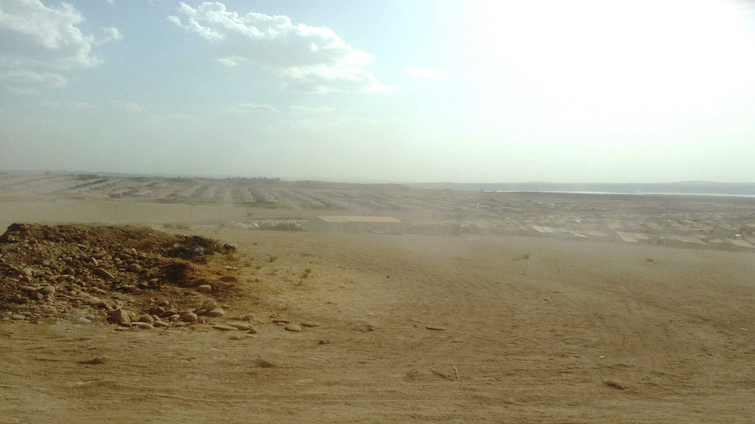

KRG: ECONOMIC AND SOCIAL IMPACT ASSESSMENT
OF THE SYRIAN CONFLICT AND ISIS CRISIS
METHODS FOR DATA ANALYSIS:
COMPREHENSIVE ASSESSMENT OF IMPACTS
WASHINGTON, D.C., NOVEMBER 2015

Slide 2
CRITICAL QUESTIONS FROM A DEVELOPMENT POLICY PERSPECTIVE
What is the impact of the regional crises on KRG—on the overall economy, on social sectors and infrastructure?
What is the cost of conflict? What is the welfare and poverty impact for the people?
And, what is the required stabilization cost to address these issues and deliver public services to the increased population?
While ensuring that the host community is not worse off…

Slide 3
CONTENT
The Economic and Social Impact Assessment (ESIA) identifies and quantifies the social and economic impacts and the required stabilization costs for KRG from the inflow of refugees and internally displaced people as a result of the Syrian conflict, and the ISIS crisis.
The impact of both shocks are assessed through a macro-fiscal and sectoral approach.
The impact on service delivery and poverty are also analyzed at the local levels.
The ESIA work contributes to national and international efforts to help address humanitarian issues in the KRI.

Slide 4
METHODOLOGY
First, the report provides a baseline of the specific sector prior to the crisis, along with its performance during the conflict(s).
Second, the “impact assessment” is measured as the difference between: (1) the actual out-turn (spending) for the sector in period t, and (2) the spending that would have occurred in period t should the conflict had not occurred (counterfactual).
Third, “stabilization assessment” is measured as spending that would be needed in period t in order to maintain the pre-conflict level of access to and quality of public services.
The ESIA report is structured under three chapters: 1) Macro-fiscal impact of the crisis; 2) Human development and social impact of the crisis; and 3) Infrastructure impact of the crisis.

Slide 5
KEY FINDINGS
As a result of the Syrian conflict and the ISIS crisis, KRI’s population increased by 28 percent placing strains on the local economy and access to public services.
The impact and stabilization costs are high for the overall economy, and as well as for social and infrastructure outcomes.
The multiple crises have depressed the economic activity in KRI and economic growth declined from 8 percent in 2013 to 3 percent in 2014, a deceleration of 5 percentage points.
Lower local revenues, increased borrowing from the private sector and large quasi-fiscal deficits.
The ISIS crisis has had a significant effect on trade of goods and services. Transportation routes disrupted.
Prices have increased so has unemployment. Increased labor supply pushing wages down.
The crises in Syria and Iraq have had a profound effect on the welfare of the people in Kurdistan Region: poverty rate doubled.
To manage the impact of these shocks, the KRG will need additional resources to restore access to public services. The stabilization cost for 2015 is estimated at US$1.4 billion for the base case scenario (in addition to KRG’s annual budget allocation).

Slide 6
STABILIZATION COST: US$1.4 BILLION IN 2015

Slide 7
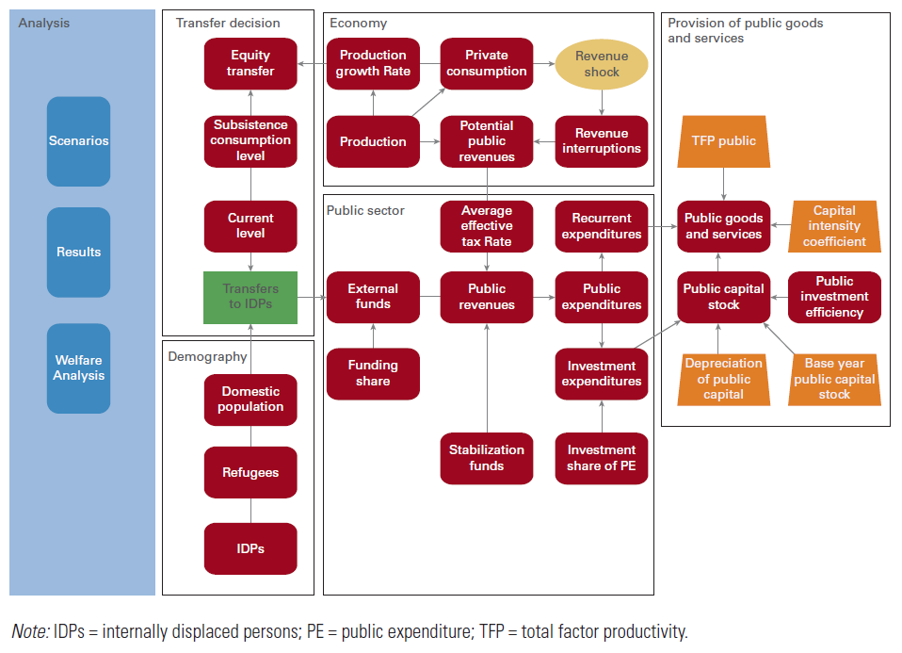
Simulation Model: Fiscal Impact of the Conflict

Slide 8
Transmission Channels for the Welfare Impact of Shocks
A microsimulation model is developed to evaluate the welfare and distributional impacts of the Syrian refugee and IDP influx in the three governorates of KRI.
The model accounts for multiple transmission mechanisms and captures impacts at the micro level across the income distribution. In particular, the model takes into account large changes in population, labor market adjustments in employment and earnings, non-labor incomes including public transfers and remittances, and price changes (including variations in food and nonfood prices).
The macroeconomic variables used as inputs into the microsimulation: (a) large changes in population, (b) changes in growth and employment, (c) changes in earnings, in particular, public sector salaries and public transfers, and (d) price changes.
At the micro level, the simulation uses information on (a) household-level income or consumption (or both), (b) household and individual characteristics, and (c) individual-level labor force and employment status and earnings, based on the Iraq Household and Socioeconomic Survey of 2012.

Slide 9
Policy Implications
This ESIA provided a technical assessment of impact of the Syrian and ISIS crises and stabilization needs which informed the dialogue between the regional and central governments and as well as provided input for international efforts to address socio-economic issues.
Furthermore, the findings for stabilization needs of specific sectors were used to inform resource allocation decisions.
The crisis calls for a number of actions moving forward. In the short-term, much of the solutions for averting the humanitarian crisis require national and international response.
In the medium-term, structural reforms are required. While it is a priority to provide necessary relief to the economic and social issues caused by the crisis, it is also important for the government to develop longer-term strategies to address structural development issues.

Slide 10
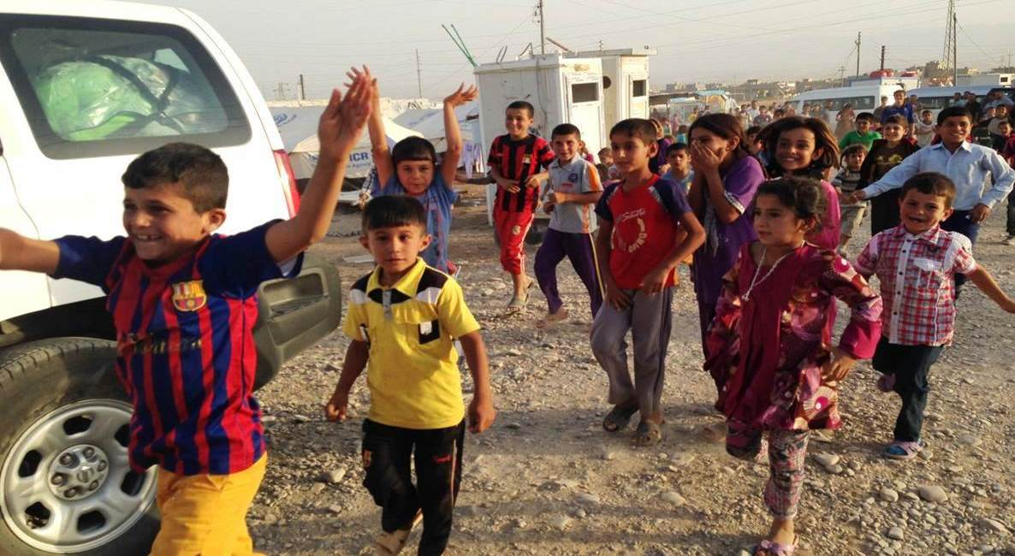
THANK YOU

