Slide 1

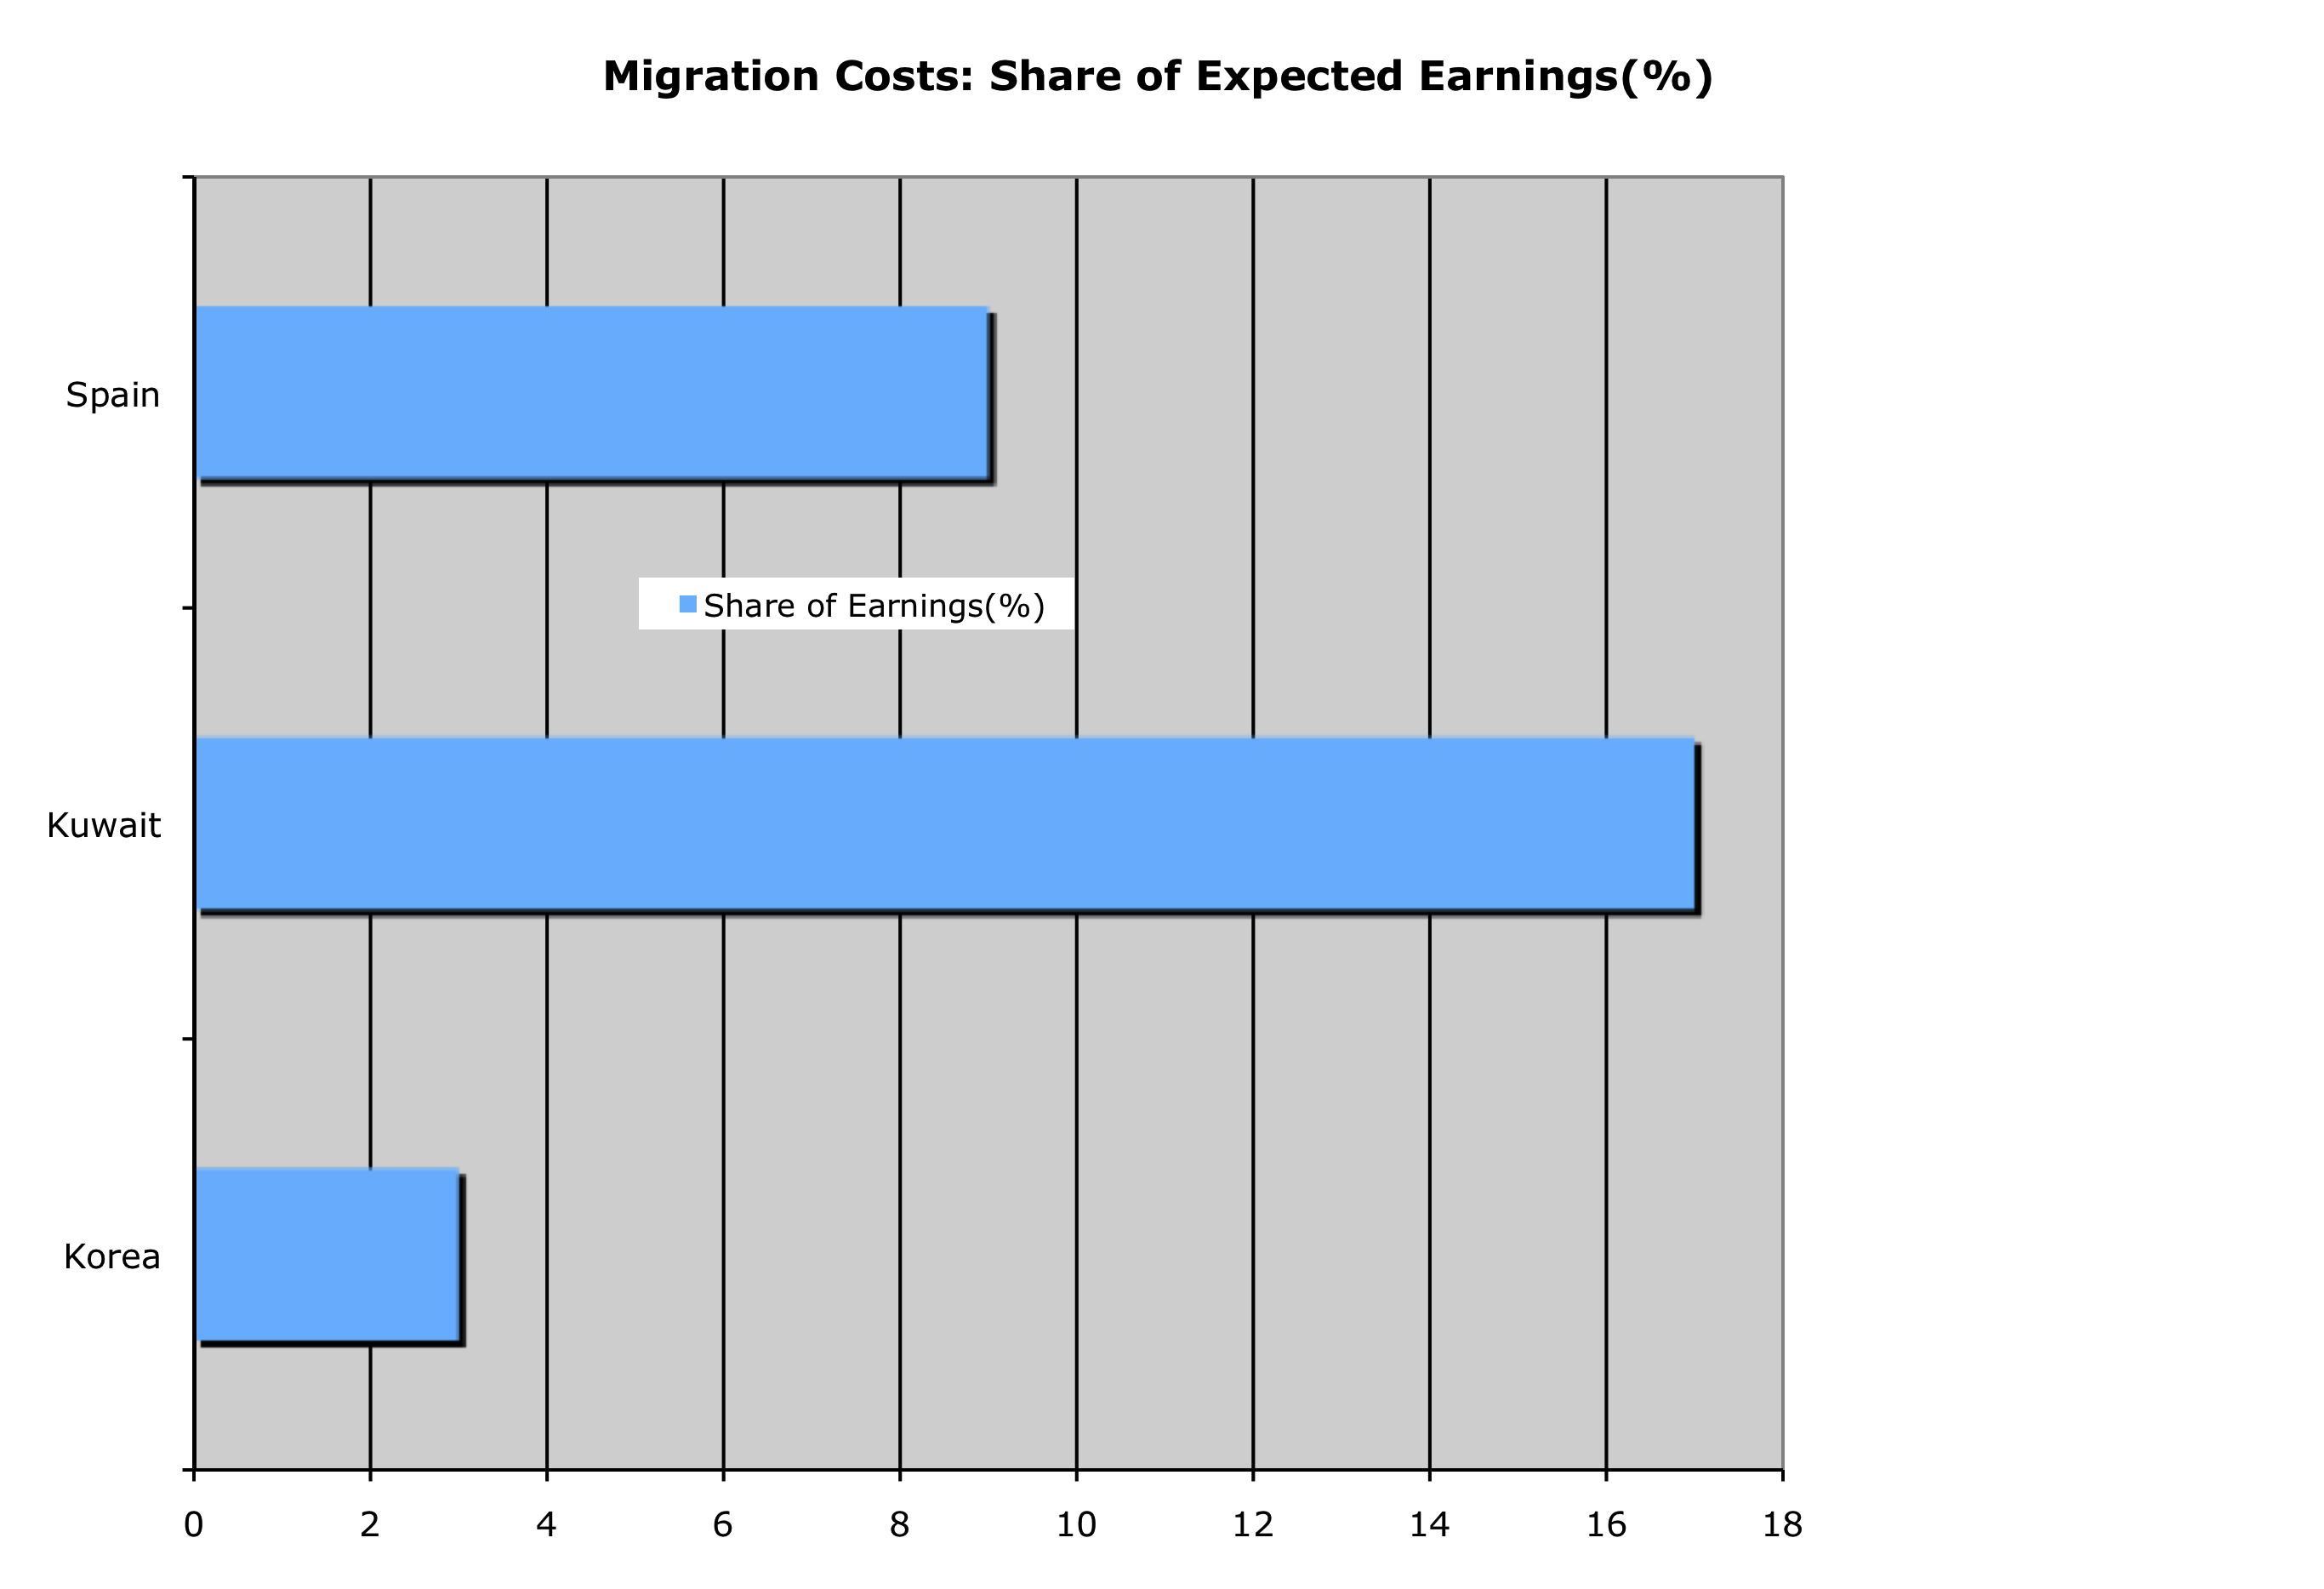
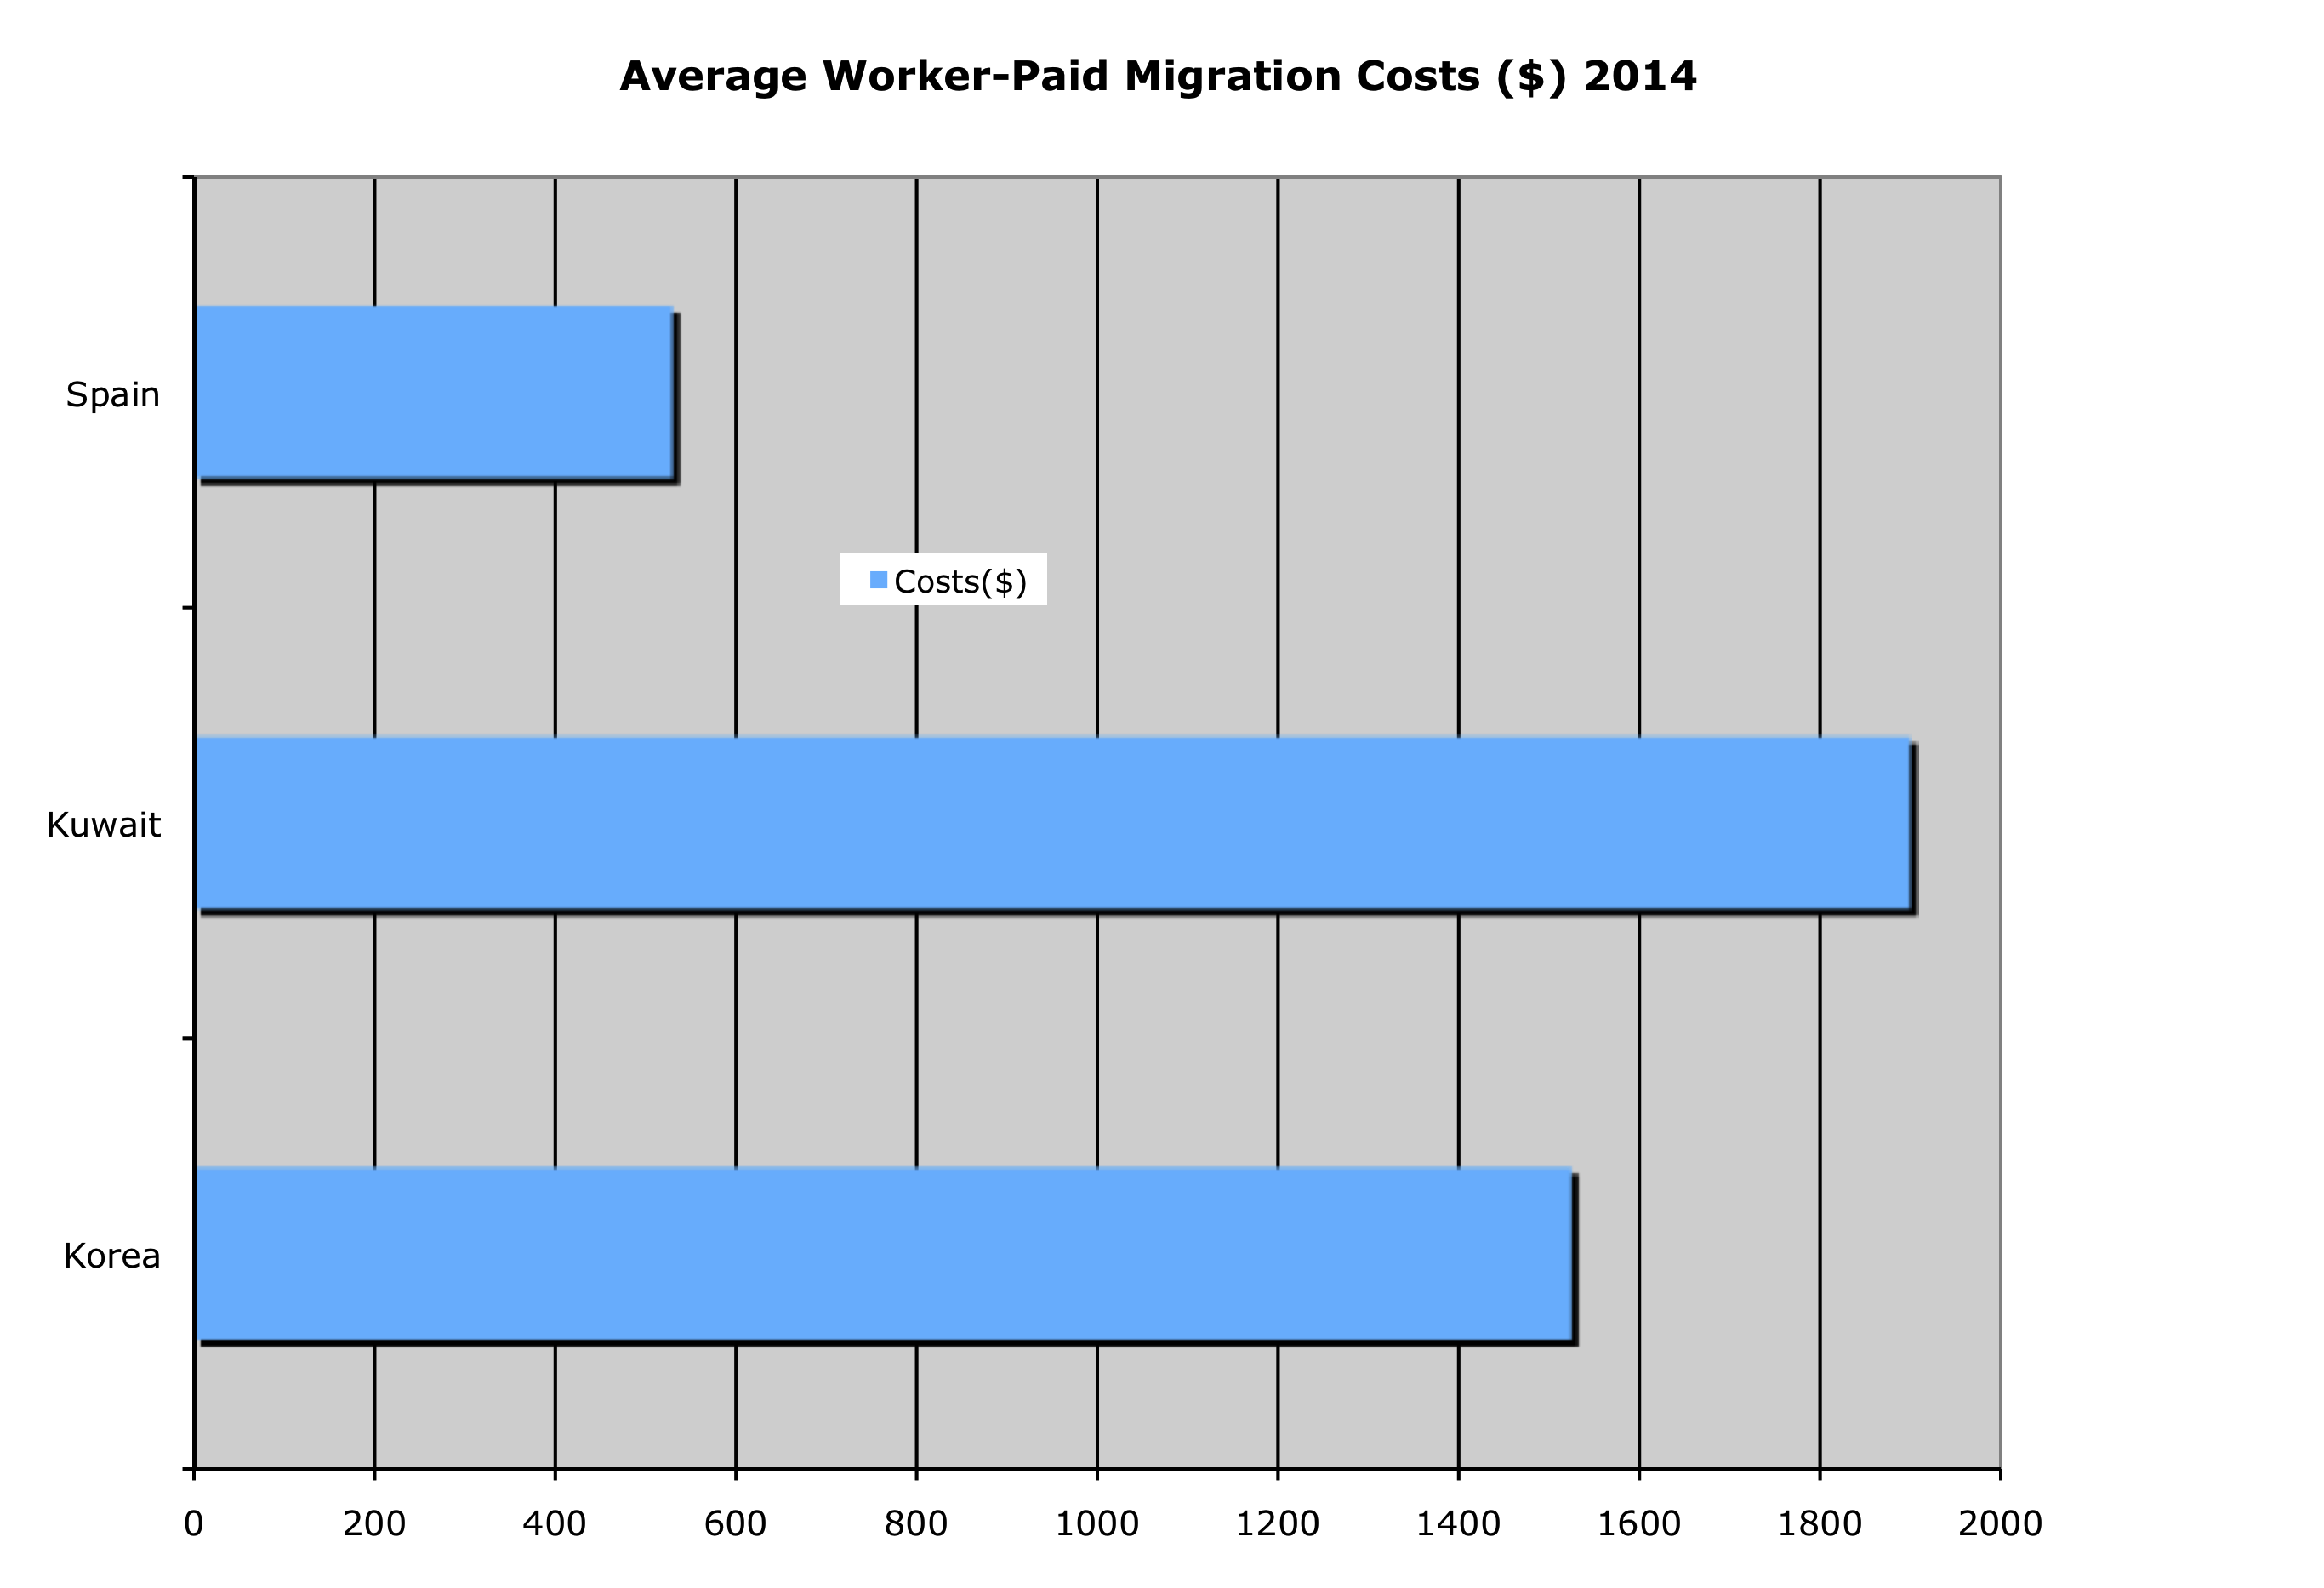
Understanding, measuring, and reducing worker-paid migration costs
Manolo Abella & Philip Martin
Notes:
Average worker paid migration costs were lowest in Spain--$530—but workers were employed only 6 months at $1k/month, so migration costs were 9% of expected earnings
Average migration costs in Kuwait were over $1900, workers earned $465/month or $11.200 over 2 years, so migration costs were 17% of expected earnings
Average migration costs in Korea were $1525, workers earned $1250 month or $45,000 over 3 years, so migration costs were 3.4% of expected earnings

Slide 2
Highlights
Int’l labor migration: big business
  10 million workers/year @$1,000 = $10 billion/year
  Who receives this revenue? How can worker-paid costs be reduced?
  Worker-paid costs go up as skill down? Why? S>D
Recruitment process: 4 phases: economic needs test, contract & deployment, employment abroad, return & re-integration
Major determinant of worker-paid costs = corridor. Structural factors & policies more important than individual characteristics

Slide 3
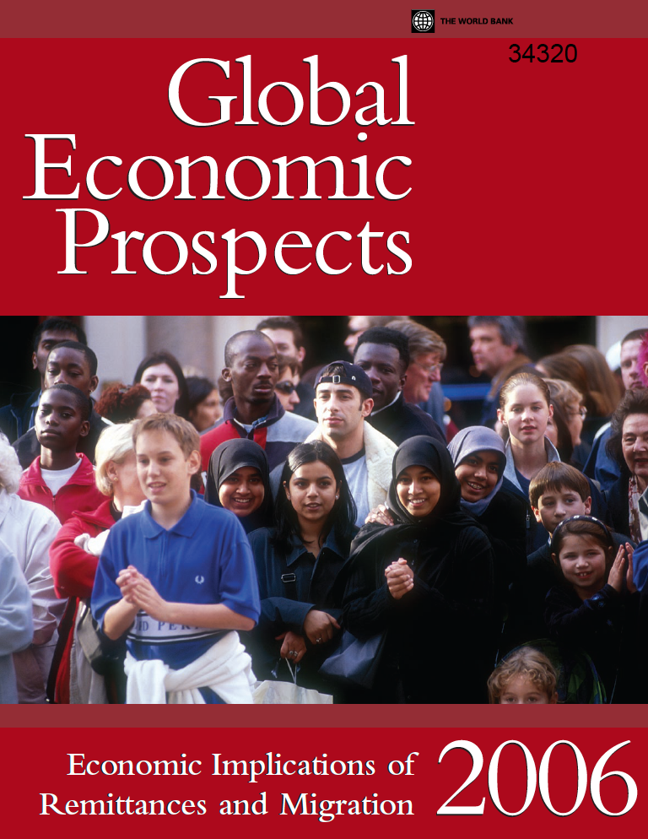
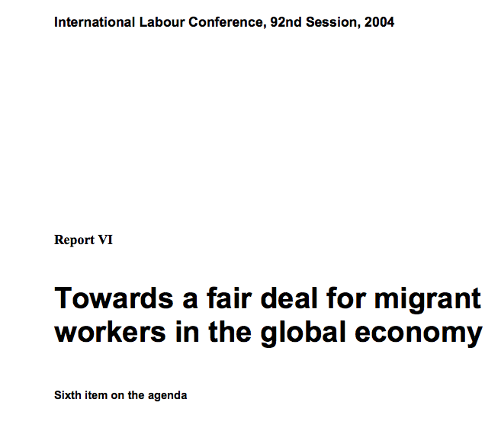

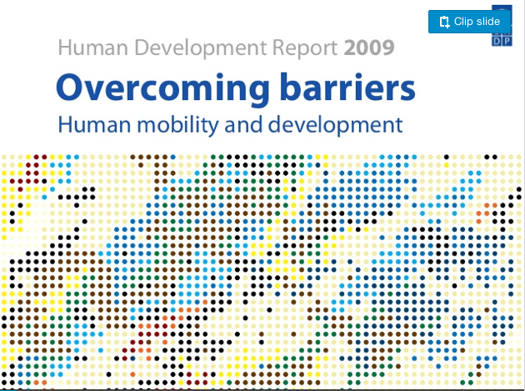
Migration can be win-win-win
Migrants, COD, COO

Slide 4
Migration costs: financial, opportunity, & social
Financial: what do workers pay:
  To learn about foreign jobs
  To obtain contracts, complete exit formalities, travel to foreign job
  Net earnings abroad, after deductions & taxes
Opportunity costs: wages not earned while worker completes formalities and waits to go abroad
Social: separation from family, not using skills to perform foreign job (brain & skill waste)

Slide 5
Migration: financial costs
Int’l conventions: employers should pay ALL financial costs for workers. But S & D mean:
  Employers pay recruitment costs for high-skilled
  Low-skilled workers pay recruitment costs
  Inverse relationship: as worker skill goes down, the worker-paid share of migration costs goes up
Wage wedge between COO & COD influences how much workers will pay
  Govt-set maximum: 1 month’s foreign earnings, 4.2% of earnings on 2-year contract, 2.8% on 3-year
  But: low-skilled migrants can pay 30-35% of foreign earnings, = 1 year of 3 years foreign earnings
Notes:
Worker disadvantages wrt employers abroad, govt bureaucracies at home, & recuriters—whose interests??

Slide 6
Benefits of Reducing Migration Costs
Individual & household:
  Increase savings and remittances, which reduces poverty & speeds growth
  Reduce vulnerability with less pre-departure debt
Employers and govts:
  Employers: more satisfied & productive workers, less likely to take 2nd jobs, abscond etc
  Governments: fewer “problem migrants”
Losers: recruiters & others who extract some of the wage wedge that motivates migration. Many recruiters are closely linked to govt officials (corruption).

Slide 7
Labor Migration: 4 Phases
Employer-led migration: employers request permission to employ foreign workers (labor market-economic needs tests, quotas, levies)
Migrant deployment: learn about foreign jobs, obtain contracts to fill them, passports, visas, pre-departure training & checks
Employment abroad: is wage & job as per contract? what end-of-service bonuses etc
Return and re-integration: how many workers return & work for wages/ start small businesses versus rest before going abroad again?

Slide 8
From employers to migrants
Employers request migrants
Govt approves, & employer job orders go to sending country
Recruiters seek workers to fill jobs
Workers sign contracts & complete pre-departure procedures
Employment abroad for 2-3 years
Return/ reintegration/ redeployment

Slide 9
Worker-paid costs
Employers normally pay labor market testing costs. Can sell visas to recruiters/migrants or deduct levy costs from wages
Getting contract for foreign job: what payments to subagents? What charges for documents & checks, travel & pre-departure training?
Do workers get stipulated wage? Same job as promised? All benefits promised? Deductions?
What cost to remit savings? Are savings invested? Are skills recognized at home?
Overall: do migrants borrow to cover costs?

Slide 10
Labor Market R’s & Migration
Labor market transactions = continuous
Recruitment: matching workers and jobs. How many intermediaries? Who pays?
Remuneration: work = exchange of effort for reward, give control of some time to employer in exchange for wages. What wages & benefits? What performance expected?
Retention: productivity rises with experience, but migrants must often leave after 2-3 years
  Who loses with departure of experienced migrants?
  What training for new hires?
Notes:
Most purchases—not continuous—shop at store, stay at hotel, do not return
LM—continuous relationship

Slide 11
Matching workers with jobs is hard
  Asymmetric information:
    Employers know more about the jobs they offer
    Workers know more about their abilities
    Employers screen to get best workers (education & experience requirements), workers signal to get best job offers (earn degrees & certificates)
Recruitment within borders:
    Employers advertise, job fairs, social networks: little use of ES
    Workers read ads & use networks to find jobs: little use of ES
    Temp firm at factory, some new hires become regular workers
Recruitment over borders should increase employer invest:
    Employers pay most costs for high-skilled. Why? Excess demand, high costs of poor worker-job matches
    Low-skilled workers pay because of excess supply of workers
    Employers who sell visas tend to overhire; can help employer in SR, but can lower productivity growth

Slide 12
Recruiters: find workers for hard-to-fill jobs
  Egypt, Greece, and Rome: recruiters find soldiers
  Modern recruitment industry: WWII
    Recruit workers who did not have to serve in military (housewives) for factory jobs
    Switch to helping ex-soldiers to find jobs when they returned to civilian life
Diverse recruiters today:
    Only match workers with jobs—brokers who bring workers and employers together
    Temp or staffing agencies: recruit & train workers and send employees from one workplace to another (Manpower)
    Professional Employer Orgs (PEOs): co-employer

Slide 13




Notes:
Goals--

Slide 14
Partner versus Agent Recruiters
  Partners: learn employer needs, screen workers, and spread costs over many transactions. Repeat business & incentives to satisfy employers & workers
Agents: may be one-time transaction, less incentive to invest in good worker-job match
Remittances: frequent transactions, standardized commodity, learning and competition reduce costs
Recruitment: few transactions, workers & jobs unique, personalize services
High-worker paid costs:
  Bad for workers, who may have to borrow $; become irregular to achieve savings targets
  Bad for govts: deal with 2nd jobs, overstays etc

Slide 15
What do workers pay? Korea, Kuwait, and Spain
  Korea: 1 to 1.5 month’s earnings. Kuwait, 4 months’ earnings; Spain: 0.5 month’s earnings
Significant variation by corridor:
  Bangladeshis & Egyptians paid more than Indians & Sri Lankans for jobs in Kuwait (Sri Lankans = domestic workers)
  Many workers pay lump sum—do not know costs of items
  High SD for standard items such as passports
Policy matters: free-movement EU and G-G EPS lowers worker-paid migration costs
Workers benefit from migration: earn 4-6 times more abroad than at home. Higher-wage countries like Korea get better educated workers, smaller wage gap. Women pay less: bilaterals for HH workers; lower wages

Slide 16
Worker-paid costs: 1 to 6 months foreign earnings
Destination | Origin | Recruitment costs | Earnings in destination | Recruitment costs in months of earnings | Prior earnings in origin country (month)
Korea | Indonesia | 1,506 | 1,394 | 1.1 | 219
Kuwait | India | 1,248 | 494 | 2.5 | 192
Spain | Ecuador | 1,046 | 1,300 | 0.8 | 132
UAE | Pakistan | 2,148 | 387 | 5.6 | 140

Slide 17
Korea: workers spent $1,525 to earn $1,500/month
  Migrants: 95% < 40; 85% men; 85% completed sec school; 80% employed in manufacturing; 60% in Korea for 1st time
Thais, Indonesians, & Vietnamese:
  Average cost $1,525: 7 items = $830, including int’l trans, $365, learn Korean, $250, passports, medical exams, security checks, welfare funds, and visas = $15 to $70 each
Thais: average costs $1,465: average travel cost = $730. Median earnings gain 3.3
Indo: average costs $1,500: average recruitment cost = $980. Median earnings gain 6
Vietnamese: average costs $1,200 (big variance): average language cost = $290, but range from $30 to $1,900. Median earnings gain 7

Slide 18
Kuwait: pay $1,900 to earn $465: 4 months earns
  Bangladeshis: average cost = $3,100 & Egyptians ($2,900) paid more than Indians ($1,250) & Sri Lankan domestic workers ($320)
Bangladeshis & Egyptians: visa costs = $2,300 to $2,500, versus $345 & $85. Visa costs explain most of the difference between corridors
Loans: most borrowed to pay migration costs, including 85% of Egyptians (mostly from family)
Egyptians: from $165 to $600 a month, 3.6x more. Indians: from $190 to $500, 2.5x more. Sri Lankans: $340 a month in Kuwait, not employed in SL
20% not working for their kafeel (sponsor)

Slide 19
Spain: Pay $530 to earn $1,000 a month
  Spain: legal workers employed in ag 4 to 9 months; migration costs = 6-12% of Spanish earnings. All had worked in Spain before 2014
Workers from E Europe, Morocco, Ecuador:
  E Europeans from Bulgaria, Poland, & Romania: travel cost of $350 was largest expense
  Moroccan women: $100 travel costs
  Ecuadoran men: $1,100, but employers paid travel & deducted half from Spanish wages at $100 a month
Few loans: only ¼ took out loans, average $350
Rural origins: usually unemployed or self-employed at home. Migrate abroad to work in ag a substitute for rural-urban migration at home

Slide 20
Conclusions
Migrants earn higher wages abroad:
  Earn 4-6 times more abroad than at home. Largest gains: Moroccan women in Spain. Smaller gains: well-educated migrants going to Korea
High variance in costs:
  Large SD around mean and median total costs and costs of standard items such as passports
  Reducing costs means reducing (1) average costs for all workers & (2) very high costs for some workers
  Policy matters: free movement lowers costs for E Europeans; Spanish employers pay half of transport costs for Latin Americans. Korean EPS limits worker-paid costs

Slide 21
3 Lessons
  Matching workers with jobs has costs that must be paid by someone. Govts that allow recruiters to charge e.g. 1 month’s foreign earnings open the door to hard-to-detect payments
  Worker-paid costs vary by corridor. Structural & policy factors > than individual characteristics to determine what workers pay
  Govt polices are important, but do not harm.
    Suppose govt says GCC employers must pay all travel costs. Employers can raise visa fee to cover full-fare ticket, so that workers pay more than the previously discounted tickets obtained by recruiters
    Pre-conditions matter: need min wage in COD to avoid having workers pay levy; visa cost paid by workers

Slide 22
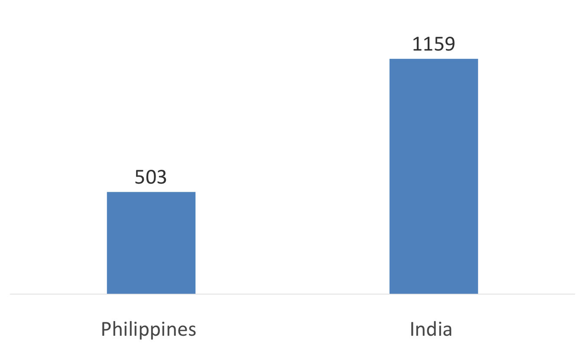
Corridor matters: Indians pay >2x more to get jobs in Qatar than Filipinos

Slide 23

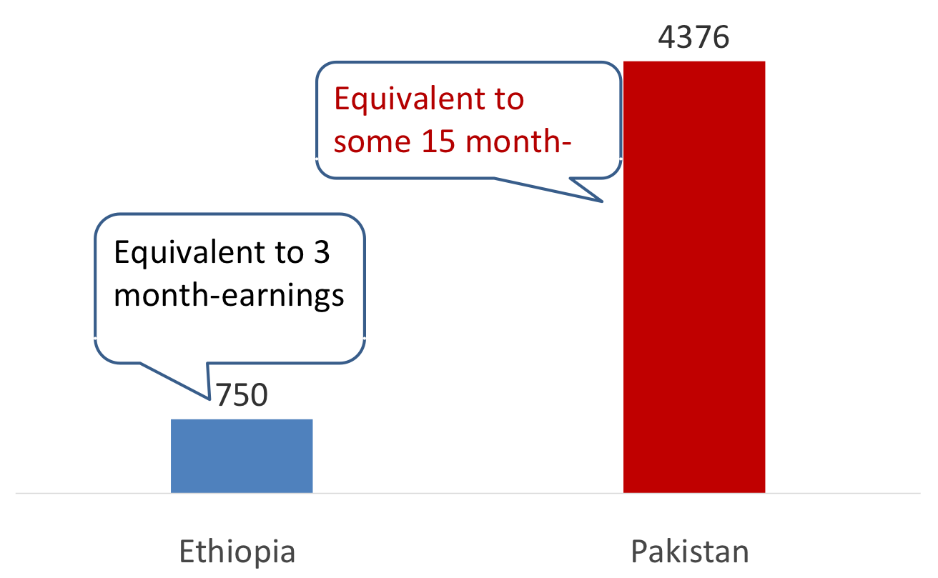
Saudi Arabia: Pakistanis pay > Ethiopians

Slide 24
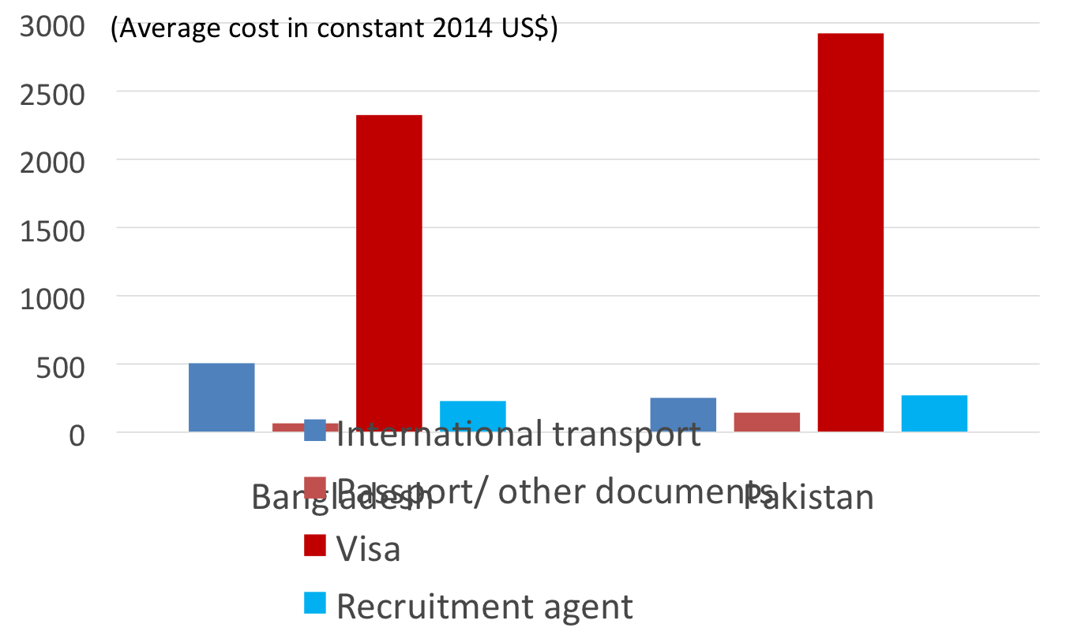
Bangladesh/ Pakistan – high visa fees (visa trading)

Slide 25
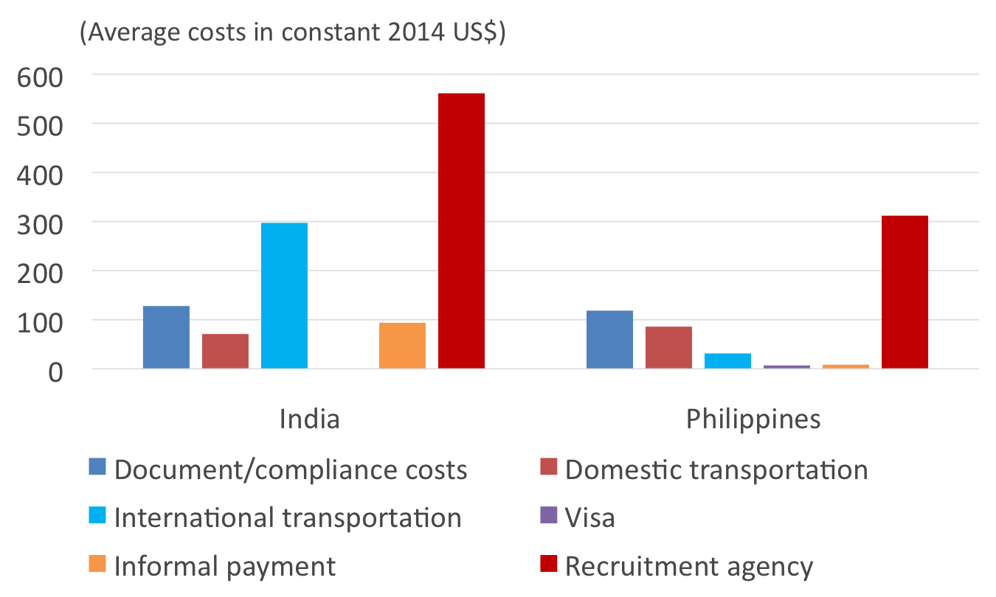
India/ Philippines –high recruiter fees

Slide 26
Next Steps 1
  Collect more data
    Begin with Q on total costs, & then move to cost items
    4 major cost items: (1) agent/recruiter/visa fee; (2) transportation; (3) documents & checks; (4) other (lang)
  Re-evaluate policies
    What are key variables—free movement policies, G-G agreements, one-stop shops? How does nature of employer & product market affect worker-paid costs?
    Which regs are truly necessary? Medical screenings before departure and after arrival?
  Technology? Phone apps for LMI?
    Would videos of migrants explaining their jobs & housing better educate migrants pre-departure?
    Is direct employer recruitment cheaper?
Notes:
Other costs for language, skills, training certs etc
NB compare HH workers in Malaysia & Gulf—inc leisure time—with SIN & HKG—promote women working for wages

Slide 27
Next Steps 2
  If corridor is the most important variable:
    What explains differences between COOs? Visa fees, recruiter costs? Transportation?
  Would focus groups help to explain differences:
    Do Indians dominate HR depts in GCC firms, and charge Indians less?
    Does corruption in COOs help to explain variance between corridors?
  Can govts reshape structure & incentives of recruiters?
    Favor fewer & larger recruiters who can achieve econ of scale and have desire to protect their reputation?
    Allow foreign employers to recruit directly—competition that raises standards?

