Slide 1

Cost of low-skilled migration:
Value chain analysis – Sri Lanka
Bilesha Weeraratne
Institute of Policy Studies of Sri Lanka
KNOMAD Workshop on Measuring Migration Costs for the Low-skilled
The World Bank
Nov. 16-17, 2015

Slide 2
Outline
Motivation
Country context
Migration cost value chain– Saudi Arabia
Migration cost value chain- Korea
Analysis
Possible value chain interventions
Further research

Slide 3
Motivation
Rising demand for global labor mobility, especially low-skilled labor
    An opportunity for developing countries to advance economic and social conditions.
A key barrier – high migration costs
  International conventions:
    Employer pay all financial cost for migrant workers.
  In reality, the less skilled, the higher out-of-pocket costs.
Benefits of lower migration cost
  Labor receiving countries: Less overstays
  Migrant workers: More earnings available to support their families’ welfare.

Slide 4
Motivation
In Sri Lanka:
  Except for housemaids for the Middle East region, other low skilled migrants incur high costs to migrate.
  Often results in pre-migration indebtedness.

Slide 5
  Sri Lanka: Majority of migrants are low skilled workers (56% in 2014)

Slide 6
The majority of low-skilled migrants go to the Middle East region.

Slide 7
About the Study
Objective:
  Analyze the cost of migration for low-skilled workers in a Value Chain (VC) framework.
  Disaggregate migration costs and identify causes for migration costs.
  Suggest value chain interventions
Scope:
  3 corridors
    Saudi Arabia (housemaids)
    South Korea (manufacturing)
    Malaysia (manufacturing)

Slide 8
Saudi Arabia

Slide 9
Employer in Saudi

Slide 10
Employer in Saudi
Job order & fee
Foreign Emp. Agent

Slide 11
Employer in Saudi
Attest/approve job order
Job order & fee
Foreign Emp. Agent
SL Embassy in Saudi

Slide 12
Employer in Saudi
Attest/approve job order
Job order & fee
Foreign Emp. Agent
SL Embassy in Saudi
Job order & fee
Emp. Agent in SL

Slide 13
Employer in Saudi
Attest/approve job order
Job order & fee
Foreign Emp. Agent
SL Embassy in Saudi
Job order & fee
Verification
Approval
SLBFE
Emp. Agent in SL

Slide 14
Employer in Saudi
Attest/approve job order
Job order & fee
Foreign Emp. Agent
SL Embassy in Saudi
Job order & fee
Verification
Approval
SLBFE
Emp. Agent in SL
Sub agent
Advance
Potential Migrant

Slide 15
Employer in Saudi
Attest/approve job order
Job order & fee
Foreign Emp. Agent
SL Embassy in Saudi
Job order & fee
Verification
Approval
SLBFE
Emp. Agent in SL
Sub agent
Advance
Pre-Dep. Training
Potential Migrant
Passport
Medical Report
FBR Report
Police Report
D.I.E.
Medical Centre
GS/DS Office
Training center
Police

Slide 16
Employer in Saudi
Attest/approve job order
Job order & fee
Foreign Emp. Agent
SL Embassy in Saudi
Job order & fee
Verification
Approval
SLBFE
Emp. Agent in SL
Sub agent
Registration
Agreement
Welfare
Advance
Pre-Dep. Training
Potential Migrant
Passport
Medical Report
FBR Report
Police Report
D.I.E.
Medical Centre
GS/DS Office
Training center
Police

Slide 17
Employer in Saudi
Attest/approve job order
Job order & fee
Foreign Emp. Agent
SL Embassy in Saudi
Job order & fee
Travel agent
Verification
Approval
SLBFE
Emp. Agent in SL
Saudi Embassy
Sub agent
Registration
Agreement
Welfare
Advance
Pre-Dep. Training
Potential Migrant
Passport
Medical Report
FBR Report
Police Report
D.I.E.
Medical Centre
GS/DS Office
Training center
Police

Slide 18
Employer in Saudi
Attest/approve job order
Job order & fee
Foreign Emp. Agent
SL Embassy in Saudi
Job order & fee
Travel agent
Verification
Approval
SLBFE
Emp. Agent in SL
Saudi Embassy
Lump sum
Sub agent
Registration
Agreement
Welfare
Lump sum
Advance
Pre-Dep. Training
Potential Migrant
Family
Passport
Medical Report
FBR Report
Police Report
D.I.E.
Medical Centre
GS/DS Office
Training center
Police

Slide 19
Wages & labour
Employer in Saudi
Housemaid from SL
Attest/approve job order
Job order & fee
Foreign Emp. Agent
SL Embassy in Saudi
Job order & fee
Travel agent
Verification
Approval
SLBFE
Emp. Agent in SL
Saudi Embassy
Lump sum
Sub agent
Registration
Agreement
Welfare
Lump sum
Advance
Pre-Dep. Training
Potential Migrant
Family
Passport
Medical Report
FBR Report
Police Report
D.I.E.
Medical Centre
GS/DS Office
Training center
Police

Slide 20
Wages & labour
Employer in Saudi
Housemaid from SL
Visa
Attest/approve job order
Job order & fee
Medical
Foreign Emp. Agent
Police
Bank
SL Embassy in Saudi
Job order & fee
Travel agent
remittances
Verification
Approval
SLBFE
Emp. Agent in SL
Saudi Embassy
Lump sum
Bank
Sub agent
Registration
Agreement
Welfare
Lump sum
Advance
Pre-Dep. Training
Potential Migrant
Family
Passport
Medical Report
FBR Report
Police Report
D.I.E.
Medical Centre
GS/DS Office
Training center
Police

Slide 21
Wages & labour
Employer in Saudi
Housemaid from SL
Visa
Attest/approve job order
Job order & fee
Medical
Foreign Emp. Agent
Police
Bank
SL Embassy in Saudi
Job order & fee
Travel agent
remittances
Verification
Approval
SLBFE
Emp. Agent in SL
Saudi Embassy
Lump sum
Bank
Sub agent
Registration
Agreement
Welfare
Lump sum
Advance
Pre-Dep. Training
Potential Migrant
Family
Passport
Medical Report
FBR Report
Police Report
D.I.E.
Medical Centre
GS/DS Office
Training center
Police
__ Through agent
__ On own

Slide 22
Cost Components
COMPONENT | FROM | TO | AMOUNT (LKR)
Passport | Agent/Migrant | DIE | 2,500
Photos for pp | Agent | Stdio | 500
Training | Agent | SLBFE | 26,500
Medical report | Agent | Medical center | 7,500
Visa fee | Agent | Saudi Embassy | 5,500
Registration fee | Agent | SLBFE | 18,000
Facilities fee | Agent | SLBFE | 5,882
Cess | Agent | SLBFE | 5,000
Contract registration | Agent | SLBFE | 6,000
Air ticket | Agent | Travel agent | 27,500
Cash advance to cover misc. transport | Agent | Migrant | 25,000
 |  |  | SUB TOTAL 129,882
Lump sum | Agent | Migrant’s family | 225,000
Lump sum | Agent | Sub agent | 100,000
Agency fee | Agent | Agent | 50,000
TOTAL |  |  | 504,882

Slide 23
Migration cost to Saudi – LKR 129,882
(Paid out by agents, excluding lump sums)

Slide 24
Saudi Arabia: Reasons for hiring Sri Lankan workers
Relatively low monthly wages (900 riyal).
Reputation to be good caregivers for children and elders.
Better trained than migrants from rest of South Asia.
Established recruitment networks.

Slide 25
South Korea

Slide 26
Employer in Korea

Slide 27
Employer in Korea
Job order
HRD Korea

Slide 28
Employer in Korea
Job order
HRD Korea
Coordinate &
monitor exam
General Admission & worker details
SLBFE

Slide 29
Employer in Korea
Job order
HRD Korea
Coordinate &
monitor exam
General Admission & worker details
SLBFE
Potential Migrant

Slide 30
Employer in Korea
Job order
HRD Korea
Coordinate &
monitor exam
General Admission & worker details
SLBFE
Potential Migrant
Training
Pvt. language Class

Slide 31
Employer in Korea
Job order
HRD Korea
Coordinate &
monitor exam
Notifies Vacancies
General Admission & worker details
SLBFE
General Admission & details
Potential Migrant
Training
Pvt. language Class

Slide 32
Employer in Korea
Job order
HRD Korea
Coordinate &
monitor exam
Notifies Vacancies
General Admission & worker details
SLBFE
Selection of potential workers
General Admission & details
Potential Migrant
Training
Passport
Medical Report
GS Report
CID Report
Attesting bond
D.I.E
Medical Centre
GS Office
Pvt. language Class
Police
Lawyer

Slide 33
Employer in Korea
Job order
HRD Korea
Coordinate &
monitor exam
Notifies Vacancies
General Admission & worker details
SLBFE
Selection of potential workers
General Admission & details
Training of workers
Potential Migrant
Training
Passport
Medical Report
GS Report
CID Report
Attesting bond
D.I.E
Medical Centre
GS Office
Pvt. language Class
Police
Lawyer

Slide 34
Employer in Korea
Job order
Selection of workers
HRD Korea
Immigration
Coordinate &
monitor exam
Notifies Vacancies
General Admission & worker details
SLBFE
Selection of potential workers
General Admission & details
Training of workers
Potential Migrant
Training
Passport
Medical Report
GS Report
CID Report
Attesting bond
D.I.E
Medical Centre
GS Office
Pvt. language Class
Police
Lawyer

Slide 35
Employer in Korea
Job order
Selection of workers
HRD Korea
Immigration
Coordinate &
monitor exam
Notifies Vacancies
General Admission & worker details
SLBFE
Korean Embassy
Selection of potential workers
General Admission & details
Training of workers
visa
Potential Migrant
Training
Passport
Medical Report
GS Report
CID Report
Attesting bond
D.I.E
Medical Centre
GS Office
Pvt. language Class
Police
Lawyer

Slide 36
Employer in Korea
Job order
Selection of workers
HRD Korea
Immigration
Coordinate &
monitor exam
Notifies Vacancies
General Admission & worker details
Financial institutes
SLBFE
Korean Embassy
Selection of potential workers
General Admission & details
Training of workers
visa
Migrant family
Processing & Ticketing
Loan
Witnesses & Guarantors
Potential Migrant
Training
Passport
Medical Report
GS Report
CID Report
Attesting bond
D.I.E
Medical Centre
GS Office
Pvt. language Class
Police
Lawyer

Slide 37
Employer in Korea
Wages &
Labour
Worker from Sri Lanka in Korea
Job order
Selection of workers
HRD Korea
Immigration
Coordinate &
monitor exam
Notifies Vacancies
General Admission & worker details
Financial institutes
SLBFE
Korean Embassy
Selection of potential workers
General Admission & details
Training of workers
visa
Migrant family
Processing & Ticketing
Loan
Witnesses & Guarantors
Potential Migrant
Training
Passport
Medical Report
GS Report
CID Report
Attesting bond
D.I.E
Medical Centre
GS Office
Pvt. language Class
Police
Lawyer

Slide 38
Employer in Korea
Wages &
Labour
Worker from Sri Lanka in Korea
Job order
Selection of workers
HRD Korea
Immigration
Medical
Banks
Coordinate &
monitor exam
Notifies Vacancies
General Admission & worker details
Financial institutes
SLBFE
Korean Embassy
Selection of potential workers
General Admission & details
visa
Remittances
Training of workers
Migrant family
Processing & Ticketing
Loan
Witnesses & Guarantors
Potential Migrant
Training
Passport
Medical Report
GS Report
CID Report
Attesting bond
D.I.E
Medical Centre
GS Office
Pvt. language Class
Police
Lawyer

Slide 39
Cost Components
COMPONENT | FROM | TO | COST (LKR)
Language Training | Migrant | Pvt. class | 8,000
Language book | MIgrant | Pvt. class | 1,000
Medical | Migrant | Medical center | 3,750
Lawyer | Migrant | Lawyer | 1,500
Stamp duty for CID report | Migrant | Police | 50
CID report | Migrant | Police | 500
Training supplies | Migrant | Misc. stores | 11,000
Training fee | Migrant | SLBFE | 20,000
Book | Migrant | SLBFE | 750
Registration fee | Migrant | SLBFE | 5,887
Processing fee | Migrant | SLBFE | 5,733
Welfare and processing fee | Migrant | SLBFE | 49,500
Ticket | Migrant | SLBFE | 47,500
Visa | Migrant | SLBFE | 7,800
Misc. Transport | Migrant | Misc. transport providers | 25,000
Airport transport | Migrant | Misc. transport providers | 6,000
1st month subsistence expenses | Migrant | Migrant | 20,000
TOTAL |  |  | 213,970

Slide 40
Migrant’s cost to Korea - LKR 213,970

Slide 41
Reasons for demanding Sri Lankan workers
Diligent workers
Hard workers
Quota

Slide 42
Comparison of Saudi Arabia and Korea

Slide 43
Labor exports - Comparison of the two value chain analyses: Net costs to workers (I) in LKR
 |  | Language & skills training | Documentation | Recruitment | Transportation | Other | Sub total cost (excluding lump sum payments) | Total cost | Wage (monthly x duration) | Net costs (excluding lump sum) to workers | Cost (excluding lump sum) as % total wages (6)/(8)*100 | Net costs to workers | Cost as % total wages (7) / (8) *100
 |  | (1) | (2) | (3) | (4) | (5) | (6) | (7) | (8) | (9) | (10) | (11) | (12)
Saudi | Costs | (26,500) | (16,000) | (34,882) | (27,500) | (400,000) | (129,882) | (504,882) |  | 921,882 | 16.4 % | 1,296,882 | 63.75 %
 | Earnings |  |  |  |  |  |  |  | 33,000x24
 |  |  |  |  |  |  |  |  | =792000
Korea | Costs | 40,750 | 13,600 | 61,120 | 78,500 | 20,000 | 213,970 | 213,970 |  | 4,286,030 | 4.75 % | 4,286,030 | 4.75%
 | Earnings |  |  |  |  |  |  |  | 125,000x36=4500000

Slide 44
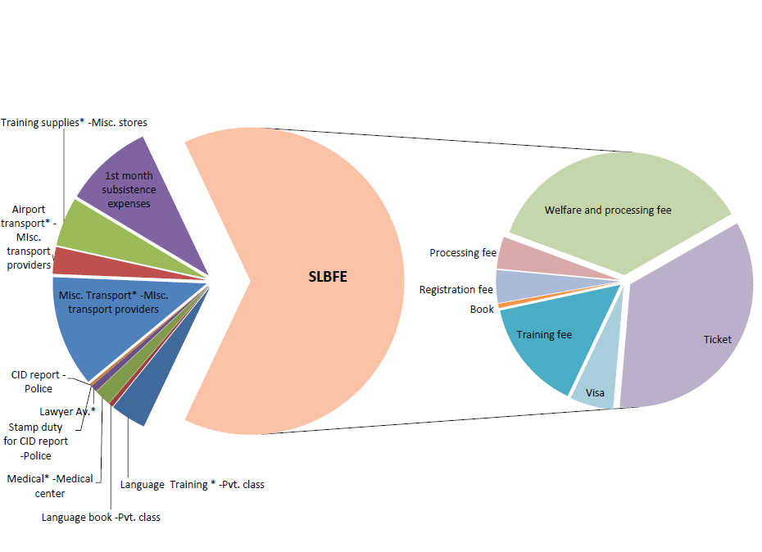
Comparison of the two value chain analyses
Korea
Saudi

Slide 45
Earnings of recruitment agencies (Sri Lanka)
Approx. 10 % of total recruitment fee paid by employer
  (as per 1 KII, others refused to share this information).

Slide 46
Simplifying the value chain
Saudi:
  Amalgamate agents’ and sub agents’ functions.
Korea:
  Attesting of bond to be done by SLBFE in-house lawyers.

Slide 47
Value chain interventions in each stage
Streamline the process to issue necessary documentation (i.e. time taken for Police report )
Reform FBR
Decentralize SLBFE activities to regional offices
Regulate informal sub-agent.
Capacity building for SL Embassy personnel at destination to minimize paper work

Slide 48
Wages & labour
Employer in Saudi
Housemaid from SL
Visa
Attest/approve job order
Job order & fee
Medical
Foreign Emp. Agent
Police
Bank
SL Embassy in Saudi
Job order & fee
Travel agent
remittances
Verification
Approval
SLBFE
Emp. Agent in SL
Saudi Embassy
Lump sum
Bank
Sub agent
Registration
Agreement
Welfare
Lump sum
Advance
Pre-Dep. Training
Potential Migrant
Family
Passport
Medical Report
FBR Report
Police Report
D.I.E.
Medical Centre
GS/DS Office
Training center
Police
__ Through agent
__ On own

Slide 49
Further research areas
Low skilled manufacturing sector migrants to Malaysia.
Value chain analysis of other skills groups.
Comparative analysis with other sending countries.
Quantitative analysis of migration cost using data from migration cost surveys.

Slide 50
Thank You
For further questions, please contact bilesha@ips.lk syi@worldbank.org

