Slide 1
KNOMAD MIGRATION COST SURVEY
Manolo Abella

Slide 2
Background
Much anecdotal evidence that migration costs are high and rising attributed to growing wage differentials.
Little is known of the value added by recruiters and how their services are priced in the labour market
There is a need for better understanding of where economic costs arise and how policy can reduce “rents”
Huge potential benefits that can accrue to migrants and origin as well as host and origin societies from reducing costs

Slide 3
Objectives of study
Provide reliable evidence, based on sound research methodology, of how much low-skill workers actually pay to get employed in another country
Identify possible areas for policy intervention to reduce costs
Enable cross-country, and cross-corridor comparisons of costs that may reveal what difference policies make
Provide the basis for estimating non-pecuniary costs such as earnings foregone or worsening conditions of employment

Slide 4
Estimating migration costs

Slide 5
KNOMAD surveys
Plan of survey
Survey methodology
Questions for considerations
Questionnaire design
Sampling
Survey implementation in the field
Usage

Slide 6
Some key questions raised
How did workers find out about jobs?
What are the biggest components of migration cost?
How did workers finance their migration? Did employers pay for some costs?
Does it cost less to migrate when workers got jobs thru social networks?
Does experience working abroad make any difference to cost?
Do origin country policies impact on cost? Significant differences between countries?

Slide 7
Considerations for survey methodology
How much detail do we really need?
What responses are we likely to get?
Who is the best source of information about migration cost?
Size of the sample?
Compromises on sample stratification
Pilot surveys – a first cut at a complex labor market process

Slide 8
QUESTIONNAIRE ISSUES
Does the Questionnaire cover all the relevant worker-paid costs that can be obtained thru interviews of migrants? Will respondents remember them?
What questions need to be included to shed sufficient light on various issues of interest such as how costs are influenced by conditions in the labour market (S D), policies of destination countries, origin countries, education, experience, sex, age, etc.?
Can greater precision and accuracy be obtained thru a re-framing of some questions?
Could the Questionnaire be structured better for greater efficiency?

Slide 9
Structure of Questionnaire

Slide 10
Surveys revealed
Worker-paid migration costs can account for anywhere between half a month to 9 months of earnings abroad.
Costs vary significantly between migration corridors
Very significant differences within corridors, large variance around the mean.
Visa cost account for much of the high migration cost to Gulf States.
The wage-wedge has a significant impact on migration cost. The effect of other factors like previous experience, age, education, marital status varies from corridor to corridor

Slide 11
Wage wedge related to migration cost

Slide 12
Total costs comparison

Slide 13
Bangladesh/ Pakistan – high visa fees (visa trading)

Slide 14
India/ Philippines – relatively high recruitment agency fees

Slide 15
PH Large variance within corridor

Slide 16
High variance in what workers paid to recruiters

Slide 17
High visa cost in some corridors

Slide 18
Ensure workers migrate through regular channels

Slide 19
Migration cost in terms of earnings

Slide 20
Do workers with previous work abroad pay less?

Slide 21
Feedback on Q from surveys:
Respondents generally able to recall total costs; but for specific cost items estimates have to be drawn from smaller number of responses.
For various reasons responses to some questions need to be interpreted with caution. These include :
- Possibility of double counting : “broker fee” reported may include costs other than for recruiter’s services
- interest paid on loan not easily estimated
- costs incurred in previous failed attempts (how far back?)
Informal payments (included in brokers’ fee?)

Slide 22
Very few responded to question on possible use of skill and if they think they can earn more
For costs incurred at different points in time need to be dated to allow for proper indexation if costs are converted into one currency.

Slide 23
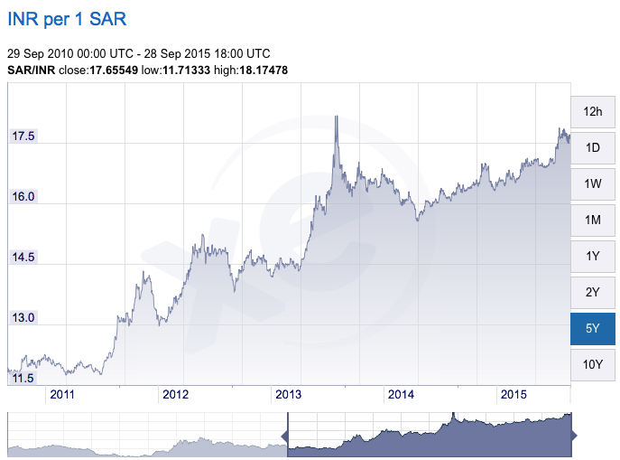
Need information on when costs incurred as exch rates change

Slide 24
Considerations in sampling
Information on reference population
Special issues in sampling returnees
Locating and accessing respondents
Limiting sample to recent migrants
Sample size and budget constraints

