Slide 1
Migrant Cost Survey: Nepal
Ganesh Gurung
Nepal Institute of Development Studies
KNOMAD Workshop on Measuring Migration Costs for the Low-skilled
The World Bank
Nov. 16-17, 2015

Slide 2
Outline
Labor migration regime
Low-skilled labor migration in Nepal
Sampling framework
Challenges

Slide 3
Migration Framework
Foreign Employment Policy (2012)
Foreign Employment Act (2007)
Foreign Employment Regulation (2007) amended in 2012
Foreign Employment Procedures (KARYABIDHI) 2007
Passport Act 2010

Slide 4
Foreign Employment Policy 2012
Goal to “ensure safe, organized, respectable, and reliable foreign employment to contribute to poverty reduction”.
Identify and promote employment opportunities in the international market.
Make each step of the foreign employment process simple, transparent, organized and safe.
Ensure good governance in the management of foreign employment.

Slide 5
Foreign Employment Act 2007
To control and facilitate the process of Nepalis seeking foreign employment.
Provisions including
Pre-departure orientation (mandatory)
Labor Permit ( Exit approval)
Creation of the Migrant Workers’ Welfare Fund (Rs.1000/head)
A Labor Desk at the national airport.
Recruiting agents fees are fixed.
Medical Exams
RECENTLY INCLUDED “ FREE VISA AND FREE TICKET”

Slide 6
Labor migration – mainly low-skilled labor
A long history of labor migration (over 200 years).
Massive outflows over the past few decades.
in response to increasing demand of Nepalese workers from the Middle East.
1500 (Approximetely) outflows per day to the Middle East region and Malaysia.
Excluding irregular migrants and those going to India.
Resulting remittances
Accounting for more than 25 percent of GDP.
One in three households receive remittances.

Slide 7
Most migrant workers are males but female migration is rising.
Number of labor permits issues, by gender (flows)
Source: DoFE, 2014

Slide 8
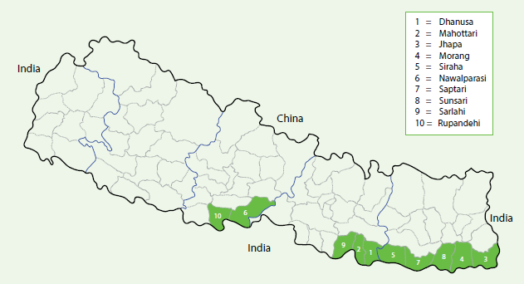
About 40 percent of migrant workers are from southern border districts (green highlights).
Source: DoFE: 2014

Slide 9
Small number of migrant workers are from the mountain districts (2008/09 - 2013/14).
Region | Total labor migrants | Share
Mountain | 97,747 | 5.7
Hill | 759,573 | 43.9
Terai | 871,932 | 50.4
Total | 1,729,252 | 100
Source : DoFe 2013/14

Slide 10
Source: Labour Migration for Employment- A Status Report for Nepal: 2013/2014

Slide 11
The number of workers leaving for Qatar increased in recent years.
Source: Labour DoFE, 2014

Slide 12
Most workers secure their jobs through recruitment agencies, especially males.
Source: Labour Migration for Employment- A Status Report for Nepal: 2013/2014

Slide 13
Recruitment agencies
744 agencies in operation in 2013/14.
The foreign recruitment agent/ human resource officer of the destination countries hires Nepali recruitment agencies to recruit. The Nepali recruitment agencies in turn hires Kathmandu based recruitment agencies who hires a village agent to recruit migrant workers. The process of recruiting one migrant worker goes through several agents/ agencies. This is one of the main reason for high costs in recruitment practices.
This survey will find out the actual cost of individual migration to Qatar thus, it will provide evidences for policy reforms.

Slide 14
1. Employer
2. Foreign Recruitment agent/ HR Officer
3. Indian Agent (Not all the time)
4. Nepali Agent Kathmandu
5. Representative Agent of Nepali RAs
6. Informal Agents in villages
7. Migrants

Slide 15
1. Employer
7. Migrants

Slide 16
Sampling framework to survey returnees from Qatar Implementation by step
The first step of the CAPI survey was to get familiar with the questionnaires, to assess the airport areas, check the arrival/departure time for Qatar Airways, the average number of respondent per flight and the number of interviewers to be hired.
We hired a total of 4 interviewers for the survey and was trained for one week.
Meetings and focus group discussions were conducted in order to clarify any doubts about the using the interviewer app. Questionnaire was carefully reviewed in these session and doubts about it were also cleared.

Slide 17
Sampling framework to survey returnees from Qatar
To minimize sampling bias, interception of returnees at the Kathmandu airport.
Stratification:
Returnees from Qatar.
Worked in the low-skilled segments.
Left Nepal in 2011 or later
Focus group discussions
5 Focus group discussions held in Kathmandu. Some more FGDs will take place in the last of November.

Slide 18
Sampling
Sample size: 350 (pre-determined)
Gender balance: There were very few female respondents in the survey as most of the respondents were construction workers. Even though, the survey included domestic workers, we were only able to find mostly men.

Slide 19
Conducting surveys
4 interviewers conducted the survey.
Respondent interceptions three times a day according to flight arrivals from Qatar.
Interview places:
At the airport – arrivals or luggage claims: Offered the respondents with tea/snacks during the interviews.
In a car: Offered car rides from the airport to their homes/hotels to increase our turnout ratio; conducting interviews during the ride.
Switch from hiring an electric car owing to the petrol crisis.
At Labor Village: For those whose interviews were incomplete. Obtained phone numbers and then followed up with respondents in the Labor Village of the Department of foreign employment, while in the queue to obtain their permit to go back to Qatar.

Slide 20
Success rates were …
 | Total number of people asked to identify qualifying respondents | Number of interviews conducted | Number of interviews approved (usable) | Average duration of an interview
Interviewer 1 |  |  | 82 | 45mins
Interviewer 2 |  |  | 85 | 40mins
Interviewer 3 |  |  | 86 | 45mins
Interviewer 4 |  |  | 83 | 45mins
Supervisor/ Interviewer |  |  | 14 | 45mins
Total |  |  | 350 | 45mins

Slide 21
Challenges
Significant delays in implementation owing to unforeseen disasters - the earthquake and the petro/diesel crisis.
Difficult to convince respondents at airport
Because most of the workers had paid in lump sum to the recruitment agents/ brokers, they did not know about the break downs of the payments.

Slide 22
Lesson Learned
Identify an interview place where the respondents are not in a hurry to go home and can actually give more time for the interview.
Any incentive mechanism to respondents (such as complains/story)

Slide 23
THANK YOU

Slide 24
Annual outflows of Nepalese workers – steadily rising at about 20 percent a year over the past two decades (average, excluding those to India)
Source: DOFE (2014 )

Slide 25
Outline
Labor migration regime
Low-skilled labor migration in Nepal
Sampling framework
Challenges

