Slide 1
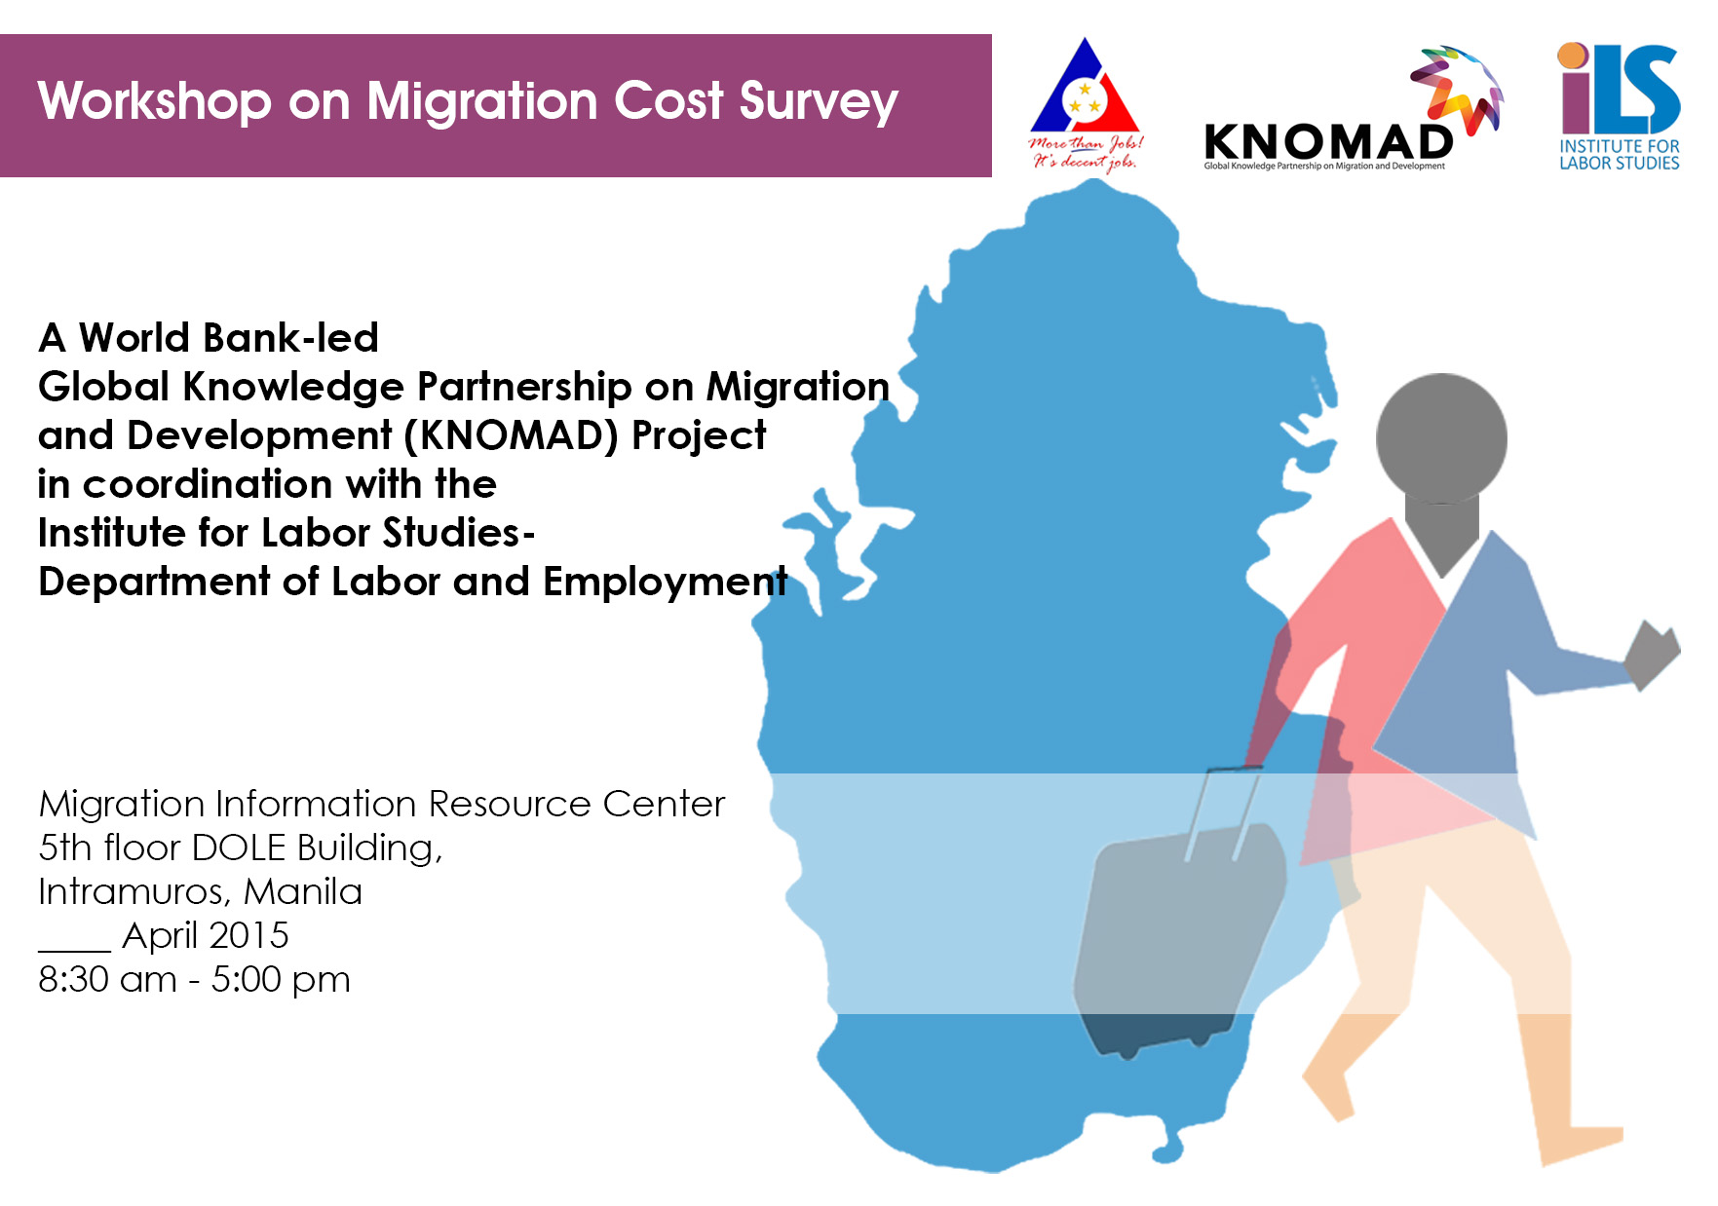




Workshop on Migration Cost Survey
Institute for Labor Studies – Department of Labor and Employment
Migration Information Resource Center
10 April 2015
8:30 AM – 5:00 PM
The World Bank, Washington DC
MC7-100
November 16-17, 2015
8 May 2015
HAROLD M. CARBO
16 December 2014

Slide 2
The PHILIPPINE LABOR MIGRATION MANAGEMENT SYSTEM
Survey of Filipino Migrant Worker Returnees from Qatar
Philippine Country Report

Slide 3
The PHILIPPINE FULL CYCLE MIGRATION MANAGEMENT SYSTEM
On-Site
(PAOS, Welfare Services/Registration of Undocumented Workers/Training, Repatriation)
Pre-employment
(PEOS, Worker’s Documentation
PDOs)
Return to the Country
(Reintegration Program/Package of Assistance)
Protective Mechanisms/Regulations
Licensing and Accreditation System
Human Resource Development
Skills Retooling/Upgrading
Survey of Filipino Migrant Worker Returnees from Qatar
Philippine Country Report
Notes:
In all these years, the Philippines has created a comprehensive structure of regulation, protection and assistance which embraces the whole migration process, for which the Philippines has gained renown as a model for migration governance.
The Philippines emphasizes a human rights framework in migration governance, consistent with its commitment to international conventions and active engagement in regional and global policy dialogues.

Slide 4

Labor Migration Flow
The Philippines is mainly an out-migration country, a major source of talents.
10.5 million Overseas Filipinos
4.9 m+ permanent migrants (46.6%)
4.2 m+ temporary migrants (40.0%)
1.3 m+ irregular migrants (12.4%)
200,016 Overseas Filipinos in QATAR
16k permanent migrants (0.0%)
172k temporary migrants (86%)
28k irregular migrants (14%)
Source: CFO 2012 Stock Estimates of Overseas Filipinos
Survey of Filipino Migrant Worker Returnees from Qatar
Philippine Country Report

Slide 5
Labor Migration Flow
Deployment Trend, 2009-Oct. 2014
* preliminary
Survey of Filipino Migrant Worker Returnees from Qatar
Philippine Country Report
Notes:
Today, the Philippines ranks as the third largest migration-sending country in the world (EEAS, 2009). Data from the POEA reveals that the number of OFWs has grown by 24.3% from 1.423 million in 2009 to 1.769 million in 2014.
The competitiveness of Filipino migrant in the global market in terms of productivity and wages is said to have maintained the country’s favorable economic indicators even in times of regional or global financial crisis or low points of economic cycles.

Slide 6
Labor Migration Flow
More than 1.7 million OFWs left the country in 2014*
Source: POEA Deployment Statistics
Landbased almost 1.40 m
Seabased
more than 363 k
New Hires more than 485 k
Rehires more than 920 k
* preliminary
Survey of Filipino Migrant Worker Returnees from Qatar
Philippine Country Report

Slide 7
Labor Migration Flow
Top Destination Countries of OFWs, 2009- Oct. 2014
Survey of Filipino Migrant Worker Returnees from Qatar
Philippine Country Report
Notes:
AS of 2009, KSA leads in the top ten destinations of OFWs, which includes five Gulf countries, placing Qatar at 5th, four Asian countries, and Canada, the only non-Asian countries.

Slide 8
Labor Migration Flow
Destination of low-skilled workers (new hires), CY 2013
Period covered: 2009-Oct. 2014
Survey of Filipino Migrant Worker Returnees from Qatar
Philippine Country Report
Notes:
In terms of low-skilled deployment: POEA data reveals that UAE (47.69%); Saudi Arabia (26.27%); Qatar (7.91%); Kuwait (3.14%); Bahrain (2.93%); Brunei (2.68%); Canada (2.12%); and Oman (1.31%)

Slide 9
Labor Migration Flow
Estimated number of Overseas Filipinos in Qatar,
January-June 2014
Survey of Filipino Migrant Worker Returnees from Qatar
Philippine Country Report
Notes:
From January to June 2014, there were 190,000 OFWs registered in Qatar. Almost 85% (159,000) of these were regular or documented OFWs and the rest were undocumented and other Filipinos (16% or 30,000)

Slide 10
Labor Migration Flow
Annual Deployment to Qatar
Survey of Filipino Migrant Worker Returnees from Qatar
Philippine Country Report
Notes:
An interesting characteristic was the increasing proportion of rehires, which grew at an average of 10.62% annually and registering a total of 79,753 rehires in 2014, the highest record for the past six years. This may indicate that the temporary migration of OFWs is gaining some stability- a case of temporary migration becoming more or less permanent-and the overseas employment experience is becoming longer. Consequently, the rate of permanent return is slow, probably because of limited wage-competitive opportunities in the Philippines.
These rehires represent the OFWs who go back to the same employer in the same country under any of the following circumstances: (a) to renew their contracts for another term; (b) to rejoin their existing employer in the same country after availing of vacation; or (c) to rejoin their existing employer in the same country with whom overseas employment was previously obtained, mostly onsite, without being registered with the POEA or passing through its registration system upon original departure of the worker.

Slide 11
Labor Migration Flow
Deployment statistics by skills (new hires) to Qatar,
CY 2014
Survey of Filipino Migrant Worker Returnees from Qatar
Philippine Country Report
Notes:
Most OFWs find employment as service or production workers. These two categories comprised almost 80% of OFWs in Qatar. The largest concentration is in domestic work. Generally, overseas employment was mostly male-dominated since overseas employment started in 1970s, but females are now the majority of the newly-hired land-based OFWs, mainly because of the number of household workers.

Slide 12
Labor Migration Flow
Top Destination Countries of HSWs, 2009-Oct 2014
Period covered: 2009-Oct. 2014
Survey of Filipino Migrant Worker Returnees from Qatar
Philippine Country Report
Notes:
After a momentarily decline in 2007 and 2008, soon after the implementation of the Household Service Workers Reform Package, which include upgrading of skills, orientation course on country-specific culture and language, protective mechanisms at the job sites, obliging employers to shoulder the cost of deploying the domestic helper, and increasing the minimum salary to a level commensurate to their acquired competencies, domestic workers have increased and more than doubled between 2009 and 2012.

Slide 13
Labor Migration Impact
Employment opportunities
Increased family income and improved family welfare
Burgeoning challenges
Survey of Filipino Migrant Worker Returnees from Qatar
Philippine Country Report
Notes:
Some eight million OFWs may have participated in the overseas employment program since it started in the 1970s. For many of them, overseas employment is a beneficial experience, at least economically. While the employment objective is the most prominent reason for migration abroad, not all Filipino migrants go abroad because of it.
The acquisition of skills, pursuit of a career, the opportunity reunite with families abroad. Experience other cultures, encounter other people and societies, and live a more developed standard of living are among other reasons that motivate some to leave the country.
Benefits are not without costs, and migrants encounter social costs (family separation, parental absence) throughout the process. In the pre-employment phase, illegal recruitment is experienced in many form (e.g. placement fees and contract substitution). During employment, migrants experience may forms of hardships, particularly, migrants in less skilled occupations-face higher risks and vulnerabilities.
Philippines has the provision of alternative remedies and legal facilities. NLRC: for money claims; POEA: for recruitment violations and other administrative cases; OWWA: welfare protection both in terms of repatriation assistance or in terms of programs of assistance to the families left behind.

Slide 14
Labor Migration Impact
(US$ Remittances)
12.4%
11.0%
10.9%
10.4%
Survey of Filipino Migrant Worker Returnees from Qatar
Philippine Country Report
Notes:
The impact of migration on the economy is evidenced by the inflow of remittances. Data from the Central Bank of the Philippines reported that total remittances grew by 22.41% (or $4.205 million) from $18.763 million in 2010 to $22.968 million in 2013. Similarly, remittances from Qatar, which represents one-tenth of the total remittances, also doubled from a $0.247 million in 2010 to $0.412 million in 2013.
The growth is attributed to the burgeoning presence of OFWs in more than 224 destinations with relatively longer years of employment engagement, a growing market leadership in the high wage-earning seafaring sector, an assumed wage escalation among those with extended contracts, and longer service records. Remittances are estimated to contribute between eight and ten percent of GDP, making overseas employment among the most important sources of the Philippines export earnings.

Slide 15

Migration Policies
THE PRESIDENT’S SOCIAL CONTRACT WITH THE FILIPINO PEOPLE IN 2010
Republic Act 10022 in 2010 (Amending RA 8042)
THE 22- POINT LABOR AND EMPLOYMENT AGENDA 2010
POEA Rules and Regulations of OE in 2002
Survey of Filipino Migrant Worker Returnees from Qatar
Philippine Country Report
Notes:
The main thrust of the Philippine migration policy was established in the 1974 Labor Code and it consisted in promoting and facilitating overseas employment, protecting Filipino migrants, and maximizing the benefits of migration. The policy was further elaborated in RA 8042 or the Migrants Workers and Overseas Filipinos Act of 1995, which was amended in 2007 and 2010- by RA 10022. This law is essentially a “protective” legislation.

Slide 16
Migration Policies
THE PRESIDENT’S SOCIAL CONTRACT WITH THE FILIPINO PEOPLE IN 2010
Creating jobs at home so that working abroad will be a choice rather than a necessity
When the citizens choose to become OFWs, their welfare and protection will still be the government’s priority
Survey of Filipino Migrant Worker Returnees from Qatar
Philippine Country Report
Notes:
As articulated by President Benigno C. Aquino III, the current policy focuses on creating jobs at home so that there is no need to look for employment abroad, while at the same time providing the best protection for Filipinos who still go to work abroad.

Slide 17
Migration Policies
Republic Act 10022 in 2010
(Amending RA 8042)
Restriction of deployment of workers only to countries compliant with the guarantees of protection as certified by the DFA
Mandatory insurance coverage for agency hired workers
Survey of Filipino Migrant Worker Returnees from Qatar
Philippine Country Report

Slide 18
Migration Policies
THE 22- POINT LABOR AND EMPLOYMENT AGENDA in 2010
Review of the continued deployment of workers to countries, which are high and medium risk areas, as well as the continued deployment of workers in high-risk occupations
Survey of Filipino Migrant Worker Returnees from Qatar
Philippine Country Report

Slide 19
Migration Policies
(cont’d)
Investment in the formal and regular skills training and upgrading of our service workers and utilize returning OFWs to conduct training so they may transfer skills learned abroad
Assistance to OFWs in achieving financial stability through training, investment and savings programs
Survey of Filipino Migrant Worker Returnees from Qatar
Philippine Country Report

Slide 20
Migration Policies
POEA Rules and Regulations of OE in 2002
“Difficult to enter, easy to operate and easy to go” policy
Safety nets for the protection of workers
Survey of Filipino Migrant Worker Returnees from Qatar
Philippine Country Report

Slide 21

Sampling Framework
Survey of Filipino Migrant Worker Returnees from Qatar
Philippine Sampling Framework

Slide 22
Overview
1
2
3
The TWG on Low Skill Migration under the KNOMAD program of the World Bank has been gathering data on worker-paid migration costs.
The group, in collaboration with the ILO, has conducted pilot surveys in several countries of destination such as Spain, Kuwait and Korea.
The group, however, intends to expand these pilot areas to cover another country, Qatar.
Survey of Filipino Migrant Worker Returnees from Qatar
Philippine Sampling Framework

Slide 23

Objective
Identify policies towards:
Reducing migration costs of low-skilled labor migrants
Facilitating cross-border movements of low-skilled labor
Contributes to setting a global target to reduce migration costs-e.g. to one month’s wage
Survey of Filipino Migrant Worker Returnees from Qatar
Philippine Sampling Framework
Notes:
Migration costs in the context of this study refer to the job opportunity costs in finding a job abroad

Slide 24
Survey Method
Survey of Filipino Migrant Worker Returnees from Qatar
Philippine Sampling Framework

Slide 25

Method and Design
One-shot (after only) design to elicit responses on migration cost among temporary OFW returnees from Qatar
Survey of Filipino Migrant Worker Returnees from Qatar
Philippine Sampling Framework
Notes:
The simplest and cheapest to administer using a standardized survey instrument

Slide 26
Opportunities and Risks
The method is vulnerable to convenience sampling and high non-response rates, with the potential attendant problem of survey bias
The intercept method is less expensive and allows greater control and flexibility for the interviewer
Although useful applications of the method are limited, it can deliver accurate results when the population is randomly selected
Survey of Filipino Migrant Worker Returnees from Qatar
Philippine Sampling Framework

Slide 27

Instrument
Adopted the KNOMAD’s Migration Cost Survey of the World Bank
Administered through the Computer-Assisted Personal Interviewing (CAPI) system
Survey of Filipino Migrant Worker Returnees from Qatar
Philippine Sampling Framework

Slide 28


Sampling and Respondents
Qatar returnees
350
Balik Mangagawa Centers
(BMCs)
Pre-departure Orientation Seminar (PDOS) for Middle East bound-OFWs in OWWA-Accredited NGO providers
Survey of Filipino Migrant Worker Returnees from Qatar
Philippine Sampling Framework

Slide 29


Sampling and Respondents
2013
OEC issuance from 886,398
rehires at BMCs nationwide
(BMCs)
Designated at the Philippine Overseas Employment Administration (POEA)
60,656
were Qatar rehires
Survey of Filipino Migrant Worker Returnees from Qatar
Philippine Sampling Framework
Notes:
BMC offices are designated by the Philippine Overseas Employment Administration (POEA) for OFW rehires to obtain their Overseas Employment Certificates (OECs) as requisite documents for deployment. While PDOS is managed by OWWA as a major component of its information and education program for departing OFWs and their families. Attendance to PDOS is mandatory for all departing OFWs.

Slide 30
Sampling and Respondents
Non-Government Organizations
Recruitment Agencies
Industry Associations
Service Providers
(PDOS)
Managed by the Overseas Workers Welfare Administration (OWWA)
Survey of Filipino Migrant Worker Returnees from Qatar
Philippine Sampling Framework
Notes:
PDOS served as major component of its information and education program for departing OFWs and their families. NGOs are authorized to conduct the PDOS for Household Service Workers (HSWs) and Overseas Performing Artists (OPAs) only; (2) Recruitment agencies are authorized to conduct the PDOS for land-based workers belonging to the professional, skilled and technical categories of workers only of their member agencies; and (3) Industry Association – conducts the PDOS for the professional, skilled and technical recruits of their member (sea-based and land-based) agencies.

Slide 31

Sampling and Respondents
Initially, the population recommended by World Bank covers Qatar returnees at the airport
The intercept at BMC offices targets a good sample of Qatar temporary returnees
Also, PDOS offices provide a good sample of OFWs who have previously worked in Qatar and now employed elsewhere
Survey of Filipino Migrant Worker Returnees from Qatar
Philippine Sampling Framework
Notes:
These rehires can provide information on their experiences while previously employed in Qatar. The respondents at PDOS are pre-determined at the first day of the 3-day seminar

Slide 32

Sampling and Respondents
Survey Q’s only pertains to previous employment in Qatar
Exclude experiences leading to their future deployment as rehires
Reduce data contamination assuming that migration cost of rehires may be lower
Survey of Filipino Migrant Worker Returnees from Qatar
Philippine Sampling Framework
Notes:
Since respondents were mix of rehires and those who are previously been to Qatar, survey questions were modified to refer only to experiences in their previous employment in Qatar and excluded experiences leading to their impending (future) deployment as rehires or workers elsewhere, which may contaminate data assuming that migration cost of rehires may be lower.

Slide 33
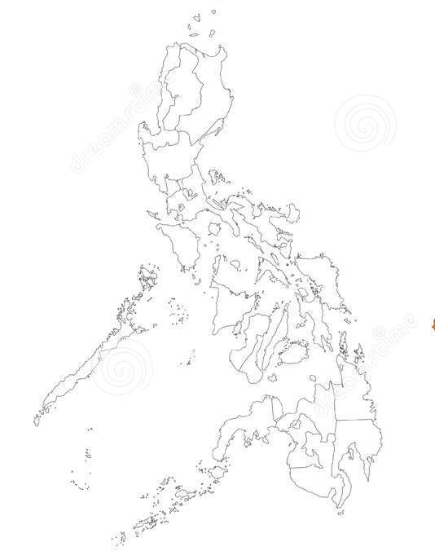

Regional Selection
BMC | 2013 | 2014 ^{[1]} | Total ^{[2]} | % to Total
NCR | 24,682 | 13,477 ^{[3]} | 38,159 | 52
Mall-Based | 2,313 | 2,873 | 5,186 | 7
Duty Free - Parañaque | 891 | 1,342 | 2,233 | 3
SM-Manila | 523 | 630 | 1,153 | 2
TRINOMA | 899 | 901 | 1,800 | 2
POEA Main Office | 22,369 | 10,604 | 32,973 | 45
CAR | 660 | 588 | 1,248 | 2
I | 1,327 | 1,252 | 2,579 | 4
II | 670 | 620 | 1,290 | 2
III | 3,752 | 5,458 | 9,210 | 13
IVA | 5,298 | 4,840 | 10,138 | 14
IVB | 272 | 261 | 533 | 1
V | 829 | 889 | 1,718 | 2
VI | 595 | 632 | 1,227 | 2
VII | 386 | 1,181 | 1,567 | 2
IX | 543 | 563 | 1,106 | 2
X | 685 | 724 | 1,409 | 2
XI | 1,158 | 942 | 2,100 | 3
XII | 402 | 365 | 767 | 1
CARAGA | 252 | 266 | 518 | 1
Total | 39,198 | 29,185 | 68,383 | 100%
^{[1]} 2014 data are only preliminary
^{[2]} Total does not include Region VIII due to data loss during the Typhoon Yolanda (Haiyan) in 2013; and 2014 data collection commenced only in February
^{[3]} Estimated from the proportion to total in 2013
Survey of Filipino Migrant Worker Returnees from Qatar
Philippine Sampling Framework
Notes:
Geographical distribution of the BMC sample was extended to BMCs outside Metro Manila. Regional selection was determined based on the highest concentration of OFWs bound for Qatar for the period 2013-14. The selected regions are: NCR (52%), IV-A (14%), III (13%) and Region XI (3%).

Slide 34
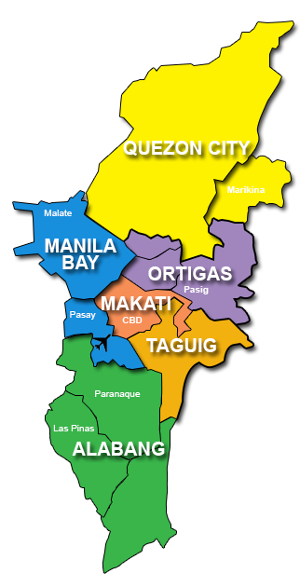

Regional Selection
13 OWWA Accredited NGO PDOS providers all concentrated in the Greater Manila Area (GMA)
Selected the OWWA offices in BFO DevCen in Intramuros, Manila and OWWA, Pasay City
Survey of Filipino Migrant Worker Returnees from Qatar
Philippine Sampling Framework
Notes:
Convenience sampling was done depending on the conduct of PDOS among Middle East bound workers during the roll-out of the survey.

Slide 35

Regional Selection
Qatar returnees
350
315
35
(BMC)
(PDOS)
Survey of Filipino Migrant Worker Returnees from Qatar
Philippine Sampling Framework
Notes:
The sample was allocated proportionally depending on its population size

Slide 36


BMC Regional Selection
BMC | Sample
NCR* | 202
Mall-Based | 28
Duty Free - Parañaque | 12
SM-Manila | 6
TRINOMA | 10
POEA Main Office | 174
III | 49
IVA | 54
XI | 10
Total | 315
RIII
NCR
RIV-A
RXI
Survey of Filipino Migrant Worker Returnees from Qatar
Philippine Sampling Framework

Slide 37

Screening Procedure
Overseas Filipino Workers (OFW) Qatar Returnees
Those who left the home country in 2011 or after
Low-skilled migrant workers
Work at the Construction, Agriculture, and Domestic Service sector
Legal migrants who left the home country with a work visa/ permit.
Survey of Filipino Migrant Worker Returnees from Qatar
Philippine Sampling Framework

Slide 38


Procedure
ILS, with the assistance of POEA and OWWA, set up booths
All OFWs under process for Overseas Employment Certificate (OEC) issuance at BMC offices and those in attendance during PDOS at OWWA office are considered as probable respondents
The OFW is directed to the booth for initial screening
If he/she is qualified, he/she proceeds to the main interview questions, given his/her willingness to participate
Prior to the start of interview, respondents was briefed on the objectives and the expected outcomes of the survey
The survey interview lasted for 30-45 minutes depending on the respondent’s response.
Survey of Filipino Migrant Worker Returnees from Qatar
Philippine Sampling Framework
Notes:
These BMCs are located at POEA Main Office in Manila and in regional offices in III, and IV-A (including XI for Option B)
High-peak season is from late January to early April, for the processing of BM OFWs, based on POEA recommendation
Initial screening confirms if the respondent belongs to the target group.
In an event, a respondent refuses to participate, the enumerator will record his gender and his nonverbal condition
During the whole survey, the respondent will be assured of confidentiality of information derived from the interview
ILS estimates a total of three questionnaires per day per enumerator will be administered

Slide 39
Highlights of the survey implementation
Survey of Filipino Migrant Worker Returnees from Qatar
Philippine Sampling Framework

Slide 40
Survey Strategies
Pre-testing was done in March to further refine the survey questionnaire
A one-day workshop training was conducted for enumerators, oriented on the Philippine labor migration system; survey questions; and the CAPI system
New hires who were deployed to Qatar as early as 2005 have been considered in the research sample
The sample was limited to legal migrant workers and first-time returnee to Qatar
For the purpose of the study, migration cost was defined as the recruitment costs incurred in getting a job in Qatar
Survey of Filipino Migrant Worker Returnees from Qatar
Philippine Sampling Framework
Notes:
Initial statistical analysis was provided to WB
Bullet No. 3: . OFWs who arrived in Qatar in 2009 were mostly returning after two to five years vacation in the Philippines depending on what was stipulated in their contract.

Slide 41
Survey Strategies
Regional selection was determined based on the highest concentration of deployed OFWs to Qatar for the period 2013-2014
Since the survey was intercepted at the BMC offices, the team has extended the survey for three rounds given that the survey administration fell during the off peak season (May to June)
Due to high non-response in Regions III and IX, the team decided to spillover at the BMC and PDOS offices in NCR to cover the remaining samples. In addition, the team no longer undertook interviews in BMCs inside shopping malls
The team has decided to tap the Management Information System Division (MISD) services of the POEA to have access to the BMC database to keep track of OFWs who went to Qatar
Survey of Filipino Migrant Worker Returnees from Qatar
Philippine Sampling Framework
Notes:
The off peak season of returning OFWs meant fewer number of interviewees hence, the team has extended the survey.
The reasons for disqualifications were: (1) low skilled workers but do not belong to the three sectors (e.g. manufacturing, transportation, hotel & services) and (2) belonging to the three sectors but highly skilled workers (e.g. engineer, technician, and analyst).
From the database, those OFWs who went to Qatar were still subject to the same interview, provided they meet they set qualification, are here in the Philippines, and expressed willingness to be interviewed.

Slide 42
Survey Strategies
Overall Summary
 | OWWA-DevCen | OWWA-Pasay | BMC-Main | BMC-RIII | BMC-RIVA | BMC-RXI | Grand Total
Actual Total | 17 | 18 | 208 | 43 | 53 | 11 | 350
Sample Desired | 17 | 18 | 201 | 49 | 54 | 11 | 350
Remaining | 0 | 0 | -7 | 6 | 1 | 0 | 0
Survey of Filipino Migrant Worker Returnees from Qatar
Philippine Sampling Framework
Notes:
The table shows the actual count of survey administration

Slide 43
Challenges
Survey of Filipino Migrant Worker Returnees from Qatar
Philippine Sampling Framework

Slide 44
Sampling
The sample should have included returnees from Saudi Arabia
Due to sampling limitations, respondents did not include permanent returnees
The sample should have included other sectors such as hotel, food and beverage, which also employ low-skilled workers
The sample of 350 is small considering the variation of deployment of low-skilled workers among origin countries
The sample specifically targets Qatar returnees and is time-bounded, the intercept could have expanded to placement agencies that deploy workers to Qatar
Survey of Filipino Migrant Worker Returnees from Qatar
Philippine Sampling Framework
Notes:
The top one destination country of OFWs is Saudi Arabia (39.53% or 377,375), and Qatar only placed fifth (7.03% or 67,103).
Due to sampling limitations, respondents did not include permanent returnees, which can be attributed to the following factors: First, intercepting at the airport was not feasible. Second, there is no existing database to easily locate those who have permanently return in the Philippines, whether they are skilled or unskilled workers, students or retirees. There is dearth of data on the magnitude of return migration and the rate of repeat migration, the characteristics of returnees and the circumstances under which they return.
There were instances wherein the employer deploys the worker/s to various establishments including hotel, restaurants and and/or households to perform domestic work (e.g., cleaning, etc.).
The universe of each country also varies. For instance, the total number of low skilled OFWs in Qatar may be too small compared with that of India. How was the quota determined?

Slide 45
Survey time/resources/respondents/others
Low turn-out of respondents at the BMC offices since the survey was administered during the off peak season (May-July)
Each interview averages to 30-45 minutes, depending on the respondent’s recall
Majority of the workers only recall the total amount paid to recruiter for obtaining the travel documents and necessary clearances
Domestic workers were more open in providing information
During synchronization, enumerators reported problems: “syncing interruptions” and “cancellation”
Survey of Filipino Migrant Worker Returnees from Qatar
Philippine Sampling Framework
Notes:
OFWs usually out-migrate to the Philippines from March-April due to the graduation and summer season. In a day, the team can only interview at an average of two qualified respondents
Problems on “syncing interruptions” and “cancellation” can be attributed to the failure of the url or server and slow internet connection

Slide 46

Thank you!
www.ilsdole.gov.ph
facebook.com/ilsdoleofficial
twitter.com/ilsdoleofficial
instagram.com/ilsdoleofficial
Survey of Filipino Migrant Worker Returnees from Qatar
Philippine Sampling Framework

