Slide 1
Sampling frameworks for survey returnees from Saudi Arabia: Ethiopia
Adamnesh Atnafu (PhD)
Addis Ababa University

Slide 2
Country context of low-skilled labor migration
Over the past two decades significant growth in international flows of labour from Ethiopia, mostly of low skilled persons.
Unfortunately, the growth in labour demand has not resulted in an improvement of the conditions of Ethiopian migrant workers - Restrictive immigration policies, commercialization of migration processes, increasing trafficking and smuggling of migrants have all increased significantly.
There has been serious infringment of rights of migrants in the process .

Slide 3
Country context cont’d: destination shift
Migration of Ethiopian workers, mostly of domestic workers has shifted from a predominantly Lebanon and to some extent Syria in the 1990s and early 2000 to Saudi Arabia in the last two years.
This shift is partly due to the ban that the Government of Ethiopia has made on labour migration to Lebanon.
The number of migrants has increased in two folds from 2010-2013 – excluding irregular migrants

Slide 4
Number of migrant workers who have processed their migration through PEAs per year and country of destination
 | 2001 J.C. (8 Jul '08 - 7 Jul '09 |  | 2002 J.C. (8 Jul '09 - 7 Jul '10 |  | 2003 J.C. (8 Jul '10 - 7 Jul '11 |  | 2004 J.C. (8 Jul '11 - 7 Jul '12 |  | 2005 J.C. (8 Jul '12 - 7 Jul '13
Country of destination | Male | Female | Male | Female | Male | Female | Male | Female | Male | Female
Saudi Arabia | 3749 | 9399 | 1082 | 2396 | 2030 | 13446 | 10341 | 158959 | 7127 | 154660
Kuwait | 103 | 6976 | 321 | 10837 | 663 | 25457 | 270 | 28476 | 130 | 20659
U.A.E. | 9 | 113 | 1 | 142 | 0 | 510 | 109 | 321 | 0 | 0
Other countries | 14 | 905 | 148 | 19 | 12 | 115 | 16 | 175 | 12 | 108
 | 3875 | 17393 | 1552 | 13394 | 2705 | 39528 | 10736 | 187931 | 7269 | 175427

Slide 5
Country context cont’d Reasons for migration
Rural and urban Poverty: Lack of means of production such as land (could be because of environmental degradation), lack of employment and means of income
Lack of educational opportunities
High demand for low-skilled labour at the destination
The influence of already settled migrants at the destination on potential migrants
The existence of the PEAs to facilitate the migration process

Slide 6
Country context cont’d Characteristics of low-skilled labor migrants: age/ gender/ education/ origin
The group that migrates is youth within the age range of 20-25 for females while the males are mostly above the age of 30 - poor and uneducated.
According to the data of the IOM (2014), the number of migrants was higher in Amhara followed by Oromiya and Tigray respectively. Addis Ababa was represented among the lowest number of migrants in comparison with the above three regions.
Males constituted the higher number representing 62% of the returnees while females constituted 33%.

Slide 7
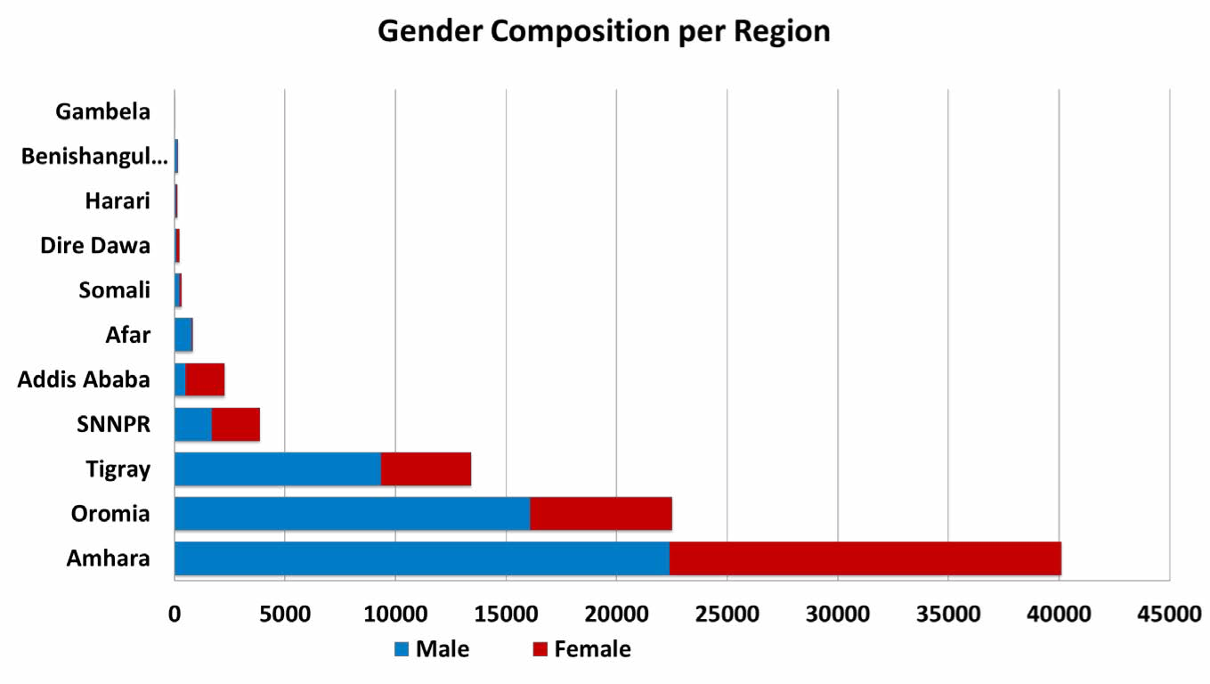

Slide 8
Country context cont’d Destinations and type of occupation
The destination of all respondents was Saudi Arabia as per the objectives and scope of the survey.
Transit routes - Djibouti and Yemen for who have migrated through illegal means.
Males engaged in agriculture (farming and cattle herding) and construction labor
Females were engaged in domestic work, kitchen assisting (cooking), and cleaning and helping at the house and/or at hotels.
Few exceptions: Men worked as drivers and guards, females in construction work.

Slide 9
Country context cont’d Employment contract
PEAs use employment contract for workers migrating to Kuwait. It is entered into by/between the employer, the agency and the employee.
Contract: on salary, interval of payment, working hours, living conditions (leisure time, access to medical services, adequate food), life and medical insurance, free ticket to and from Ethiopia, termination, and alteration.
No contract with employer in KSA – PEAs sign on behalf of the employer - bilateral labour agreement with KSA.

Slide 10
Country context cont’d Proclamation No. 632/2009 January 2010
Demands the PEAs to protect the rights of citizens
Minimum wage for migrant workers at 180 USD
Not sign a contract with workers younger than 18 years of age
Change the contract without the knowledge of the MOLSA
As of 23 August 2013, the no. of PEAs is 406. Most of these PEAs have also branch offices in different towns Currently, most PEAs send workers to Saudi Arabia. 71 PEAs to both KSA and Kuwait, while 253 PEAs only to KSA

Slide 11
Country context cont’d Regular vs irregular migration
Reasons for choosing irregular migration: distorted information on the costs of legal way, advice from smugglers and traffickers, long and bureaucratic processes of the legal route, charging of unlawful fees by PEAs
Cost: irregular migration costs much more than regular migration
Benefits: irregular migration has more benefit in terms of freedom, more wage, and unbound by contracts, better treatment by employers
Migrants still want to migrate to the same destination as the opportunity materializes

Slide 12
Surveying and Sampling frame
A team of 6 research assistants and a supervisor conducted the survey using the CAPI system.
To properly coordinate the survey process and facilitate support among research team, all members were at each survey area at once.
Research assistants were selected based on merits of education/experience.

Slide 13
Surveying cont’d
The selection was based on previous work experience and regional affiliation to ensure language and cultural exposure of the regions.
All have a minimum of first degree and adequate experience in surveys using the CAPI system.
Research assistants received training on the CAPI system and discussions on the details of the questionnaire to have the same understanding of the tool

Slide 14
Sampling frame
Most commonly used sampling frames for migration surveys are stock of migrants, population census/registers; and flows of migrants/border statistics.
Ethiopian returnees from KSA as arrived at Bole International Airport are considered in proposing the sampling design - border statistics.
It permits drawing a sample of areas where returnees are concentrated, making the survey less costly while maintaining representativeness.

Slide 15
Sampling frame cont’d
Other similar studies conducted - Collect contact information from returnees upon their arrival at the airports and the other possible way is to undertake the full interview at the airport upon return.
In this particular case of Ethiopian returnees, the challenge is that they have already been dispersed to their respective areas of origin and difficult to locate them; this makes it impracticable to use either of the above methods as used by the other countries – yet they left contact addresses at the offices

Slide 16
Sampling frame cont’d
Even though the number is known on the basis of those who have arrived through Bole International Airport - no statistical record of the updated number
Contact addresses of most - not all - is available in the regional and zonal offices – can this be employed as a sampling frame?
Interviewers were able to call people on the phone in terms of randomized selection. Yet, when the non-response is substantially high, interviewers were obliged to call for substitutes of the randomly selected participants.
Thus, in such cases, the final sample of respondents is considered as a non-probability sample

Slide 17
Sampling frame cont’d
In the absence of a reliable sampling framework, it is suggested that purposive sampling be applied according to returnee’s region of origin.
The survey was therefore undertaken in returnee communities of three regions and the city administration of Addis Ababa where substantial number of returnees are reported according to IOM (2014) data – Amhara, oromiya and Tigray.
Due to financial and time limitations, returnees from other regions are not part of the study.

Slide 18
Selection criteria
The data- collection was carried out in Ethiopia in three regions namely Amhara, Oromiya, Tigray, and the Addis Ababa. These are selected because highest number of migrants originated from these areas.
Tracking participants based on areas of concentration is a feasible approach, which increases the possibility of obtaining higher response rate.
The subjects of the study are Ethiopian returnees who have migrated to Saudi Arabia in the past 3-4 years.

Slide 19
Sampling
Participants were contacted through phone, through families, friends, and acquaintances using the snowball method. Quota method was also applied according to returnee’s age, sex, educational level and other differentiating factors.
The actual ratio of males and females who were part of the research was 40% male and 60% females. The team has attempted to contact respondents as per IOM’s sex proportion, however, significant number of males were out of reach, few stated that they are no longer in their respective areas.
This shows the instance of re-migration within the country or even abroad.

Slide 20
Sample size
According to IOM’s registry, as of 24 March 2014, the number of Ethiopian returnees from Saudi Arabia was estimated to be approximately 163,018, - 62% males while 33% and 5% are females and children.
The highest number of returnees is from Amhara region, followed by Oromia and Tigray compared to the rest of the regions.
Yet, the number provided by this registry includes only those people registered to have arrived at Bole International Airport; this does not guarantee if they are still in the country in the absence of a follow up strategy.

Slide 21
Sample size cont’d
As per an official at the MOLSA, they are scattered within the country where there is no systematic way of recording migratory movements.
Possibility of re-migration either internally or internationally, as there is no system of knowing who have re-migrated and who have stayed.
Number of Ethiopian returnees currently residing in the regions is not known as there is no comprehensive and updated statistical data recorded. Thus, probability random sampling remains difficult to apply.

Slide 22
Sample size cont’d
The highest sample size for reliability of 5% error tolerated and 95% confidence level (percent in population assumed to be 50%) is 383 for population size more than 100,000 while it is 384 where it is estimated to be 500,000 or more (Hill, Roth & Arkin, 1962).
The researcher preferred to take sample size 384 to ensure reliability.
We have collected data from 400 to leave space for missing and unfit responses.

Slide 23
Lessons learnt and challenges
CAPI advantages - its effect on interview duration, allowed the supervisor to closely monitor the survey and provide immediate feedback to interviewers.
Willingness of migrants to take part in the study. The surveys took much lesser time than a paper and pen interviewing - contributing for motivation of participation.
Locating migrants at the respective regions was difficult - updated data and follow-up is relevant
Little or no reception of network in the rural areas of the regions, research assistants were not able to synchronize data as frequently as intended.

Slide 24
End
Thank you

