Slide 1
Measuring Migration Costs for Low-Skilled Migrant Workers from Pakistan to Saudi Arabia and UAE
Nasir Iqbal
Benazir Income Support Programme (BISP)
Pakistan
KNOMAD Workshop on Measuring Migration Costs for the Low-skilled
The World Bank
Nov. 16-17, 2015

Slide 2
Road Map
Background
Spread
  Destination, Regional variations, Skill composition
Methodology
  What is cost?
  What is low skill?
  Sampling framework
  Data collection procedure
Migration COST
Key Challenges

Slide 3
Background
Pakistan the second largest labour sending country (after India) in South Asia
Between 1971-2015, more than 8 million Pakistani have officially proceeded abroad for employment
  Migration from Pakistan reached a new peak after 2011
  During the five years (2011-2015), more than 3 million people proceeded abroad for employment
  Out of this total labour migration about 96% have proceeded to the six GCC member states – Saudi Arabia, UAE, Kuwait, Oman, Qatar and Bahrain

Slide 4
Spread
Destination, Regions, Skill Composition

Slide 5
Distribution of Migrant Workers: Middle East
Source: BEOE, 2015

Slide 6
Regional Variations
Source: BEOE, 2015

Slide 7
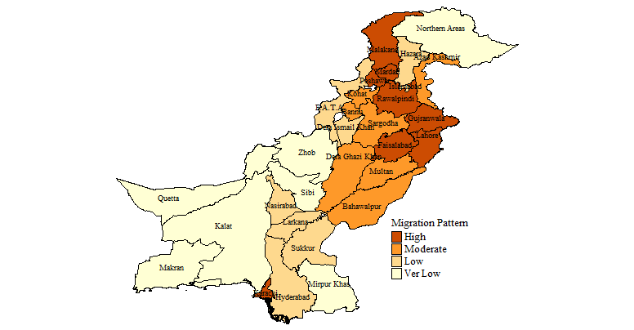
District Level Variations

Slide 8
Skill Composition
Source: BEOE, 2015

Slide 9
Share of Low Skilled Workers in Total Migration (Only Laborer and Agriculturist)

Slide 10
Methodology

Slide 11
Measuring migration Cost
Migration costs refer to the costs associated with workers’ national border crossing, and consists of recruitment fees (including sale of visas and other job-matching fees), document costs, and transportation costs. Migration cost components include:
  Documentation (passport, visa, medical exam report, security clearance),
  Transportation (internal and international),
  Training (skills and language);
  Recruitment (job information; brokerage fees; service charges) fees;
  Guarantee deposits; insurance schemes and welfare funds; informal payments; opportunity costs; and also the costs to borrow money to finance migration

Slide 12
Sampling Framework
Definition of migrant respondent
  The migrant who
    has worked or is working in Saudi Arabia or in UAE;
    went abroad (Saudi Arabia or UAE) in January 2011 or after;
    is a legal migrant worker (e.g. has gone through a regular channel);
    has returned home (to Pakistan) after the completion of their jobs at the time of survey, or, is visiting his family in Pakistan on holidays or has returned home with a new contract to go abroad soon;
    has worked or working in Saudi Arabia or UAE in low skilled categories of occupations like construction and agriculture sectors

Slide 13
Sampling Framework
Identification of respondents
  The major challenge for the survey was the identification of respondents as defined earlier
Steps involve in identification of respondents
  Step 1: Identification of Districts
    Pakistan is divided into four provinces and three regions including FATA, GB & AJK. There are more than 146 districts in these provinces and regions. More than 60% migrated from only 20 districts.
    We identified high migration districts on the basis of number of migrants went to GCC countries during 1981-2015.
    Survey is conducted in 6 high-migration districts

Slide 14
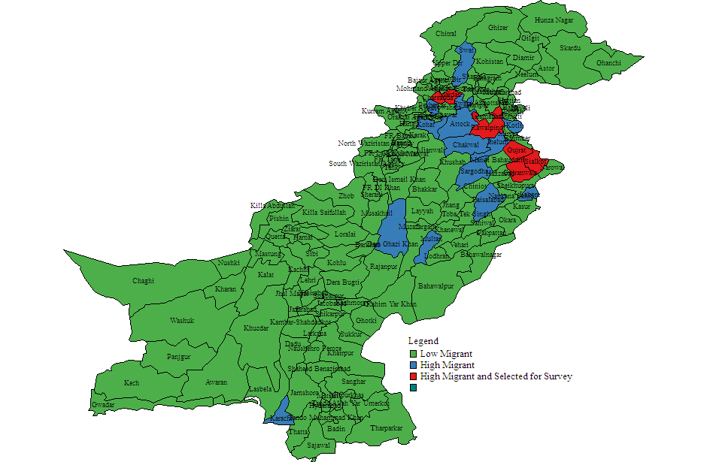
Sampling Framework
Selected Districts
  Rawalpindi and Gujrat from North Punjab
  Gujranwala and Sailkot from the central Punjab;
  Mardan and Charsada from KPK

Slide 15
Sampling Framework
  Step 2: Identification of targeted migrants
    Purposive/snowball sampling strategy was used
    To obtain required respondents an extensive listing process was undertaken with the assistance from key informants, migrants visiting the offices of regional Protector of Emigrants and return migrants
  Number of Respondents Listed in each District
District Name | No of Respondents
Sailkot | 150
Gujranwala | 151
Gujrat | 155
Rawalpinidi | 110
Mardan | 151
Charsada | 160
Total | 877

Slide 16
Data Collection Procedure
For data collection three teams were formulated:
  Team A for Central Punjab (Gujranwala and Sailkot);
  Team B for North Punjab (Rawalpindi and Gujrat);
  Team C for KP (Mardan and Charsada)
    Each team consists of two enumerators including head enumerator (supervisor).
One week training is conducted by the two trainers to develop the capacity of enumerators and supervisors
  The training of all enumerators helps to go thought each question in the questionnaire to ensure that the enumerators are able to guide the survey participants through each question

Slide 17
Data Collection Procedure
This training session covers the following tasks:
  Training of the World Bank’s Computer Assisted Personal Interviewing system (CAPI) and use of tablets to conduct survey;
  Field test 1 carried out in surrounding areas of Rawalpindi to review the performance of the enumerators along with the validity of questionnaire
  Field test 2 carried out after incorporating the suggestion regarding the adaptation of questionnaire and after improving the skill of the enumerators and supervisors.

Slide 18
Field Survey
620 interviews were conducted from migrants in selected districts, ensuring more than 100 interviews in each districts
Sample Distribution across Districts
District Name | Sample Size | Share
Rawalpindi | 109 | 17.58
Mardan | 101 | 16.29
Charsada | 104 | 16.77
Sailkot | 101 | 16.29
Gujrat | 103 | 16.61
Gujranwala | 102 | 16.45
Total | 620 | 100.00

Slide 19
Socio-economic characteristics of the sampled migrants
Indicator | Value
Average Age of Migrant (years) | 29.2
Marital Status (%)
Unmarried | 41.9
Married | 58.1
Educational Status(%)
No Education | 10.5
Primary Education | 33.1
Secondary Education | 46.5
Tertiary Education | 10.0
Average number of dependents (No.) | 8.0

Slide 20
Cost?

Slide 21
Cost: Average Migrant Cost (US$)
Regions | All Sample | Saudi Arabia | UAE
Pakistan | 3489 | 4290 | 2358
District wise
Rawalpindi | 3238 | 3442 | 2982
Mardan | 4548 | 4904 | 2590
Charsada | 3302 | 3858 | 2432
Sailkot | 3995 | 4663 | 2853
Gujrat | 3365 | 4464 | 1863
Gujranwala | 2640 | 4278 | 1896

Slide 22
Cost: Component wise
Components | Cost US $ |  |  | (as % share of total)
 | All Sample | Saudi Arabia | UAE | All Sample | Saudi Arabia | UAE
Visa Fee | 2823.6 | 3493.8 | 1818.4 | 80.9 | 81.4 | 77.1
Agent Cost | 271.3 | 342.5 | 164.1 | 7.8 | 8.0 | 7.0
International Transport | 249.4 | 248.2 | 251.1 | 7.1 | 5.8 | 10.6
Inland Transport | 60.7 | 73.9 | 41.1 | 1.7 | 1.7 | 1.7
Passport Fee | 46.2 | 48.3 | 43.1 | 1.3 | 1.1 | 1.8
Medical Fee | 45.5 | 60.0 | 23.9 | 1.3 | 1.4 | 1.0
Contract Fee | 30.8 | 27.5 | 35.8 | 0.9 | 0.6 | 1.5
Others | 14.6 | 22.3 | 3.1 | 0.4 | 0.5 | 0.1
Insurance | 10.9 | 10.9 | 11.0 | 0.3 | 0.3 | 0.5
Briefing Fee | 6.6 | 5.4 | 8.5 | 0.2 | 0.1 | 0.4
Clearance Fee | 0.9 | 0.8 | 1.0 | 0.0 | 0.0 | 0.0
Exit Fee | 0.9 | 1.1 | 0.6 | 0.0 | 0.0 | 0.0
Welfare Fund | 0.1 | 0.1 | 0.1 | 0.0 | 0.0 | 0.0
Total | 3489 | 4290 | 2358 | 100 | 100 | 100

Slide 23
Cost: Migration Cost against different financing sources
 | All | Saudi Arabia | UAE
Self Financed | 2922 | 3926 | 1907
Borrow Money | 3790 | 4444 | 2679
Source of Finance
Family Member | 3799 | 3182 | 4347
Friend/Relatives | 3677 | 4404 | 2400
Money Lender | 4180 | 4171 | 4244
Bank | 5030 | 6421 | 2247
Recruiter | 5038 | 6477 | 2519

Slide 24
Fundamental Causes of High Migration Cost
  Source of Job information and the functioning of a “visa market” in Pakistan
Source of Job | ALL | SA | UAE
Relative/Friend | 3776 | 4491 | 2204
Individual recruiter/ broker | 2482 | 4237 | 2813
Manpower agency | 1735 | 2666 | 2268
Other* | 3435 | 2700 | 1321

Slide 25
Fundamental Causes of High Migration Cost
Previous foreign employment experience

Slide 26
Fundamental Causes of High Migration Cost
  Wage wedge

Slide 27
Migrant Costs: Key Challenges
Identification of Respondent
  Law and order situation
  Choice criteria (only low skill)
  Time period (after 2011)
Cost estimates?
  Majority knows LUMP SUM not breakdown
  Role of Friends/Relatives
  Semi-illegal market for visas
    operate through Friends/Relative and individual agents
  Lesser job opportunities in home countries may increases the demand for foreign employment hence cost of migration

Slide 28
The Way Forward
The central conclusion of this analysis is that
  large benefits associated with the overseas migration of low-skilled workers are eaten up as visa fee by an unscrupulous group of people who trade in the selling of visas.
  But?
    How are these illegal profits collected and how this large semi-illegal market for visas works needs much more study?

Slide 29
The Way Forward
Pakistan has developed institutions overtime to regulate overseas temporary migration for employment.
The exploitation of low-skilled workers through visa trading in the presence of the official regulating machinery is extremely disappointing but also shows that the faith in government in solving problems may not be well placed.
Indeed the more controls are put in place the higher can be the costs which are extracted by those officials who are tasked with implementing these countries.
This points to the enormous challenges that any reforms to reduce these costs will face.

