Slide 1





Workshop on Migration Cost Survey
Institute for Labor Studies – Department of Labor and Employment
Migration Information Resource Center
10 April 2015
8:30 AM – 5:00 PM
The World Bank, Washington DC
MC7-100
November 16-17, 2015
8 May 2015
HAROLD M. CARBO
16 December 2014

Slide 2

Highlights of the CAPI system
Survey of Filipino Migrant Worker Returnees from Qatar
Philippine Sampling Framework

Slide 3
Conducting surveys using CAPI
Main activities of the survey process include: survey assignment, administration, syncing, and approval
Uploaded data were checked for: data entry errors, consistency of the total recruitment cost, unit and currency, ISIC and ISOC codes, and current wages for low-skilled workers
Some fields in the questionnaire were inputted in advance: the country where the interview is being conducted, the country of origin, place of birth and nationality
Survey of Filipino Migrant Worker Returnees from Qatar
Philippine Sampling Framework
Notes:
CAPI provides tool for (i) interviewers receive assignments and manage the completeness and quality of their questionnaires, (ii) field supervisors assign interviews, oversee the completeness and quality of interviewer outputs, and upload outputs for management review, and (iii) survey managers allocate workload across field teams and track the progress of survey operations.

Slide 4
Challenges
Survey of Filipino Migrant Worker Returnees from Qatar
Philippine Sampling Framework

Slide 5
Conducting surveys using CAPI
In the question regarding violation of rights, “long working hours” was not included in the options
Variations in the different migration systems among countries of interest should have been taken into account in developing the questionnaire
Encountered some invalid questions that needs fixing: the year of arrival in Qatar; and the current wage before and after tax
High variations were observed in the total recruitment costs
Survey of Filipino Migrant Worker Returnees from Qatar
Philippine Sampling Framework
Notes:
An FGD with stakeholders, e.g., recruitment agencies, POEA, workers, should have been undertaken before developing the survey instrument to ensure that the instrument appropriately captures the unique labor migration systems of different countries. Some questions/items in the instrument may not be applicable to all.
Among the reasons for these variations were attributed for the cost paid in medical expenses and local transportation. Respondents who entered Qatar as tourist were more likely to shoulder their visa and international transportation

Slide 6
Conducting surveys using CAPI
One major concern that was encountered during the data collection is inputting the industry classification during their prior work
Jobs prior to migration under information and communication; professional, scientific and technical activities; administrative and support service activities; and arts, entertainment and recreation are not listed under the ISIC field question
It would be helpful if the comments in the questionnaire were reflected in the extracted database
Survey of Filipino Migrant Worker Returnees from Qatar
Philippine Sampling Framework
Notes:
It seems that the ISIC for the type of work before is locked on the options under the industry classification during their current work (technical issue in the survey design)
In addition, some occupational classification is not reflected, hence enumerators were forced to categorize these under extraterritorial organizations and bodies.
Extracted comments can help in data cleaning and flagged nuances.

Slide 7
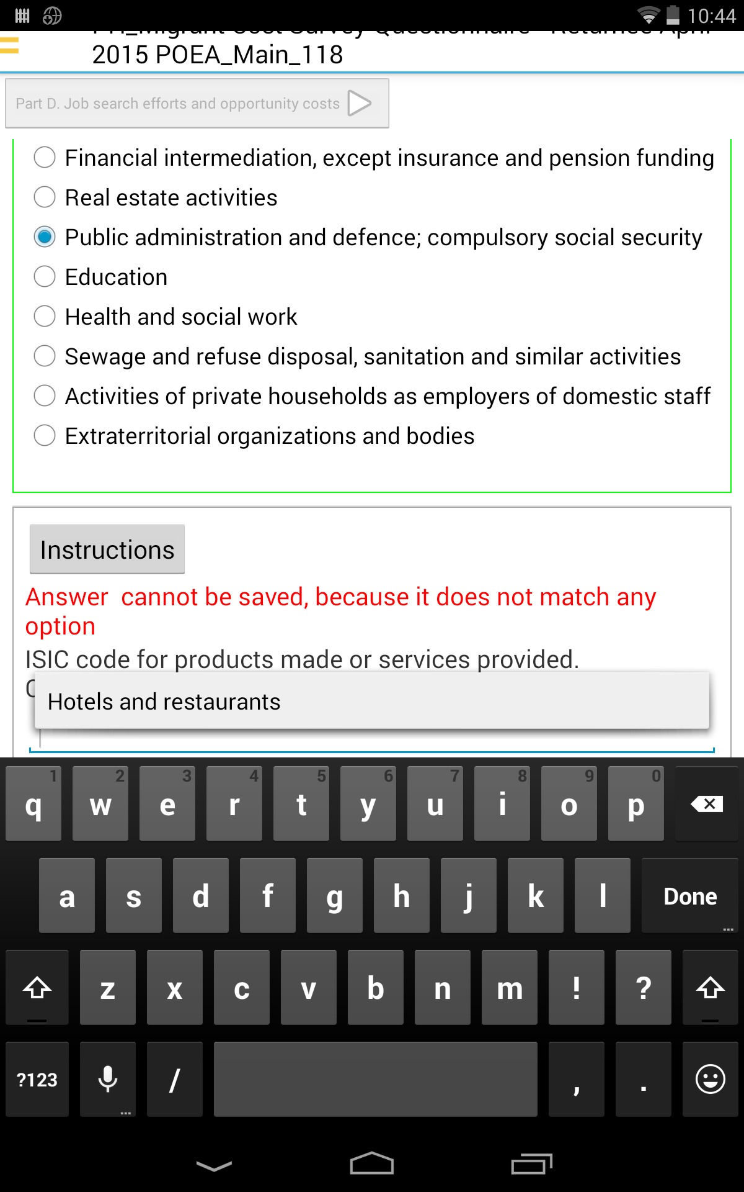
Conducting surveys using CAPI
Survey of Filipino Migrant Worker Returnees from Qatar
Philippine Sampling Framework

Slide 8
Lessons learned
Survey of Filipino Migrant Worker Returnees from Qatar
Philippine Sampling Framework

Slide 9
CAPI System
The strict survey controls were necessary for the efficient process of data operation
Built-in functions in the CAPI ease quality control: skip instructions, ranges and validation points
The survey provided an overview of the process that an OFW undergoes and the costs incurred during the application process
Survey of Filipino Migrant Worker Returnees from Qatar
Philippine Sampling Framework
Notes:
First, it support complex skip patterns and simple questionnaire navigation capabilities. Second, it offers a simple but powerful interface for enumerators via a easy-to-use interface for the recording and correcting of answers. Third, it provides built-in interview aids and interactive prompts to check the consistency and accuracy of errors.

Slide 10

Thank you!
www.ilsdole.gov.ph
facebook.com/ilsdoleofficial
twitter.com/ilsdoleofficial
instagram.com/ilsdoleofficial
Survey of Filipino Migrant Worker Returnees from Qatar
Philippine Sampling Framework

