Slide 1
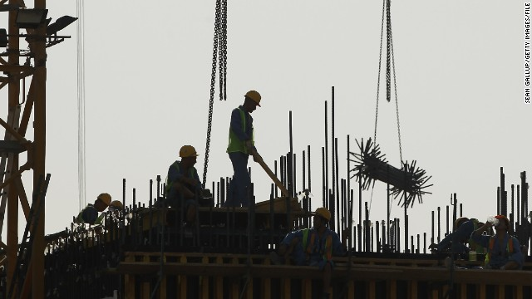
The State of Migrant Workers in Qatar and Recent Reforms in the Kafala System
KNOMAD
Workshop on Measuring Migration Costs for the Low-skilled
The World Bank, Washington DC
MC7-100
November 16-17, 2015
Mughal, Abdul Ghaffar
Qatar University

Slide 2
Outline
Background: Myths and Realities of the Living and Working Conditions of Migrant Workers in Qatar
Review of Findings from Previous Surveys by SESRI
III. Key Provisions of the Existing Kefala System
New Law 21 of 2015 Regulating the Entry, Exit, and Residence of Expatriates
Some Implications for the Planned Surveys

Slide 3
Background

Slide 4
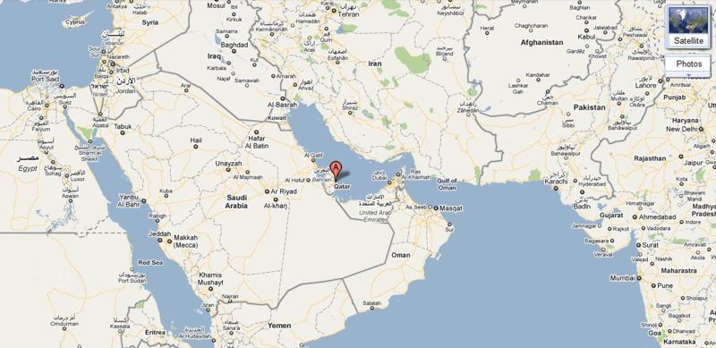
Qatar is a tiny city state. With 13.4 percent of global natural gas reserves, Qatar leads the GCC in the gas sector , and holds the third largest gas reserves in the world right after Iran’ 18.2 percent and Russia’s 16.8 percent.

Slide 5
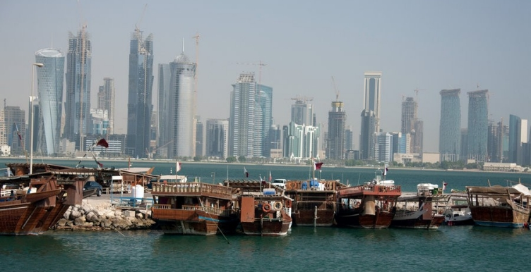
Qatari society has witnessed significant socioeconomic development over the last two decades, earning Qatar first place among Arab States in terms of Human Development Index or HDI (MOPDS, 2015).
With a PCI of $97,518 (2014), it is the richest country in the world.

Slide 6
Background
Qatar has the dubious distinction of having the highest proportion of foreign to native population, and of foreign to native workers, of any country in the world.
  As of 2014, the share of non-Qataris in the total population of Qatar was 88% (MODPS, p.26).

Slide 7
Review of Findings from Previous Surveys by SESRI

Slide 8
Surveys by SESRI on low-income Migrants in Qatar
SESRI has been conducting periodic surveys in Qatar, including surveys on migration since 2010, starting with Omnibus 2010: A Survey of Life in Qatar.
Findings from the previous surveys can serve as benchmarks to monitor changes
Notes:
SESRI has also been engaged in studies that address Qatar's and regional concerns such as the GCC single currency, life in Qatar, social capital in Qatar, education, gender, and migrant workers. Its collaborations with the Global Competitiveness Report of the World Economic Forum, World Values Survey and Arab Barometer Project have helped advance research in Qatar and the wider region, providing key statistics to help formulate policy and set national priorities.

Slide 9
Financial burden on Migrant Labor, under the existent structure of Kafala !
Findings from the 2013 Study by SESRI on low-income Migrants in Qatar:
Almost all (96%) of the low-income workers in the survey arrived under a formal work visa.
Low-income migrants in Qatar paid for recruitment agencies an average of US$1,031 for the right to work in Qatar for two years (with a median amount of US$933).
The Survey found that the three most significant sources of funding for these trips were:
Loans (reported by 45% of migrants surveyed)
household/family savings (30%)
personal savings (26%)

Slide 10
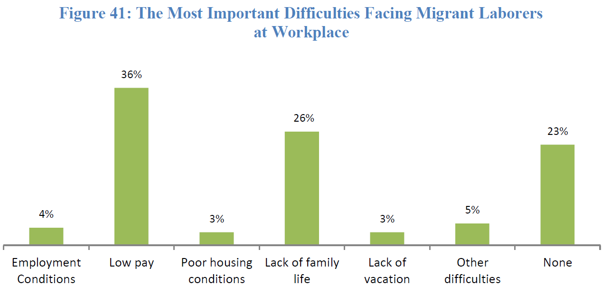
Under the Current Kafala System -- Migrant Labor Status
Source: 2012 SESRI-Annual Omnibus Survey

Slide 11
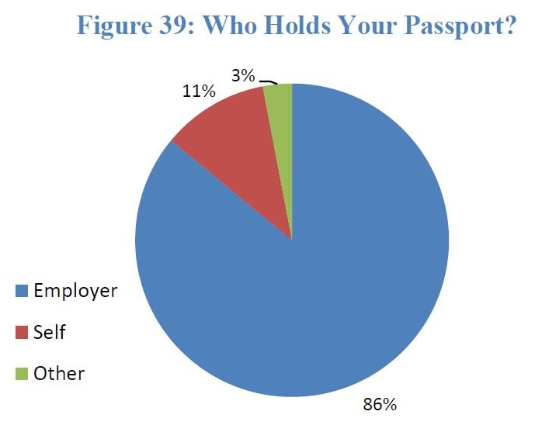
Under the Current Kafala System -- Migrant Labor Status
Source: 2012 SESRI-Annual Omnibus Survey

Slide 12
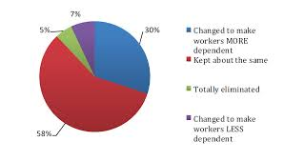
What is the attitudes of citizens toward reforming the Kafala System?
Source: 2014 SESRI Survey - Qatar Attitudes Towards Foreign Workers

Slide 13
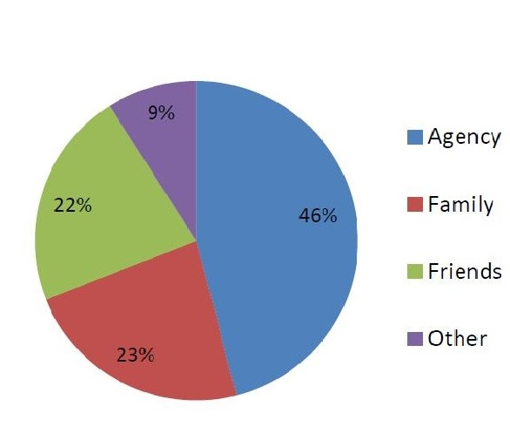
Sources of Recruitment
According to a 2012 Survey By SESRI, Most Foreign Labor who were asked how did you find your first job in Qatar, they answered through recruitment or placement agency.
84 % of these migrant laborers who used a recruitment or placement agency said they had to pay a fee.
Source: 2012 SESRI-Annual Omnibus Survey

Slide 14
Background: Flies in the Ointment
Qatar’s record on most growth indices, including higher education is impressive.
However, there are some flies in the ointment. These include
  high rate of youth unemployment,
  inefficiency,
  environmental pollution,
  extreme inequality, a conspicuous consumption culture,
  Socio-economic Discrimination
  Inequality
  The only available official statistic on inequality dates back to 2007 which showed a Gini coefficient of 0.41, ranking Qatar 129st among a list of 176 countries in the world, indicating an extremely high degree of inequality. Since then, there have been no published data on inequality.

Slide 15
Push for Qatarization
(Qatar National Vision 2030)
Two goals are enshrined in Qatar’s national vision (QNV 2030):
  Qatarization and
  creating a knowledge based economy (defined as an economy that derives its income from intangible assets)

Slide 16
Flies in the Ointment
While nationalization of the labor force in the expat-dominated private sector has long been the avowed goal of the resource-rich Gulf states, including Qatar, the trend in Qatar has so far consistently evaded the stated vision.
We believe this situation is due mainly to both
  structural conditions, and,
  government policies.

Slide 17
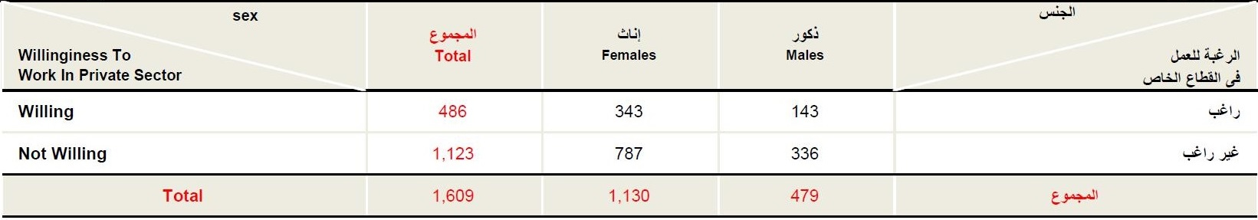
Market Segmentation: Willingness of Qataris to Work in Private Sector
Source: 2014- Labor Force Sample Survey. Ministry of Development Planning and Statistics

Slide 18
Quality of Life of Migrant Workers
The plight of migrant workers, particularly in the construction sector, has been well documented in both academic and advocacy literature.
Qatari government has undertaken some measures to improve the working and living conditions of migrant workers

Slide 19
Quality of Life of Migrant Workers
Qatar Foundation (QF) has announced Mandatory Standards for Migrant Worker Welfare for Contractors and Subcontractors which are enforced in all contracts to be awarded by QF and the Supreme Committee on Delivery and Legacy which is overseeing construction of infrastructure for FIFA 2022.
Standards for contractors working on World Cup ban companies from installing bunk beds and can only house up to four workers in a room.
The government has announced the construction of new housing units measures that are expected to improve the quality of life of migrant workers to be employed in future.
Notes:
http://dohanews.co/reports-suggest-looming-housing-shortages-qatar/

Slide 20
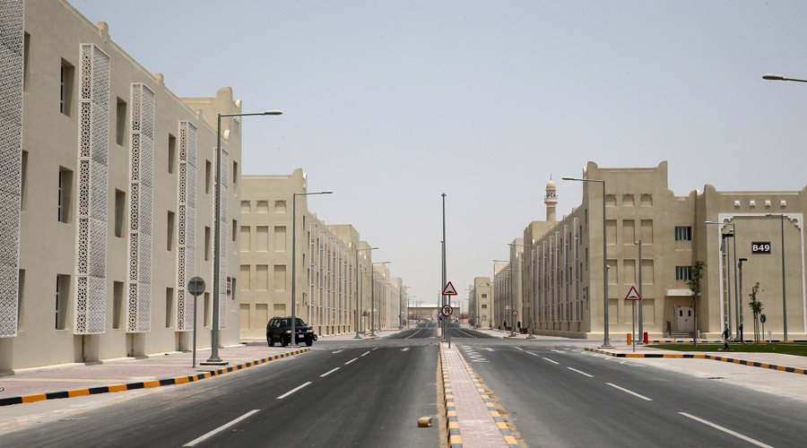
Qatar recently opened ‘Labor City’ for 70,000 migrant worker. The 55-building Labor City has recreational facilities, green spaces and a medical clinic, as well as WiFi access and outdoor telephone booths. It was built to reflect a “keenness (for) the welfare of all segments of society,” the government said in a statement on QNA.

Slide 21
Existing Legal Framework Governing Foreigners in Qatar

Slide 22
Relevant Constitutional Provisions
“Personal freedom shall be guaranteed and no person may be arrested, detained, searched, neither may his freedom of residence and mobility be restricted save under the provisions of the law.“
[Qatar Permanent Constitution]

Slide 23
Relevant Constitutional Provisions
“The employee-employer relationship shall be based on the ideals of social justice and shall be regulated by law.”
[Qatar Permanent Constitution]

Slide 24
Three Laws Defining the Existing Legal Framework Governing Foreigners in Qatar
The employment of migrant workers in Qatar is governed largely by three laws
Law 14 of 2004 (Labor Law);
Law 4 of 2009 (Sponsorship Law); and,
Law 15 of 2011 (Trafficking in Persons Law).
Law No. 15 of 2010 (Prohibition of workers’ camps within residential areas)

Slide 25
Law No. 4 of 2009
Regulating The Entry And Exit of Expatriates in Qatar And Their Residence And Sponsorship
"Expatriate" means any person that may enter the State other than a Qatari national.
Every Expatriate granted a visa to enter the state shall have a sponsor.

Slide 26
Law No. 4 of 2009
Regulating The Entry And Exit of Expatriates in Qatar And Their Residence And Sponsorship
No work Visa shall be granted to any expatriate that has already been granted a Visa to work in the State until the expiry of two years from the date of Departure.
  Implication for the definition of the Returnee for future surveys: the question on returnees should capture various categories: permanent returnees with follow-up questions on the reasons; returnees on short vacation (paid or unpaid); returnees in the two-year waiting category with follow-up questions on costs

Slide 27
Law No. 4 of 2009
Regulating The Entry And Exit of Expatriates in Qatar And Their Residence And Sponsorship
That the employer alone shall sponsor the Expatriate coming for work;
[Working expatriates] may not leave the state temporarily or permanently unless they provide an exit permit issued by the Residence Sponsor.

Slide 28
Residential Segregation
Reluctance of many local communities to house single male migrant workers within their communal space has resulted in the issuance of the law mandating segregated housing for single male workers in populated areas.
As in most Gulf cities, the young male workers are housed in labor camps by design to isolate them from the host community.
Law No. 15 of 2010, Prohibition of workers’ camps within residential areas
Recently, Qatari authorities have published maps detailing “no-go” zones for single male blue-collar migrant workers.

Slide 29
II. Details of Law No. 21 of 2015 to Regulate the Entry, Exit, and Residence of Expatriates
Notes:
Announced on 27 October 2015

Slide 30
Law Regulating the Entry and Residence of Arrivals
This law repeals Law No. 4 of 2009 Regulating the Entry, Exit, Residence and Sponsorship of Expatriates (Art. 49).
Changes the name of the “kafala law” with law regulating the Entry and Residence of Arrivals.
Replaces the Kafala System with employment contract.
The term recruiter is used in lieu of the term sponsor as well as employer.

Slide 31
Expatriates vs Recruiters
For the purpose of this law an expatriate is any non-Qatari person entering the State for the purpose of work, residence, visit, or any other purpose.
A recruiter is any entity, employer, head of family, or host, who recruits an expat or to whom the expatriate’s residence is transferred in accordance with the provisions of this law (Art. 1).[1]

Slide 32
Responsibilities of the Recruiter
Art. 19 lists the responsibilities of the recruiter which include:
  notifying the competent authority within fourteen days of the expatriate leaving his employment or refusing to leave the country after his residence permit has been cancelled or expired;
  bearing the expenses of the expatriate’s return to his country of origin;
  bearing the expense of burying the body of the expatriate or transporting it to his family.
    Implication for the Cost Survey

Slide 33
Easing of Exit Permit
Replaces the system of Exit Permit with a new automatic system working via the Ministry of Interior.

Slide 34
Easing of Exit Permit
According to Art. 7 of this law, the competent authority at the Ministry of Interior has to be informed about an expatriate’s intention to leave the country at least three working days before the exit date. The worker may exit the country as soon as the recruiter informs the competent authority of his approval of the request.
In case of any objection to the exit of the worker by the recruiter or the competent authority, the expatriate can approach the exit petitions committee. The Minister of Interior shall issue a decision to form such a committee and specify its jurisdictions and the procedures to be followed by it, in addition to its mechanism of work.
In case of an emergency for the worker, the petitions committee shall take a decision on his exit request within three working days.

Slide 35
Elimination of Wait Period for Re-entry
Terminates the two-year wait period outside the country for renewal of the work visa after its cancellation.

Slide 36
Easing of Transfer of Employment
Allows migrant workers to move to another job without the need of an NOC (No Objection Certificate) from the employer/recruiter after five years, or depending on the employment contract, whichever is less.
In accordance with Art. 21, the approval of the both the employer and the competent authority within the Ministry of Labor and Social Affairs is needed for the transfer of employment before the end of the work contract.
The expatriate may transfer to another employer immediately upon the expiry of his work contract in the case of limited term contracts or after five years in the case of unlimited contracts, subject to obtaining the approval of the employer and the Ministry.]

Slide 37
Transfer of Employment
The Minister or his nominee may approve the transfer of employment of any expatriate worker on a temporary basis if a suit is filed between him and his recruiter.
  In cases where the Labor Law does not apply to the expatriate worker, the Minister or his nominee may approve the transfer of the expatriate to any other employer in the event of abuse by the employer or as if deemed to be in the public’s interest. [Domestic Worker]
  For the same reasons, with the consent of the Minister or his nominee, and if requested by the worker and approved by the Ministry of Labor, the transfer of a worker who is subject to the Labor Law may be approved.

Slide 38
The So-called Free Visa
In accordance with Art. 23, recruiters may not allow their workers to be employed by anyone other than himself or herself or employ an expatriate who was not recruited by them.
The competent authority may however authorize a recruiter to lend the expatriate worker he has recruited to another employer for no more than six months, which may be renewed for another six months.
Moonlighting Option: The competent authority may also grant permission to an expatriate to work for another employer outside the regular working hours of his original employment provided that his recruiter agrees to it in writing. The approval of the Ministry of Labor must be obtained for workers who are subject to the Labor Law.

Slide 39
Ban on Passport Confiscation
Art. 8 requires the employer to return to the worker his passport or travel document once procedures for issuing or renewing his residence permit have been completed.
The only exception is if the expatriate requests his employer to hold onto the passport in writing. The employer shall return the passport upon the expatriate’s request.
Increases the penalty of confiscation of workers’ passport from 10,000 QR to 50,000 QR per each case.

Slide 40
Electronic Wage Payment System (WPS) for Wage Protection
Requires the employer to directly pay the wages electronically into workers’ bank acccount within the first week of the due date for guaranteeing more transparency and monitoring of on-time and regular payment.
Imposes penalties for delay in paying workers’ wages and for violating the accommodation’s standards.

Slide 41
Grey Areas

Slide 42
Grey Areas: Irregular Workers
The law does not address the status of migrants who are forced to become irregular or ‘illegal’ when the employer fails to renew or process their work permits on time.
There is an unknown number of workers in this situation.
This is a glaring omission as this subjects workers to extreme degree of vulnerability.

Slide 43
Implementation of the New Law
All expatriate workers will be given fresh job contracts by their employers after the new law regulating entry, exit and residency of foreigners in Qatar comes into force by 2016-end.

Slide 44
Recruiter or Reincarnation of Kafeel
The decree does not require any qualifications for “recruiters” allowing a citizen or legal resident to recruit workers.
Article 18 of the law simply says a recruiter is one “who is qualified to handle the legal responsibility of an expat.”
Critics argue that this ambiguous, unenforceable “qualification” carries forward the very core of Kafala; a system that transfers legal responsibility for the migrant worker from the state to private citizens (kafeels). As a result, a migrant’s legal documents cannot be issued or renewed without an employer’s consent.

Slide 45
Recruiter or Reincarnation of Kafeel
Critics argue that migrant workers’ dependency on the employers remains unaffected.
Migrants are likely to remain excessively bound to employers/recruiters, and is made vulnerable to the power granted to employers by state.
Critics argue that this is the the primary characteristic of the system that has long facilitated abuse and exploitation in Gulf States therefore remains intact.

Slide 46
References
Gardner, A., Pessoa, S., Diop, A., Al-Ghanim, K., Le Trung, K., & Harkness, L. (2013). A portrait of low-income migrants in contemporary Qatar. Journal of Arabian Studies, 3(1), 1-17.
Ministry of Development Planning and Statistics (MODPS). (2015). Fourth National Development Report.
SESRI.
Qatar Foundation. Mandatory Standards for Migrant Worker Welfare for Contractors and Subcontractors, Doha, Qatar Foundation, 2013. Available at http://www.qf.org.qa/news/news?item=128.
Alemadi, D. A. H., Rahim, H. A., Diop, A., Khan, M. N., Le, K. T., Elawad, E. F., & Wittrock, J. (2010). First Annual Omnibus Survey: A Survey of Life in Qatar. Social and Economic Survey Research Institute.< http://www. qu. edu. qa/sesri/surveys. php.
Al-Meezan: Qatar Legal Portal. Law No. 15 of 2010 Prohibition of Workers Camps within Family Residential Areas. Available at: http://www.almeezan.qa/LawArticles.aspx?LawTreeSectionID=8328&lawId=2510&language=en

Slide 47
Gengler, J., Tessler, M., Al-Emadi, D., & Diop, A. (2013). Civic Life and Democratic Citizenship in Qatar Findings from the First Qatar World Values Survey. Middle East Law and Governance, 5(3), 258-279.
Qatar Labour Law State of Qatar, 2004.
Qatar Law No. 4 of 2009 Regulating the Entry and Exit of Expatriates in Qatar and their Residence and Sponsorship
LESLEY WALKER (October 5, 2015). Qatar ministry publishes maps with ‘no go’ housing zones for workers. Doha News. Accessed online: http://dohanews.co/qatar-ministry-publishes-maps-with-no-go-housing-zones-for-workers/
KOVESSY PETER. (June 23, 2014). Housing supply not keeping up with population rise. Doha News. Available at: http://dohanews.co/reports-suggest-looming-housing-shortages-qatar/

Slide 48
Thank you
Questions?

