Slide 1
Findings from Household Surveys on Migration and Remittances Africa Migration Projet Sonia Plaza (The World Bank) February 12, 2015

Slide 3
Motivation
A review of 70 household surveys conducted during 1990-2006 found that migration and remittances data are spread across various sections of surveys but are rarely linked.
Main findings:
Migration modules are sometimes found in a separate sections. Other times, the topic of migration is added to other modules.
Most surveys collect data on the migration history of all household members above 10-15 years(typically); however, some collect information on household head only.
Most surveys collect data on the migration of household members since birth but some limit to preceding one year.
Remittances are captured as part of income and expenditures modules, but many of the surveys do not distinguish between remittances and other transfers.

Slide 4
Outline
Survey features
Sample characteristics
Main findings
Household characteristics
Housing
Asset and expenditures
Use of financial services
Return migration

Slide 5
Methodological Challenges
Comparability: changes in questionnaire and data collection
Data collection needs to be designed according to their objectives
Absence of a proper sampling frame
Fear of participation or to provide the information
Length of the questionnaire
Capacity and training of fieldworkers

Slide 6
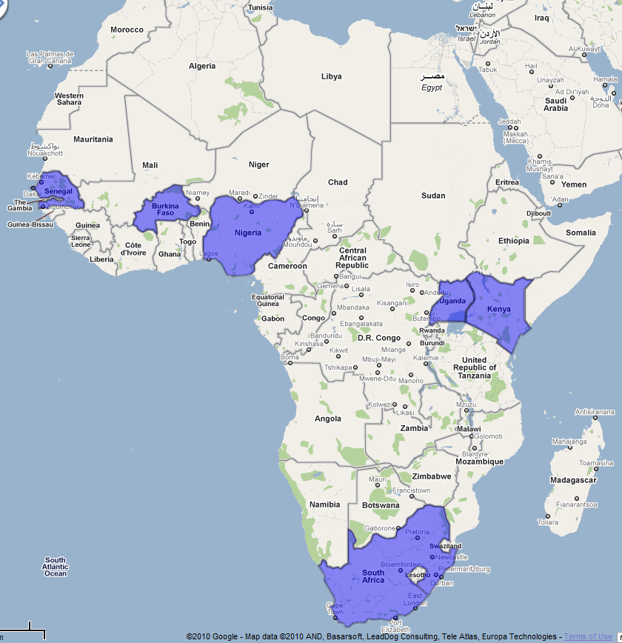
Household survey coverage
Senegal
Kenya
Burkina Faso
Nigeria
Uganda
South Africa

Slide 7
Basic survey features
Survey type
A single-round, cross-sectional survey was implemented as part of the project in six countries.
Information about households with internal migrants, international migrants, and no migrants.
Survey modules
household roster
housing conditions
household assets and expenditure
household use of financial services
internal and international migration and remittances from former household members
internal and international migration and remittances from non-household members
return migration.

Slide 8
Limitations of the data
Like all sample surveys, these household surveys only produce estimates that are limited by a number of factors.
Sample coverage – the sampling frame does not cover the whole population in all countries.
Sampling variability – all samples can differ from the population by chance (sampling error).
Sample bias – if the sample under/over-represents sections of the population the estimates may differ substantially from the population.
Amount of data collected - these surveys were not designed to provide reliable "economic" statistics such as unemployment rates and average earnings.

Slide 9
Remittances questions
Cash and in kind remittances: both
Who send the money: migrants (household member and non-household member)
Internal and international remittances
Channels (adapt to each condition)
Frequency (always include a time frame)
Purposes of the use of remittances

Slide 10
Main sample characteristics
Country | Level of statistical representativeness | Households screened | Target sample | Households successfully interviewed | Individuals interviewed
Sending country
Burkina Faso | 10 most important provinces for migration | 9,177 | 2,106 | 2,102 | 18,704
Kenya | 17 districts with largest concentration of migrants households | 7,373 | 2,000 | 1,942 | 8,372
Nigeria | Nationally representative | 8,075 | 2,000 | 2,251 | 13,414
Senegal | Nationally representative |  | 2,000 | 2,100 | 17,883
Uganda | Nationally representative | 24,618 | 2,000 | 1,961 | 9,138
Receiving country
South Africa | Main corridors: Limpopo/Gauteng | 6,760 | 2,028 | 2,012 | 12,247

Slide 11
Characteristics of migrants from select African countries
Household characteristics | Burkina Faso | Ghana | Nigeria | Senegal | Kenya
Age (middle 50 percent)
Migrants in OECD countries | 35 | 37 | 33 | 38 | 34
Intra-African migrants | 32 | 35 | 28 | 35 | 33
Internal migrants | 32 | 35 | 27 | 32 | 31

Slide 12
Characteristics of migrants from select African countries
Household characteristics | Burkina Faso | Ghana | Nigeria | Senegal | Kenya
Gender (percent male)
Migrants in OECD countries | 79 | 70 | 72 | 80 | 57
Intra-African migrants | 90 | 63 | 75 | 86
Internal migrants | 82 | 62 | 62 | 75 | 61

Slide 13
Characteristics of migrants from select African countries
Household characteristics | Burkina Faso | Ghana | Nigeria | Senegal | Kenya
Education (percent with given level of education)
Migrants in OECD countries | 52 secondary | 61 secondary | 45 tertiary | 44 tertiary | 47secondary
Intra-African migrants | 65 primary | 45 secondary | 38 secondary | 48 primary
Internal migrants | 45 secondary | 54 secondary | 49 secondary | 35 primary | 43 secondary
Reason for emigration
Employment | 78 | .. | 48 | 48 | 54
Education | 8 | .. | 29 | 29 | 38
Others | 4 | .. | 4 | 3 | 2

Slide 14
Main findings
Intraregional migration is still very predominant
Migration Patterns have changed
West Africa (e.g, Senegal to Spain)
East Africa (e.g, Gulf, Sudan, Dubai)
Although old destination countries are still important: Ivory Coast, South Africa and Gabon
Remittances: Unofficial channels still very predominant
West Africa
East Africa
Access to new technologies in rural areas increase internal remittances

Slide 15
Migrant destinations
 | Burkina Faso | Ghana | Nigeria | Senegal | Kenya
OECD | 2% | 21% | 17% | 36% | 30%
Africa | 46% | 5% | 6% | 16% | 11%
Internal | 52% | 74% | 77% | 47% | 59%
Total | 100% | 100% | 100% | 100% | 100%
Main destinations
Burkina Faso | Ghana | Nigeria | Senegal | Kenya
Côte d'ivoire - 85% | USA – 22% | USA – 24% | Italy - 26% | US - 34%
Mali - 8% | UK – 18% | UK – 19% | Spain - 21% | UK - 13%
Ghana - 1% | Other ECOWAS 16% | Germany 6% | France - 12% | Uganda - 10%
Gabon - 1% | Otaly 11% | Canada – 6% | Gambia - 10% | Tanzania - 5%
USA - 1% | Germany 8% | South Africa – 6% | Côte d'ivoire - 4% | Germany - 5%

Slide 16
Labor-market status of individuals, before and after migrating (percent)
Labor market status | Burkina Faso |  | Senegal |  | Nigeria |  | Kenya
 | Before | After | Before | After | Before | After | Before | After
Self-employed | 80 | 64 | 42 | 43 | 16 | 26 | 7 | 9
Student | 10 | 5 | 21 | 8 | 43 | 23 | 31 | 16
Housewife | 3 | 5 | 9 | 8 | 1 | 5 | 2 | 3
Full-time wage earner | 3 | 9 | 9 | 24 | 14 | 34 | 21 | 53
Part-time wage earner | 1 | 12 | 3 | 4 | 3 | 4 | 4 | 8
Unemployed | 2 | 2 | 9 | 3 | 22 | 4 | 33 | 8
Other | 1 | 3 | 7 | 10 | 2 | 4 | 1 | 3
Self-employed | 80 | 64 | 42 | 43 | 16 | 26 | 7 | 9
Notes:
Table 4.5 from Plaza et al (2011)

Slide 17
Use of remittances by recipient households, by source
Use | Burkina Faso |  |  | Kenya |  |  | Nigeria
 | Outside Africa | Within Africa | Domestic | Outside Africa | Within Africa | Domestic | Outside Africa | Within Africa | Domestic
Construction - new house | 25.7 | 10.1 | 2.6 | 11.2 | 27.5 | 1.3 | 5.8 | 0.0 | 0.1
Food | 23.5 | 34.9 | 48.7 | 12.8 | 14.5 | 29.7 | 10.1 | 20.1 | 1.0
Education | 12.4 | 5.9 | 9.4 | 9.6 | 22.9 | 20.5 | 22.1 | 19.6 | 4.5
Health | 11.3 | 10.1 | 12.5 | 7.3 | 5.8 | 7.0 | 5.1 | 12.0 | 10.6
Business | 10.4 | 2.6 | 2.4 | 3.9 | 8.4 | 13.0 | 21.7 | 20.1 | 11.1
Clothing | 5.0 | 0.7 | 0.7 | .. | .. | .. | .. | .. | ..
Marriage/funeral | 2.1 | 3.9 | 3.1 | 0.9 | 1.7 | 2.0 | 0.4 | 1.0 | ..7
Rent (house, land) | 1.4 | 0.6 | 1.7 | 5.7 | 0.4 | 7.4 | 4.4 | 4.9 | ..8
Rebuilding of house | 0.3 | 1.0 | 1.2 | 5.3 | 3.1 | 1.3 | 4.7 | 3.2 | 7.0
Cars/trucks | 0.1 | 0.0 | 0.1 | 1.3 | 1.0 | 0.4 | 0.0 | 0.0 | 0.5
Purchase of land | 0.0 | 1.4 | 0.1 | 8.4 | 7.0 | 1.3 | 24.8 | 16.6 | 18.2
Improvement of farma | 0.0 | 3.9 | 1.1 | 2.3 | 0.4 | 4.4 | .. | .. | ..
Investment | .. |  | .. | 24.2 | 0.6 | 4.7 | .. | .. | ..
Other | 7.7 | 24.9 | 16.3 | 7.2 | 6.6 | 6.9 | 0.8 | 2.6 | 3.5
Notes:
Table 4.7 from Plaza et al (2011)

Slide 18
Use of remittances by recipient households, by source
Use | Senegal |  |  | Uganda
 | Outside Africa | Within Africa | Domestic | Outside Africa | Within Africa | Domestic
Construction - new house | 7.0 | 0.7 | 0.0 | 2.5 | 1.6 | 0.4
Food | 52.6 | 72.6 | 81.9 | 7.6 | 9.7 | 12.4
Education | 3.6 | 2.3 | 4.6 | 12.7 | 14.5 | 20.2
Health | 10.7 | 7.3 | 2.9 | 6.3 | 14.5 | 24.8
Business | 1.3 | 5.7 | 0.2 | 7.6 | 9.7 | 2.1
Clothing | .. | .. | .. | .. | .. | ..
Marriage/funeral | 2.9 | 2.4 | 1.1 | 7.6 | 6.5 | 1.7
Rent (house, land) | 1.0 | 0.0 | 2.2 | 5.1 | 8.1 | 4.5
Rebuilding of house | 4.2 | 0.7 | 0.1 | 6.3 | 3.2 | 2.1
Cars/trucks | 0.2 | 0.0 | 0.0 | 2.5 | 0.0 | 0.0
Purchase of land | 3.0 | 0.0 | 0.0 | 3.8 | 4.8 | 2.1
Improvement of farma | .. | .. | .. | .. | .. | ..
Investment | .. | .. | .. | .. | .. | ..
Other | 13.5 | 8.3 | 6.9 | 38.0 | 27.4 | 29.8
Notes:
Table 4.7 from Plaza et al (2011)

Slide 19
Channels used to send remittances
Internal migrants
Channel | Burkina Faso | Ghana | Kenya | Nigeria | Senegal
Western Union | 1 | 0 | 1 | 3 | 5
Money Gram | 0 | 0 | 1 | 2 | 0
Other money transfer operator (MTO) | 0 | 0 | 0 | 2 | 0
Postal money order | 1 | 0 | 1 | 0 | 3
Direct transfer to bank account | 0 | 1 | 6 | 35 | 0
Bank as paying agent for MTO | 0 | 0 | 1 | 3 | 0
Foreign exchange bureau | 0 | 0 | 1 | 0 | 0
Credit union | 0 | 0 | 0 | 0 | 0
Travel agency | 1 | 0 | 0 | 0 | 0
Informal individual agents | 1 | 0 | 0 | 4 | 3
Mobile phone/telecom service providers | 0 | 0 | 60 | 0 | 1
Through friend or relative | 27 | 44 | 7 | 21 | 37
Courier, bus, or other transport | 3 | 0 | 1 | 0 | 12
Brought back himself during visit | 63 | 50 | 21 | 28 | 37
Pre paid cards/ATM card | 0 | 0 | 0 | 0 | 0
Internet money transfer | 0 | 0 | 0 | 0 | 0
Other | 1 | 5 | 1 | 1 | 2
Total | 100 | 100 | 100 | 100 | 100

Slide 20
Channels used to send remittances
Within-Africa migrants
Channel | Burkina Faso | Ghana | Kenya | Nigeria | Senegal
Western Union | 10 | 17 | 24 | 31 | 30
Money Gram | 1 | 6 | 12 | 3 | 1
Other money transfer operator (MTO) | 0 | 0 | 2 | 1 | 0
Postal money order | 3 | 0 | 2 | 1 | 6
Direct transfer to bank account | 0 | 0 | 11 | 12 | 0
Bank as paying agent for MTO | 0 | 0 | 1 | 18 | 0
Foreign exchange bureau | 0 | 0 | 2 | 1 | 0
Credit union | 0 | 0 | 0 | 0 | 0
Travel agency | 0 | 0 | 0 | 0 | 0
Informal individual agents | 3 | 0 | 3 | 4 | 4
Mobile phone/telecom service providers | 0 | 0 | 24 | 0 | 0
Through friend or relative | 64 | 43 | 9 | 15 | 41
Courier, bus, or other transport | 3 | 0 | 4 | 0 | 1
Brought back himself during visit | 15 | 30 | 8 | 13 | 14
Pre paid cards/ATM card | 0 | 0 | 0 | 0 | 0
Internet money transfer | 0 | 0 | 0 | 0 | 0
Other | 0 | 4 | 0 | 0 | 2
Total | 100 | 100 | 100 | 100 | 100

Slide 21
Channels used to send remittances
OECD migrants
Channel | Burkina Faso | Ghana | Kenya | Nigeria | Senegal
Western Union | 32 | 54 | 43 | 51 | 74
Money Gram | 9 | 6 | 20 | 5 | 6
Other money transfer operator (MTO) | 2 | 14 | 1 | 0 | 2
Postal money order | 0 | 0 | 1 | 0 | 3
Direct transfer to bank account | 0 | 2 | 8 | 12 | 0
Bank as paying agent for MTO | 2 | 0 | 8 | 11 | 1
Foreign exchange bureau | 0 | 0 | 7 | 0 | 0
Credit union | 0 | 0 | 0 | 0 | 1
Travel agency | 0 | 0 | 1 | 0 | 0
Informal individual agents | 0 | 0 | 1 | 2 | 2
Mobile phone/telecom service providers | 0 | 0 | 2 | 0 | 0
Through friend or relative | 18 | 18 | 4 | 13 | 10
Courier, bus, or other transport | 0 | 0 | 0 | 0 | 0
Brought back himself during visit | 34 | 4 | 2 | 5 | 1
Pre paid cards/ATM card | 0 | 0 | 0 | 0 | 0
Internet money transfer | 0 | 0 | 0 | 0 | 0
Other | 2 | 2 | 0 | 0 | 0
Total | 100 | 100 | 100 | 100 | 100

Slide 22
Return migration in selected African countries (percent)
 | Burkina Faso | Nigeria | Senegal
Returnees as a share of all migrants | 25 | 3 | 9
of which:
Returned in less than 4 years | 67 | 69 | 32
Returned in 5–15 years | 16 | 23 | 2
Returned after more than 15 years | 16 | 8 | 66

Slide 23
Housing status – own (%)
Migration Status | Burkina Faso | Nigeria | Senegal | Ghana
Domestic Migrants | 92% | 82% | 88% | 51%
Within Africa Migrants | 97% | 73% | 91% | 44%
OECD Migrants | 83% | 67% | 85% | 33%
Non-Migrants | 93% | 73% | 73% | 45%

Slide 24
Construction material of dwelling
Brick/stone | Burkina Faso | Nigeria | Senegal | Ghana
Domestic Migrants | 9% | 48% | 65% | 30%
Within Africa Migrants | 4% | 82% | 48% | 50%
OECD Migrants | 48% | 91% | 90% | 69%
Non-Migrants | 5% | 41% | 70% | 46%
Mud | Burkina Faso | Nigeria | Senegal | Ghana
Domestic Migrants | 90% | 45% | 21% | 63%
Within Africa Migrants | 95% | 16% | 42% | 43%
OECD Migrants | 48% | 6% | 3% | 24%
Non-Migrants | 91% | 56% | 19% | 49%

Slide 25
Summary of main findings
Migrants are young people
Mean reason for migration is economic
Senegal and Kenya: brain drain?
Main use of remittances: consumption, health, education and housing
New technologies are penetrating in rural areas in East Africa
Return migration is high for seasonal/circular migration. Very little for others.

