Slide 1
Improving Access to Remittances and other Financial Services through Digital Solutions
February 12, 2016, KNOMAD Workshop
Lotte Nordhus, GIZ
Mayada El-Zoghbi, CGAP

Slide 2
Background for the Study: German DC project
Improving Access to Remittances and other Financial Services through Digital Solutions
Commissioned by: German Federal Ministry for Economic Cooperation and Development (BMZ)
Implemented by: GIZ
Special initiative to support hosting communities and refugees
Funding: EUR 2.3 million
Timeframe: 2015 - 2018

Slide 3
Objectives
Improve the access of refugees and low-income Jordanians to digital payments/financial services
Increase the usage of digital payment/financial services by the target group
Improve the quality of digital payment/financial services for the target group (cost-effectiveness, meeting demand, efficiency, consumer protection)
Improve the legal environment of international and domestic digital payment/financial services (KYC, cards, mobile, internet)

Slide 4
Planned Activities
Research (CGAP)
Pilot (PPP)
Policy, Regulatory Advice
Dialogue, Knowledge Sharing
Financial Education
2015 2016
2017 2018

Slide 5
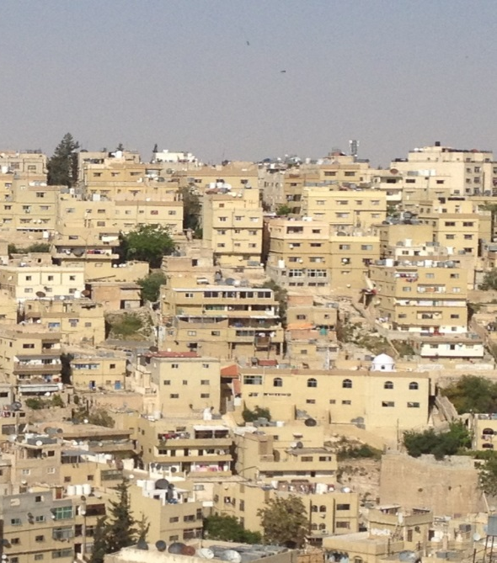
Context/Case
Syrian refugees and low income Jordanians receiving remittances from inside and outside Jordan
Hosting communities: focus on urban areas (Amman, Mafraq, Irbid)

Slide 6
Context/Case
Financial characteristics of the target group
Only 25% of Jordanians have a bank account
Refugees are not allowed to open bank accounts
High mobile penetration for both Jordanians and refugees
Low level of financial literacy, unbanked/financially underserved
Culture of informal saving among Syrian refugees
Female headed households are more likely to receive remittances and to invest the money sustainably
Financial services in use
Cash assistance/social transfers through card-based and iris-scan systems
Exchange office services to send and receive remittances -> both internal and international P2P transfers are cash-based
Informal channels to send and receive remittances

Slide 7
Formalizing and digitizing payment services: Potentials and challenges for the project
Potentials | Challenges
Gateway for broader financial inclusion; thus usage of and access to further financial services Accessible Transparency: AML/CFT Private sector open for market innovations Central Bank has established platform for national digital payments | Consumer behavior/trust in services could prevent take-up (e.g. moving from cash to digital) Informal channels widespread/difficult adoption of formal channels Consumer protection/data privacy Regulation for international digital payments Licences/take-up for digital services

Slide 8
Comprehensive Baseline Study (CGAP)
Market assessment in Jordan (micro-level analysis: supply and demand)
Potential Methods: Demand surveys and focus group discussions
Analysis of economic behavior of the target group in Jordan (micro-level analysis: choices and usage)
Potential Methods: interviews and focus group discussions
Notes:
COMPONENT 1:
analysis of both national and international remittances services supply (market share/landscape/patterns, attributes of target market) and demand; challenges to use existing services in Jordan for Syrian refugees and unbanked Jordanians in terms of access, usage, price features and quality of products.
COMPONENT 2:
- evidence on the reasons for clients to choose formal or informal, cash-based or digital remittance channels and clients’ perceptions and needs. Drivers of behavioral change (e.g. cash to digital; price features that attract or detract consumers)

Slide 9
Comprehensive Baseline Study (CGAP)
Analysis of the economic and regulatory environment in Jordan for digital cross-border remittances (macro- and meso- level analysis)
Potential Methods: desk research, analysis of regulation and legal framework documents, expert interviews
Analysis of international remittances corridors, market assessment on the sending side (sending country analysis)
Potential Methods: secondary data analysis, remittances services market assessment for selected focus corridors
Notes:
COMPONENT 3: This study component will take into account the demand, supply, policy, and regulatory environment for digital remittances (including taxes and agents), focusing on barriers for digital cross-border remittances. It will identify the economic policies related to remittances services and their potential impact on digital financial services. The study will provide recommendations on reforms needed that could facilitate digital cross-border remittances products to become fully functional in the selected corridors and for the selected products. This work stream will entail close collaboration with GIZ country teams in Jordan and the Jordanian project partners.
COMPONENT 5: The research will provide a detailed overview of remittances volume of international remittances corridors used by the target group (bringing together data on formal and informal remittances). In close consultation with GIZ project staff in Jordan, the research will select one or several focus sending countries. For these focus sending countries, a remittances services market assessment will be realized.

Slide 10
Potential challenges for data generation
Access to the target group and trust
Remittances and financial issues as a sensitive topic: e.g. refugees do not want to talk about financial issues due to fear of getting less cash assistance
Informal transfer systems: people providing informal services would put their business at risk when they talk about it
Researchers
Finding trained researchers/companies with local knowledge/ experience on both refugee and remittances issues
Secondary Data
little data on financial inclusion of refugees
No reliable data on volume of remittances sent to and from Syria (both formal and informal)
Different official statements with regard to refugees (e.g. on the number of persns residing in Jordan)

Slide 11
Questions?
Recommendations for data generation and analysis?
Thank you very much!
Lotte.nordhus@giz.de
Melzoghbi@worldbank.org

