Slide 1

Remittances as Informal Aid
Micah M. Trapp, PhD
Workshop on Measuring Remittances Sent to and from Refugees and IDPs
World Bank
February 12, 2016
Research Funded by the National Science Foundation

Slide 2
Questions/Objectives of the study
What impact do transnational remittances have on refugee livelihoods and migratory options and decision-making processes?
  Do remittances improve overall well being of refugees in a camp setting?
  How do remittances influence transnational social relations and systems of social status?

Slide 3
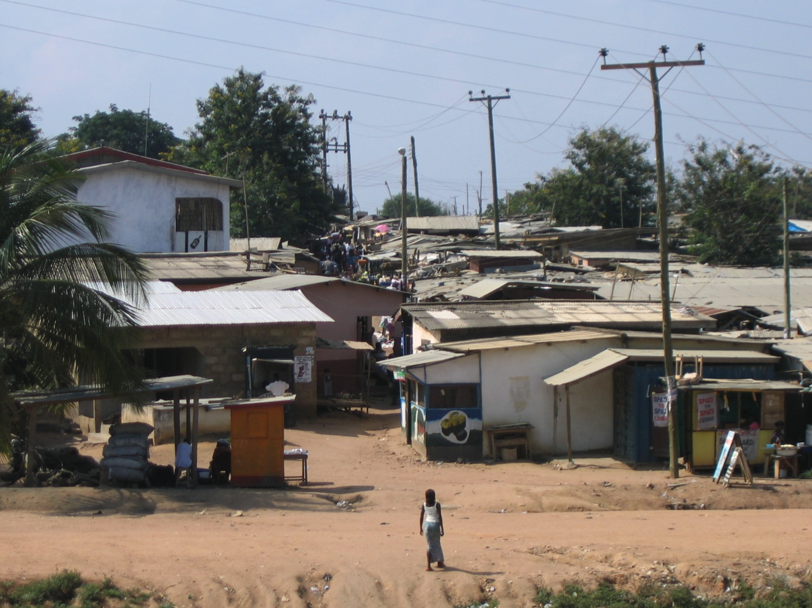
Case study:
Buduburam Liberian Refugee Camp, Ghana

Slide 4
Data: Mixed-methods ethnographic research
Household survey and social resource map (135)
  including measure of household food security status
Semi-structured household food economy interviews (28)
Stakeholder interviews with eleven stakeholders (11)
Focus groups on social status and resource allocation (3)
Daily household economy record-keeping for one month (2)

Slide 5
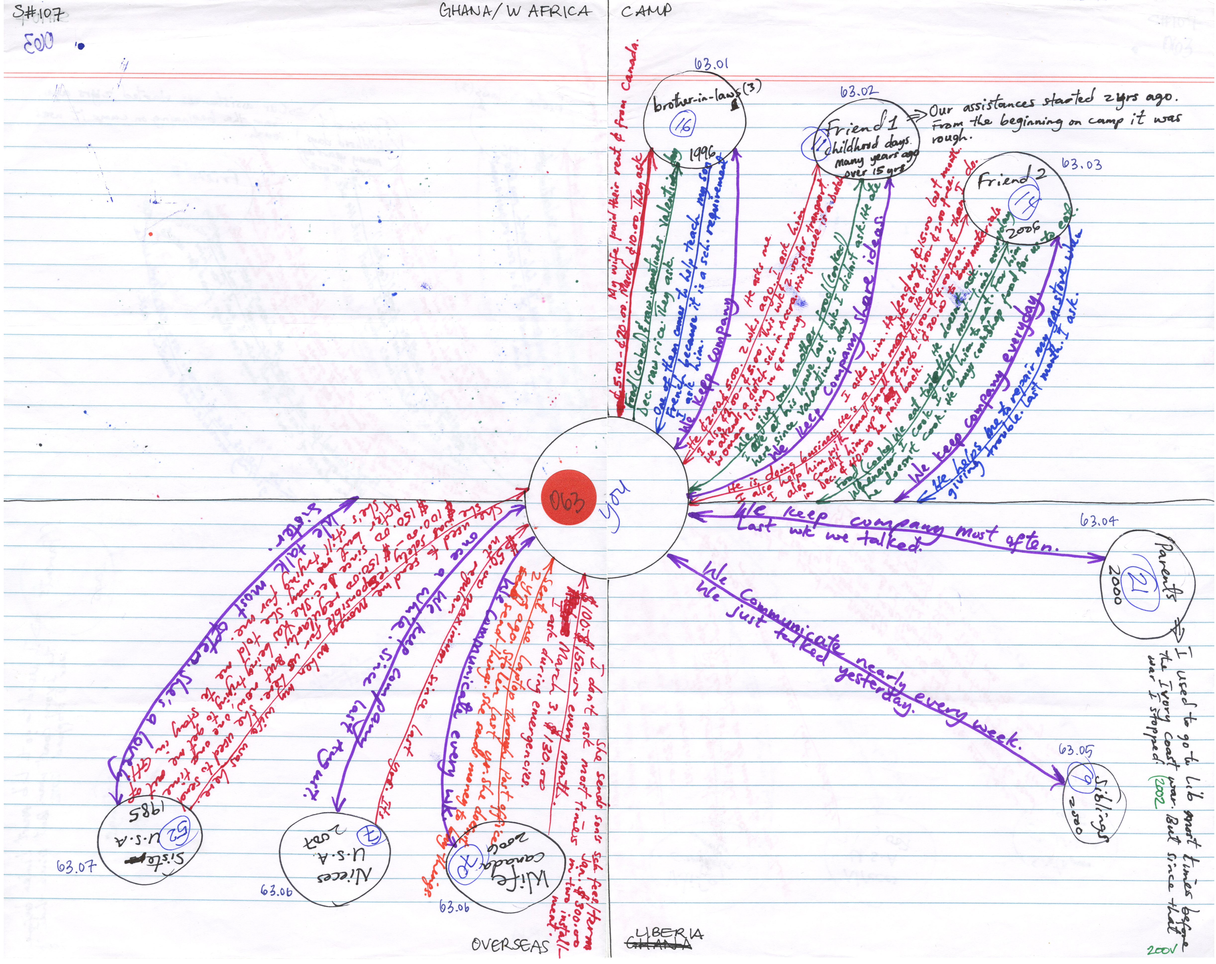

Slide 6
Remittances
73% (99) received remittances
37% (50) received remittances regularly
  every month or every other month
Regular remittances ranged from US$50 to $1,000.
Use of targeted remittances
  food; school fees; emergency; holiday; travel
Becoming a remittance sender to develop Liberia

Slide 7
Findings:
Remittances were viewed as a source of individual and collective development, but regular remittances did not always result in improved well being
Destabilizing Factors
Global economy –> job loss
Irregular/inactive remittances
Shifting ideas of personhood, social obligation, and responsibility
“Family money” – unequal/disingenuous distribution of remittances

Slide 8
Challenges
Obtaining specific figures for monetary exchanges
  Limited data set on last monetary resource exchanges
Defining units of analysis
  Individual remittances
  Households – defining, supporting
Time-consuming data collection
  Must be paired with other data sets
Reliability of data
  Refugees were (understandably) not always forthcoming with information about remittances received
  Fabrication of data on multiple levels

Slide 9
Methods used for data analysis
  Coding of household food security status
Descriptive statistics on remittances
Qualitative analysis
  Household summaries
  Identification and coding of risk factors, perceptions on remittances
Analysis of maps (ACCESS)
  Code for reciprocity
  Code for geographic concentration of resource exchanges

Slide 10
Lessons learnt
Importance of distinguishing research from programmatic (resettlement, repatriation) interviews
  Innovative methods
Participant-observation, follow-up interviews, and triangulation of data to improve reliability
Benefits of collaborative research
  Need for quantitative expertise
  Inclusion of refugees in research design and implementation
On-going training of research team

Slide 11
Further research
Scale of study ->
  Development of survey instrument to assess nature and impact of remittance income and exchanges
How are second tier remittances distributed in a camp setting?
  Systematic data collection on second tier remittances
Do the cautionary findings on the impact of remittances at the Buduburam camp apply to other refugee populations?

