Slide 1
Remittance Data in LSMS Surveys
DIANE STEELE
Surveys and Methods Group
Development Data Group
The World Bank
Workshop on Measuring Remittances
February 12, 2015

Slide 2
Living Standards Measurement Study Surveys (LSMS)
Purpose: Study household behavior, welfare, interactions with government policies: determinants of outcomes, and linkages among assets/ characteristics of households and actions of the government.
Started in 1980s by WB + academia + practitioners, over 110 surveys done in 40 countries
Topics include (inter alia)
  Hhld composition - Consumption
  Education - Agriculture
  Health - Hhld enterprises
  Labor - Transfers/Remittances
  Migration - Income
  Credit Use - Household Enterprises
  Housing - Shocks/Strategies
Supported by World Bank, UN agencies, IADB, bilaterals, governments

Slide 3
Transfers/Remittances
The aim of this section is to ascertain whether household members receive money or other gift items from organizations or people outside of the household.
  Within the country
  Overseas
Also, to find out who sent the money or gifts and the purposes they are meant for.

Slide 4
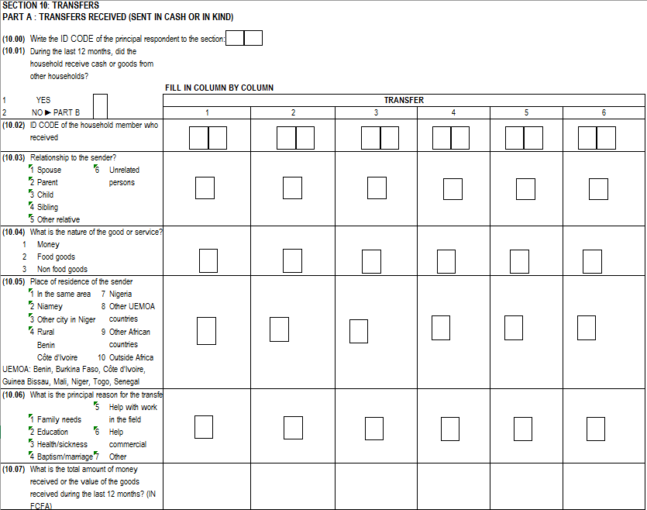
Transfers/Remittances

Slide 5
Migration
Internal Migration
International Migration
Family members living away from home

Slide 6
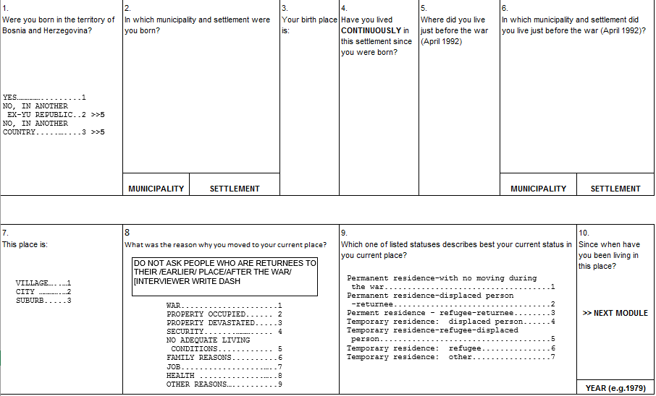
Migration

