Slide 1
Brainstorming session on
improving evidence
10 years ago - “remittances, the new development mantra”
Today - cash, the new humanitarian mantra
Notes:
e.g. WV has 3 major strategic initiatives for humanitarian department cash, urban, protracted conflicts/crises
These are quite relevant to our workshop today
I think there are some fields of study/practice which offer some collaboration potential to help address the challenges we’ve been discussing.
At the least, humanitarian actors are a partner that might help your field work, but they are also as a key target audience for impact of your research.

Slide 2
    Fragile, protracted, urban
chronic protracted contexts of conflict, at the bulk of humanitarian needs and intervention increasingly urban
debate about Honduras, El Salvador, Guatemala
strong correlation between these and high remittance recieving
Notes:
20 million refugees (maybe 50% of which are in 2 crises?)
but there’s 40million IDPs
and possibly a large pop. of unrecognised IDPs… e.g. cities in L.America

Slide 3

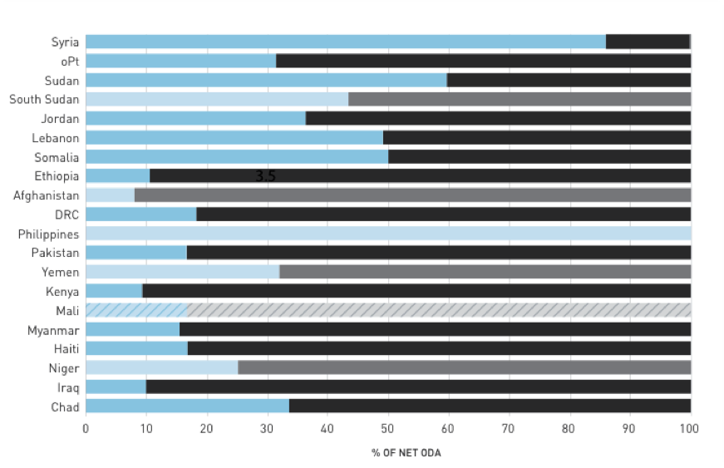
Notes:
This is a chart of the main humanitarian contexts (which does not change quickly)
Red circles are notably high remittance receiving countries
Chart is of % of overall foreign aid which is either officially humanitarian (blue) or not (black).

Slide 4
  Why are we here? Why do we want to know more about remittances to IDPs/refugees?
is it really strictly only about remittances?
or is it understanding needs (and help) people in crisis (who are moving about and need to transfer money)?
Notes:
As Patricia mentioned in the last session, it’s good to consider objectives and what we’re about. \\Why do we wan
I think this is important because it helps to consider who our audience is for the research.
If it’s the latter, then I think it will be useful to consider engaging with humanitarian practitioners working on cash (particularly in urban contexts) and social protection – there share the same objectives and are experiencing the same challenges we’ve been discussing in researching remittances

Slide 5
Humanitarians are furiously trying to scale up cash transfers:
    learn how financial services and technologies work
    learn about financial regulations
    learn how to engage the private sector (Mastercard, Visa and other transfer agencies)
    how to overcome technical and policy barriers to transfers

Slide 6
Who should we support?
  how do we better measure and understand livelihoods of displaced?
  who are most vulnerable/who is most in need of cash?
  how do we find, identify and target them (particularly in cities)?
  how do we understand them in context of host community?
Notes:
Humanitarians thinking about cash are asking who should we support
Or to improve the grammar, “to whom should we prioritize giving cash?”
Humanitarians trying to serve IDPs and refugees have big challenges
do we have a census of everyone? how do we register everyone?
how do we understand people’s livelihoods and needs (if we ask them they’ll just say they don’t have anything and no income)
we can’t help everyone, how do we target the most in-need? How do we compare them to the community hosting them?
argh! they’re moving all over the place! if only they would stay in camps it would be so much easier for us to give them stuff and keep track of them…

Slide 7
How do we give people money?
  how do we transfer money efficiently, overcome regulatory barriers to cash transfers? (taxation!?)
  how do we deal with identification? KYC, AML…
  how do we avoid getting arrested (here or in the USA) for allegedly funding terrorists?
  how do we safeguard and manage data to protect recipients?
Notes:
SG has just made a statement that cash should be our default response and implying that if it is it will be an order of magnitude change required
but how? humanitarians know how to give goods and services, giving out money is not their expertize

Slide 8
How do we help them receive it?
  how do we help people overcome access barriers?
  get them bank accounts or access to mobile money?
  get them identities/identification?

Slide 9
How do we report back to donors?
  what did they spend the money on?
  how can we enhance impact? link to safety nets, microfinance, improve access to mobile money services, and improve remittance flows?
Notes:
So, the questions that humanitarians are asking are quite similar to what we need for remittance research with similar challenges
And arguably are key influencers of policy in certain contexts, and thus a group that remittance researchers wanting research-impact should involve

Slide 10
Opportunity?
Common challenges and interests with humanitarians working on cash (and urban and S.P.) - understanding income and transfers
As cash interventions go to large scale there will be opportunities for data and may have impact on remittances (per GIZ presentation)
Major donors’ and humanitarians’ interest in cash may be something to use to get support for remittance research (field support, funding)
Notes:
general purpose unconditional cash transfers at scale will be forced to use systems that recipients already or will use for other things (remittances) which should be an opportunity (challenging) for data collection if we work out the ethics etc.
and humanitarian donors want to cut out the middle man and go straight to funding cash safety nets
Humanitarians are working with the same private sector actors (Western Union etc.) that are here today.
And indeed with the World Bank too – just not this department. World Bank is working with the humanitarian community through the IASC and WHS (S.P.&Labour, DRM) to better understand cash transfers and link to safety nets.
It would be good to collaborate on this more as we have a similar/overlapping set of knowledge needs, so we should be able to work together to consider the challenges in gathering and using data at the least,
and ultimately I think have some overlapping objectives, so it would be good to involve these others in the design of the research so that we can maximise the impact it has
Also, as this are difficult places, you may need support of humanitarians to do the research AND you may need funding – so if we make the connection between this work and their present major focus on cash, it may get such support or funding for more remittances research

Slide 11
HPG studies 2006
humanitarians often fail to recognise and understand affected people’s own means and capacities (such as remittances)
remittance disruption can be devastating; remittances may be crucial to enduring, recovering from disasters
focused on established remittance receiving populations affected by crisis

Slide 12
Implications from studies
Better understand context and people’s livelihoods and economics
Promote flows through reestablishing communications and access: support identification, telecommunication and family tracing
Make interventions complementary to affected people’s lives and livelihoods: use cash, don’t inhibit mobility through conditions, don’t create parallel transfer systems, don’t impose conditionality
Advocate for remittance promoting policies of public and private sectors: waiving fees, visa waivers after disaster; reducing costs, barriers, improving efficiencies generally
Advocate for refugee rights: self-reliance and movement

Slide 13
Challenges
very sensitive and difficult to ask about income, let alone from abroad (one team chased, arrested) in a crisis setting
chronic, protracted more so, especially in short time; best results take long time, longitudinal
may be difficult to distinguish and categorise people, particularly ‘economic migrant’ vs ’forced displacement’
Notes:
big methodological challenges to understanding income and expenditure
Longitudinal study is really necessary
security is a problem even - one research team spent the night in jail after being chased out of a village
Studies used a wide variety of methods – FGDs of remitters and receivers, interviews with money transfer agents, one study was based on surveying people leaving money transfer office,
Interesting that since this work, the lit. review today suggests that not very much has happened since.
Should be an opportunity today with donor and humanitairan community interest so much on cash to get some support/engagement from them on this

