Slide 1



Improving the Evidence Base:
Potential Role of Remittance Price Comparison Websites
February 12, 2016
KNOMAD Workshop on Measuring Remittances
Sent to and from refugees and IDPs
Alana Fook and Marco Nicolì
Lotte Nordhus
Charlie Gillig

Slide 2
Existing data, possible implications and challenges:
Content
World Bank Remittance Prices Worldwide (RPW) Database remittanceprices.worldbank.org
German government-led portal for migrants, GeldtransFAIR.de
US-based portal for migrants, RemitRight.com

Slide 3
Types of data from the three websites
Overview
Price developments and conditions and comparison among countries
Product and provider availability
usage of comparison websites by migrants
profiles of the users
Provider choices of users
RPW provides data analysis
relevant for national websites that offer services to migrants
relevant for portals that are linked to provider‘s websites (e.g. RemitRight)

Slide 4
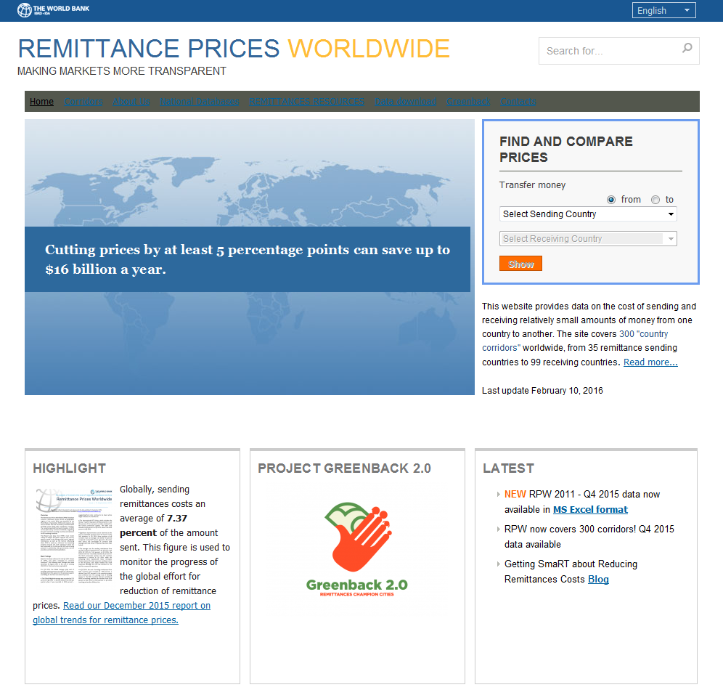
Introducing Remittance Prices Worldwide (RPW)
I. RPW
RPW Basics
Launched in 2008 by the World Bank
Served as the primary source of data to track progress towards G8- and G20-endorsed 5x5 objective
Remains a key tool to measure the cost incurred by remitters when sending money along major remittance corridors
Coverage was recently increased from 227 corridors to 300
WB also certifies other national, regional and private sector databases
35
Sending
countries
RPW Coverage
Q4 2015
99
Receiving
countries
300
Corridors

Slide 5
RPW Coverage of Forced Displacement:
Refugees
I. RPW

Slide 6
RPW Coverage of Forced Displacement:
IDPs
I. RPW
*RPW covers international remittances (cross-border, person-to-person transfers of relatively low value) so transfers concerning refugees are likely to be more relevant, though IDPs may certainly receive remittances from outside the country.

Slide 7
RPW Data
I. RPW
What data can we extract?
What could it mean?
Number and type of Remittance Service Providers (RSPs) serving particular corridors
Number, type and relative costs of services offered to send money to and from countries affected by forced displacement
Range of average total cost in a given corridor or for a particular type of service
These data points could be interpreted to give an indication of several characteristics of the market, including:
Market size
Level of competition
Degree of innovation

Slide 8
Challenges with Interpreting Data
I. RPW
RPW does not include ALL available services for a given country or corridor, rather the aim is to represent the market trends
It is difficult to distinguish which services are used by refugees and IDPs, so average costs may not reflect realities
Number, type of RSPs facilitating transfers to and from affected countries, as well as the number, type and cost of their services are a function of several factors, including:
  Payment system infrastructure in sending and receiving countries (quality, accessibility, interoperability)
  Legal and regulator environment (access to payment system, licensing requirements, AML/CFT requirements etc)
  Levels of financial inclusion and education in both countries
  Migration patterns, including economic migration and forced displacement
  Time of the year (cost only)

Slide 9
GeldtransFAIR.de:
Existing Data and Limitations
II. GeldtransFAIR.de
Existing Data
Quantitative Data
Price developments / average and range per corridor, disaggregated by method of transfer, product type, etc.
Development of provider availability /number of MTOs per corridor
Usage of comparison websites/clicks per corridor
Qualitative data:
user comments on Facebook and via E-Mail
interviews with remittances senders using the platform on events

Slide 10
II. GeldtransFAIR.de
GeldtransFAIR.de:
Existing Data and Limitations
Limitations
Prices, conditions and providers updated every 2 months
Average prices of all providers in the list, no data on providers used by migrants in Germany
No data on internal remittances
corridors relevant to refugees and IDPs only included if a large migrant group is residing in Germany
List of MTO without online presence might not be exhaustive
No quantitative data on users (e.g. origin/migratory status/nationality)

Slide 11
Preliminary analysis of GeldtransFAIR.de data: corridors and prices relevant for refugees and IDPs
II. GeldtransFAIR.de

Slide 12
Preliminary analysis of GeldtransFAIR.de data:
Service availability for refugees/IDPs
II. GeldtransFAIR.de
*GER – SYR: Syria was only added to the website in December 2015.

Slide 13
Preliminary analysis of GeldtransFAIR.de data: usage of the website per country
II. GeldtransFAIR.de
*GER – SYR: Number of clicks per corridor also includes clicks on information subpage on sending remittances to Syria.

Slide 14
GeldtransFAIR.de: Potentials for further data generation
II. GeldtransFAIR.de
Pop-up surveys among users
Questionnaires via Social Media and on Events

Slide 15
III. RemitRight
RemitRight: What data do we extract?
Real-time data for digital providers (not brick and mortar)
Number and type of digital Remittance Service Providers (RSPs) serving particular corridors
Number of users who select particular MTO’s, how much they send and whether and how they transact after leaving RemitRight
Information on all data points when remittance sender selects MTO, including f/x rate, transaction fee, send and receive methods, speed at time of decision
Demographic info on users including gender, age, country of origin

Slide 16
RemitRight: Future Questions Answered
III. RemitRight
Collect real-time data on focus refugee corridors including number of providers, prices, services offered both digital and brick and mortar
What factors affect refugee remittance decision-making?
How does refugee remittance decision making differ from other remittance senders?
How does refugee digital decision-making differ from brick and mortar?
How do comparison tools affect remittance behavior? Does the number of providers change for these corridors post-influx? Does it change over time?

Slide 17
Questions?

