Slide 1
Information exchange and modelling: Solutions to imperfect data on population movements
James Raymer, on Behalf of the IMEM team
Australian Demographic and Social Research Institute
Australian National University
Joint KNOMAD-UN Population Division Seminar on the Role of Migration in Population Modelling, New York, 29 April 2014

Slide 2
Double-entry matrix for selected countries, 2003
I = Receiving country’s reported flow; E = sending country’s reported flow;
… = no reported data available

Slide 3
Double-entry matrix for selected countries, 2003
I = Receiving country’s reported flow; E = sending country’s reported flow;
… = no reported data available

Slide 4
Double-entry matrix for selected countries, 2003
I = Receiving country’s reported flow; E = sending country’s reported flow;
… = no reported data available

Slide 5
Double-entry matrix for selected countries, 2003
I = Receiving country’s reported flow; E = sending country’s reported flow;
… = no reported data available

Slide 6
Introduction
Since 2007, there have been two international and interdisciplinary projects on estimating international migration flows in Europe
MIMOSA funded by Eurostat, 2007-2009
IMEM funded by New Opportunities for Research Funding Agency Co-operation in Europe (NORFACE), 2009-2012

Slide 7
IMEM project
The project brought together expertise in modelling, data and uncertainty
Southampton Statistical Sciences Research Institute
James Raymer (PI), Jon Forster, Peter Smith, Jakub Bijak and Arkadiusz Wiśniowski
Netherlands Interdisciplinary Demographic Institute
Rob van der Erf, Janette Schoorl and Joop de Beer
University of Oslo
Nico Keilman and Solveig Christiansen

Slide 8
IMEM design
Bayesian model for harmonising and correcting the inadequacies in the available data and for estimating the completely missing flows
The methodology is integrated and capable of providing measures of uncertainty
Key aspects of our methodology:
Development of the underlying statistical framework
Elicitation and inclusion of relevant expert prior information
Scope: flows amongst 31 European countries by age and sex, 2002-2008
Adopted definition according to United Nations 1998 recommendation

Slide 9
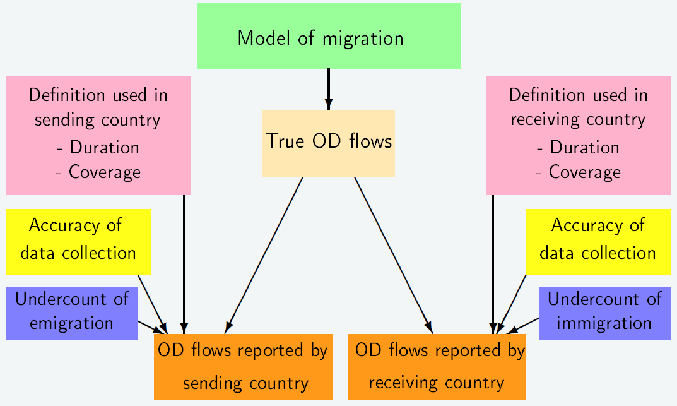
Origin-destination (OD) model

Slide 10
Origin-destination (OD) model
Expert opinion
Expert opinion

Slide 11
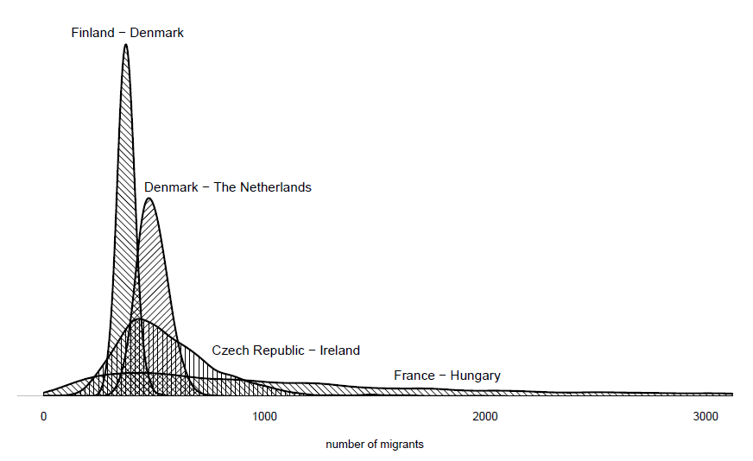
Posterior densities of the estimated true migration flows for selected countries, 2006

Slide 12
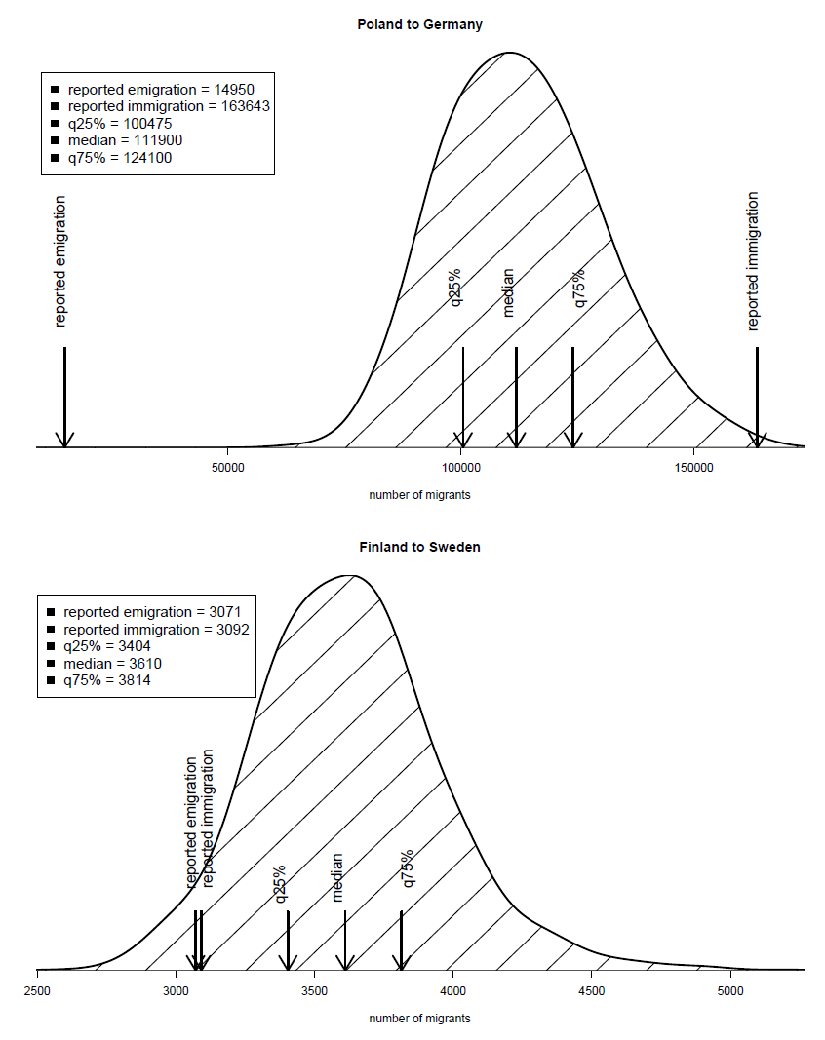
Posterior densities of selected migration flows, 2006

Slide 13
Median estimates of selected true flows (solid), reported emigration (cross) and reported immigration (circle), 2002-2008

Slide 14
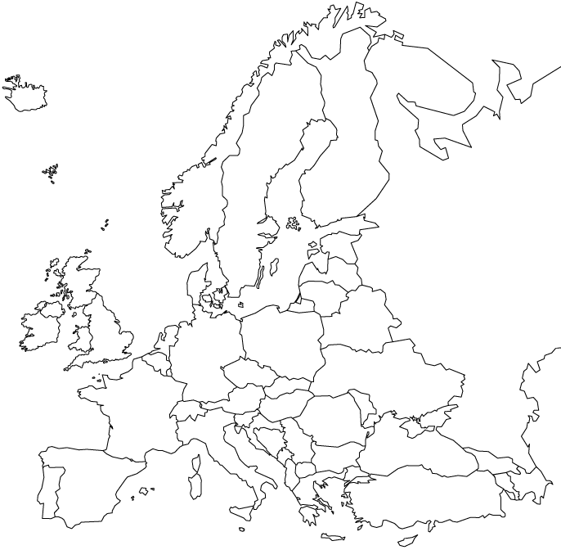
Top ten median flows from Poland, 2002
Rest of world
Top ten flows = 93.9% of total (145,988)

Slide 15
Top ten median flows from Poland, 2003
Rest of world
Top ten flows = 93.8% of total (145,186)

Slide 16
Top ten median flows from Poland, 2004
Rest of world
Top ten flows = 93.6% of total (251,636)

Slide 17
Top ten median flows from Poland, 2005
Rest of world
Top ten flows = 93.4% of total (267,065)

Slide 18
Top ten median flows from Poland, 2006
Rest of world
Top ten flows = 92.5% of total (253,427)

Slide 19
Top ten median flows from Poland, 2007
Rest of world
Top ten flows = 91.8% of total (272,928)

Slide 20
Top ten median flows from Poland, 2008
Rest of world
Top ten flows = 91.7% of total (293,059)

Slide 21
Top ten median flows from Poland, 2008
Rest of world
Interquartile ranges
Total flow:
270,149 - 381,093
~ 19% +/- from median
Red: ~ 28% +/-
Green: ~ 10% +/-

Slide 22
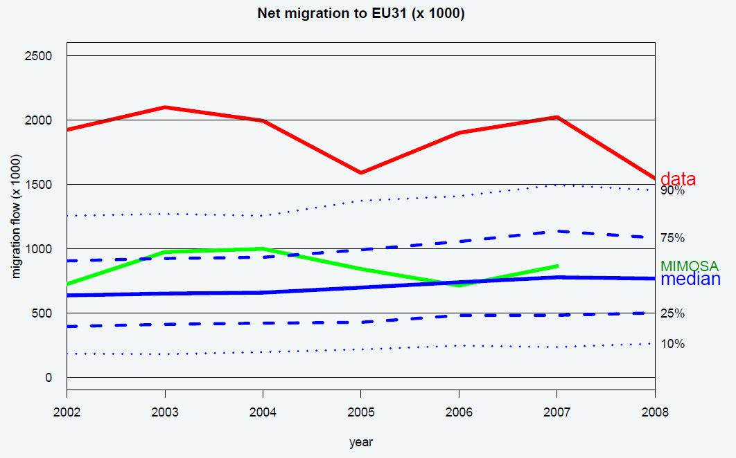
Net migration for the EU / EFTA

Slide 23
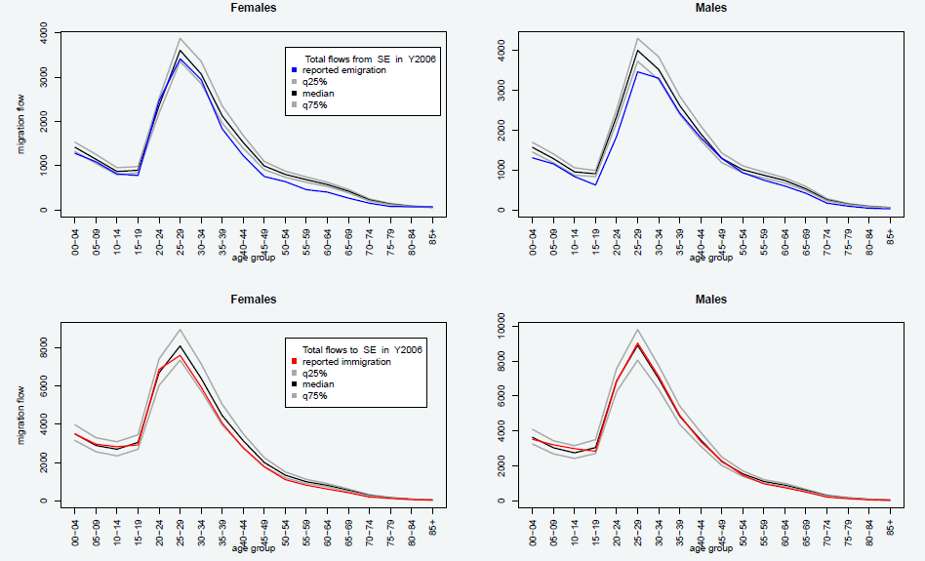
Estimated age-sex flows for Sweden

Slide 24
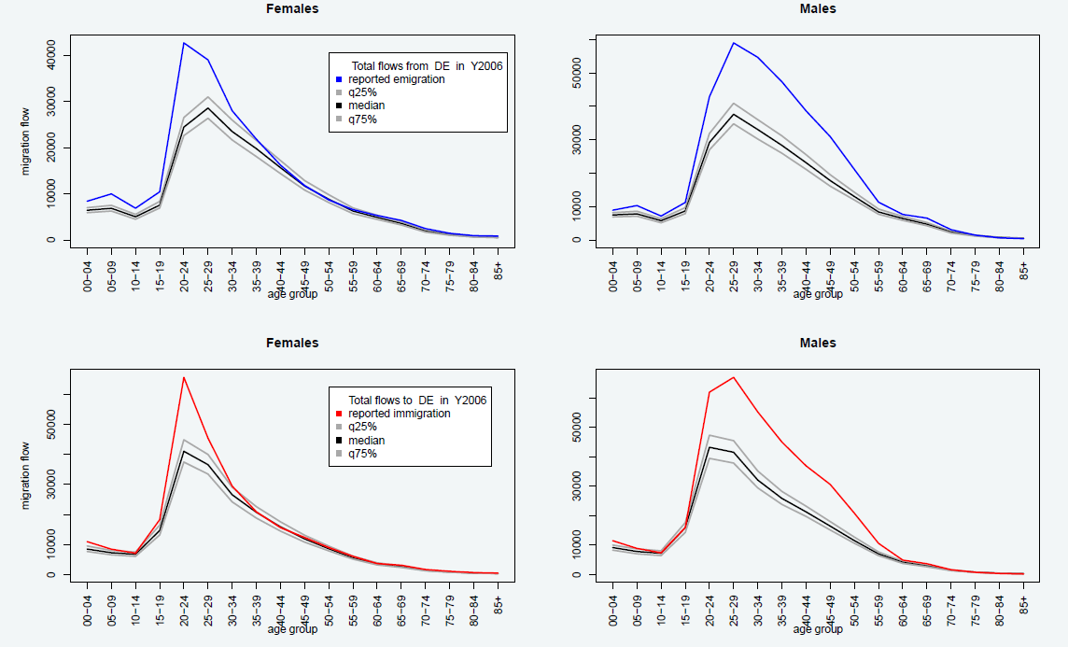
Estimated age-sex flows for Germany

Slide 25
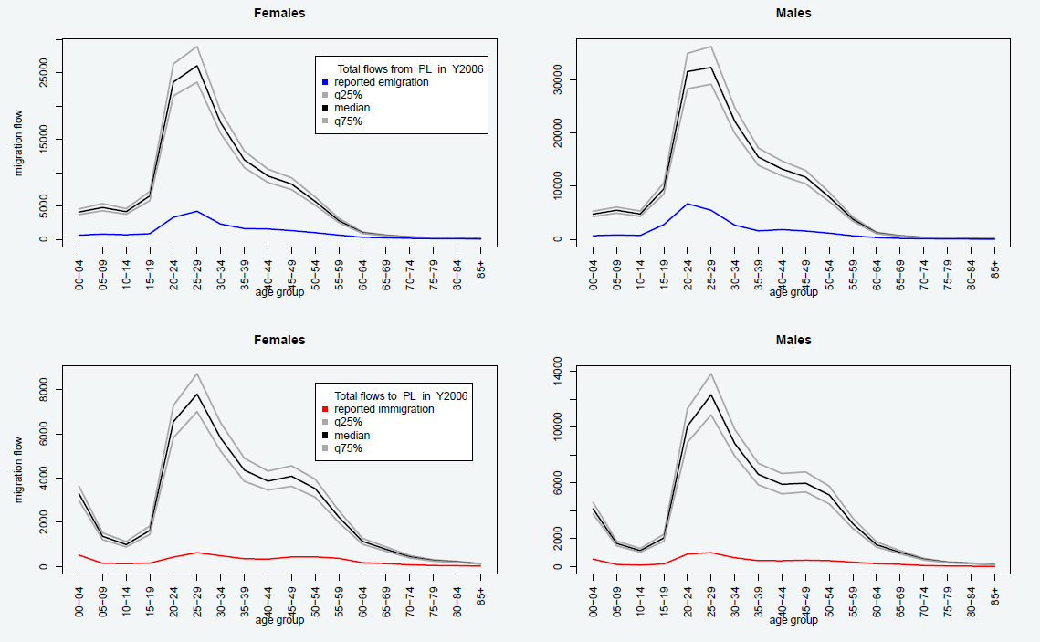
Estimated age-sex flows for Poland

Slide 26
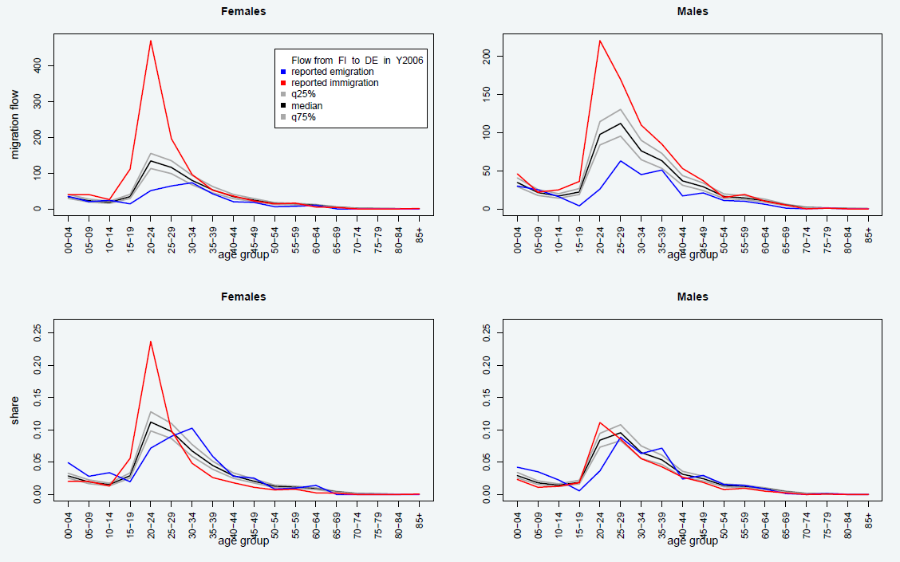
Estimated Finland to Germany migration by age and sex, 2006

Slide 27
Summary
We produced a set of harmonised and complete estimates of migration by origin, destination, age and sex for the 31 countries in the EU and EFTA from 2002-2008
Some results are available on the internet
http://www.cpc.ac.uk/research_programme/IMEM_project.php
Our plan is to continue improving and expanding the model as new funding and data become available

Slide 28
Contributions of the IMEM project
A methodology for estimating harmonised flows of international migration by age and sex
Integration of a measurement model with covariate information and expert judgments to estimate missing flows
Estimates include measures of uncertainty

Slide 29
Usefulness of an integrated migration estimation system
Single resource for policy making and research
Reference for data validation
Platform for sharing information, harmonising definitions and removing inconsistencies
A data source for countries with inadequate collection systems

Slide 30
Main conclusions
Reported flows on international migration data are highly inconsistent and incomplete
Expert knowledge on data collection systems is needed to understand the reported flows
Real improvements in the data requires information exchange between national statistical offices
In the absence of communication, statistical modelling is necessary to reconcile inconsistent data and to estimate missing data
Uncertainty measures are necessary for understanding the quality of the estimates

Slide 31
Forecasting: Argument for origin-destination migration flow tables
Net migration totals (or rates) do not exhibit regularities across age and space that you can depend on
Forecasts of net migration result in biased population projections
Reported net migration totals are not simply the difference between immigration and emigration; they contain administrative corrections and other unknown quantities
Although more cumbersome, flow tables provide flexibility and access to better checks and validation (e.g., origin-destination migrant stock data)

