Slide 1

Diversification and development: the role of migrants
Dany Bahar, PhD
The Brookings Institution
Harvard Center for International Development
@dany_bahar

Slide 2
Founded by David Tran in 1980, Huy Fong Foods today employs close to 200 workers in Irwindale, California and its sales exceed $60 million per year.
The company is named after the freighter Huey Fong that carried him and over 3,000 other refugees out of Vietnam to the coast of California in December 1978.
@dany_bahar

Slide 3
Migrants are 15% of US population, but are over represented in new ventures and among inventors
@dany_bahar

Slide 4
Young firms have created ~1.5 million jobs a year in the US during the past decades
Source: Kaufmann Foundation
@dany_bahar

Slide 5
Migrants and the Global Economy…
Networks
Diffusion of Knowledge
@dany_bahar

Slide 6
Global Networks
@dany_bahar

Slide 7
Local firms struggle to export and to invest in foreign countries
Migrants reduce the costs of ”doing business” between two nations, fostering trade and foreign investment
@dany_bahar

Slide 8
US states that randomly received more Vietnamese refugees in the late 1970s are larger exporters of goods and services to Vietnam today (Parsons and Vezina, 2017)
This is applicable to all countries and particularly for goods that are differentiated. Also applicable to investment (Kugler, Rapoport and Leventhal, 2017)
@dany_bahar

Slide 9
International diffusion of knowledge
@dany_bahar

Slide 10

Knowledge is difficult to transfer and to acquire
@dany_bahar

Slide 11
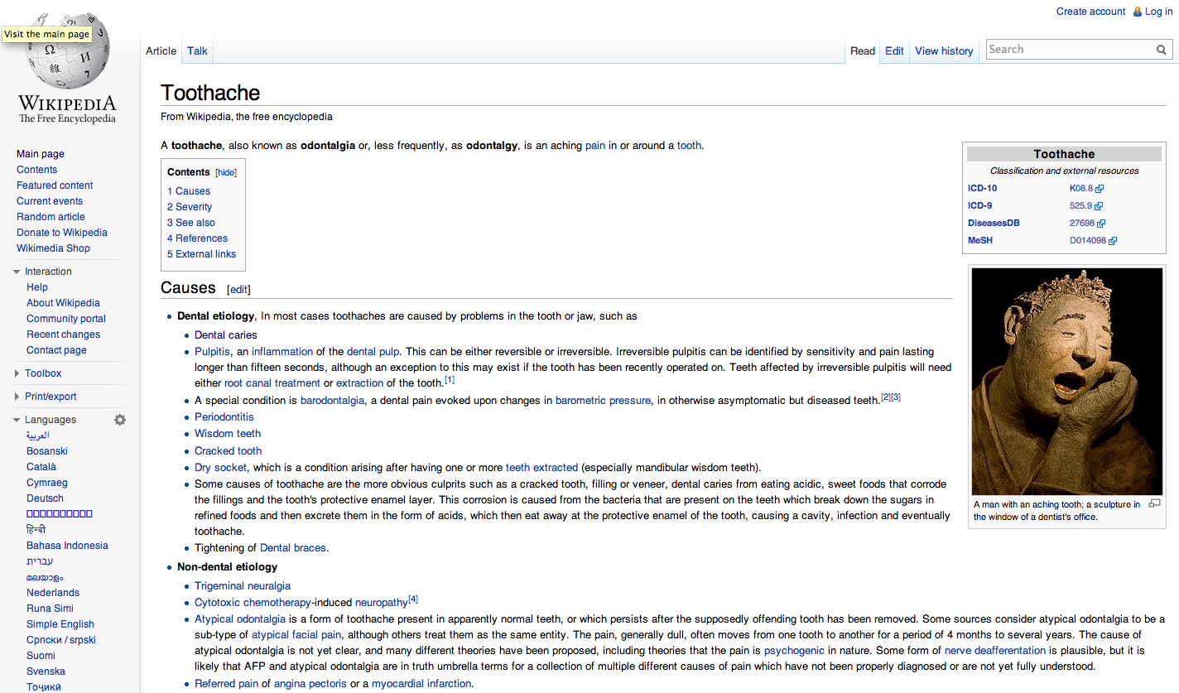
@dany_bahar

Slide 12

@dany_bahar

Slide 13
@dany_bahar

Slide 14
@dany_bahar

Slide 15


Knowledge has a large tacit component.
Michael Polanyi (1966)
Channels for knowledge transmission are limited to human interaction
Kenneth Arrow (1969)
@dany_bahar

Slide 16

Productive knowledge is also tacit
@dany_bahar

Slide 17

Tacit knowledge that travels through narrow channels and its diffusion is geographically localized
@dany_bahar

Slide 18
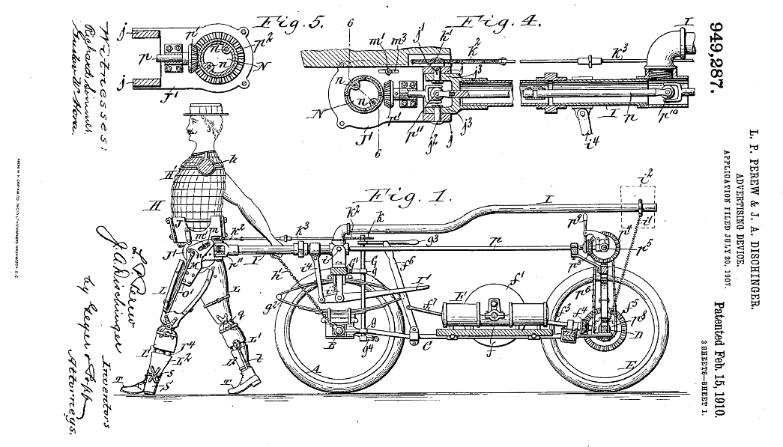
Patents citations are predominantly local
(Jaffe, Trajtenberg and Henderson)
@dany_bahar

Slide 19

Industrial R&D has geographically “bounded” spillovers
@dany_bahar

Slide 20

Does the emergence of a new export sector is consistent with local diffusion of knowledge?
@dany_bahar

Slide 21
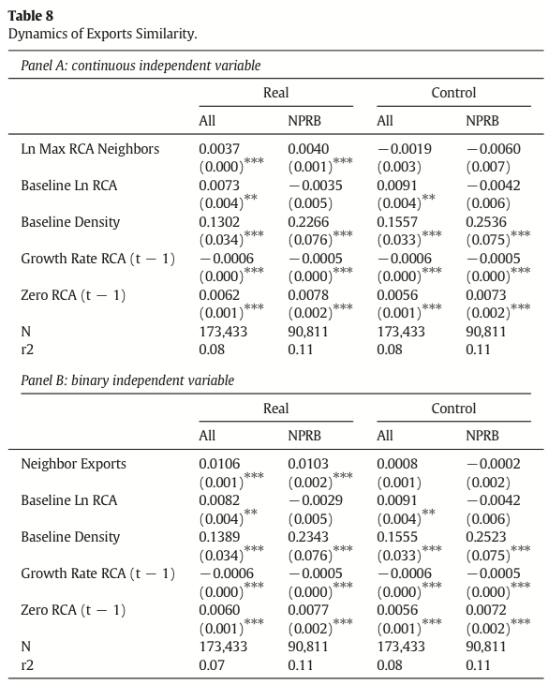
Bahar, Hausmann and Hidalgo (2014 JIE)
  Uses new export as a measure of knowledge acquisition (control for global demand)
  Emergence of new export product explained to existence of such product in a neighbors’ export basket
@dany_bahar

Slide 22
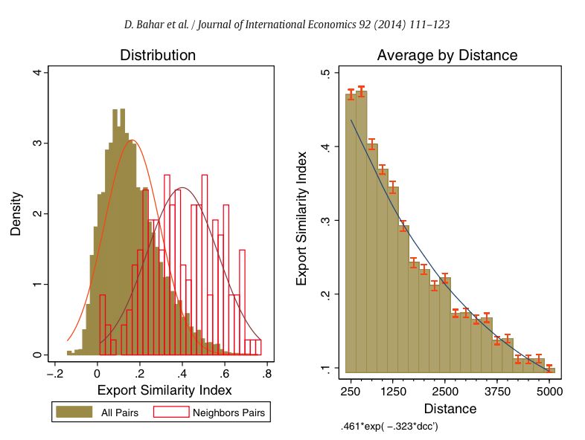
Export similarity is stronger among neighbors and strongly decays with distance
@dany_bahar

Slide 23
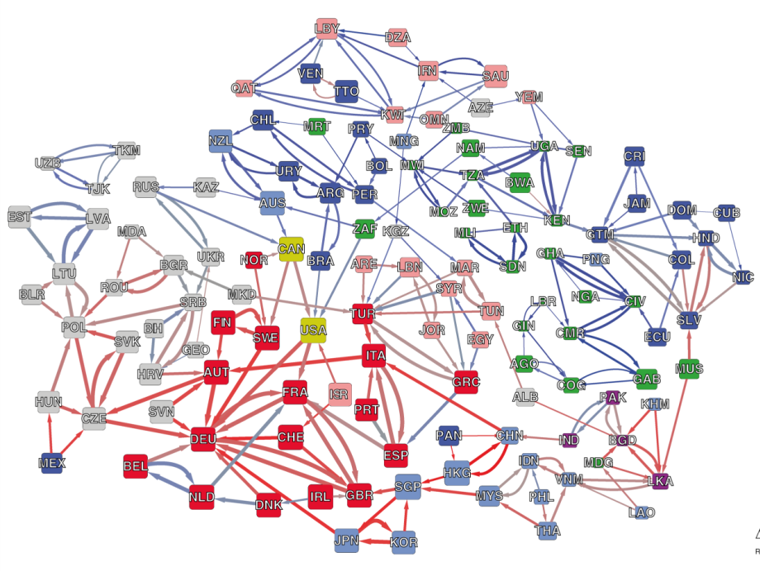
Bahar, Dany, Ricardo Hausmann, and César A Hidalgo. 2014. Neighbors and the Evolution of the Comparative Advantage of Nations: Evidence of International Knowledge Diffusion?. Journal of International Economics 92, no. 1: 111-123.
@dany_bahar

Slide 24


Geographic limits to diffusion of knowledge is present even within firms…
@dany_bahar

Slide 25
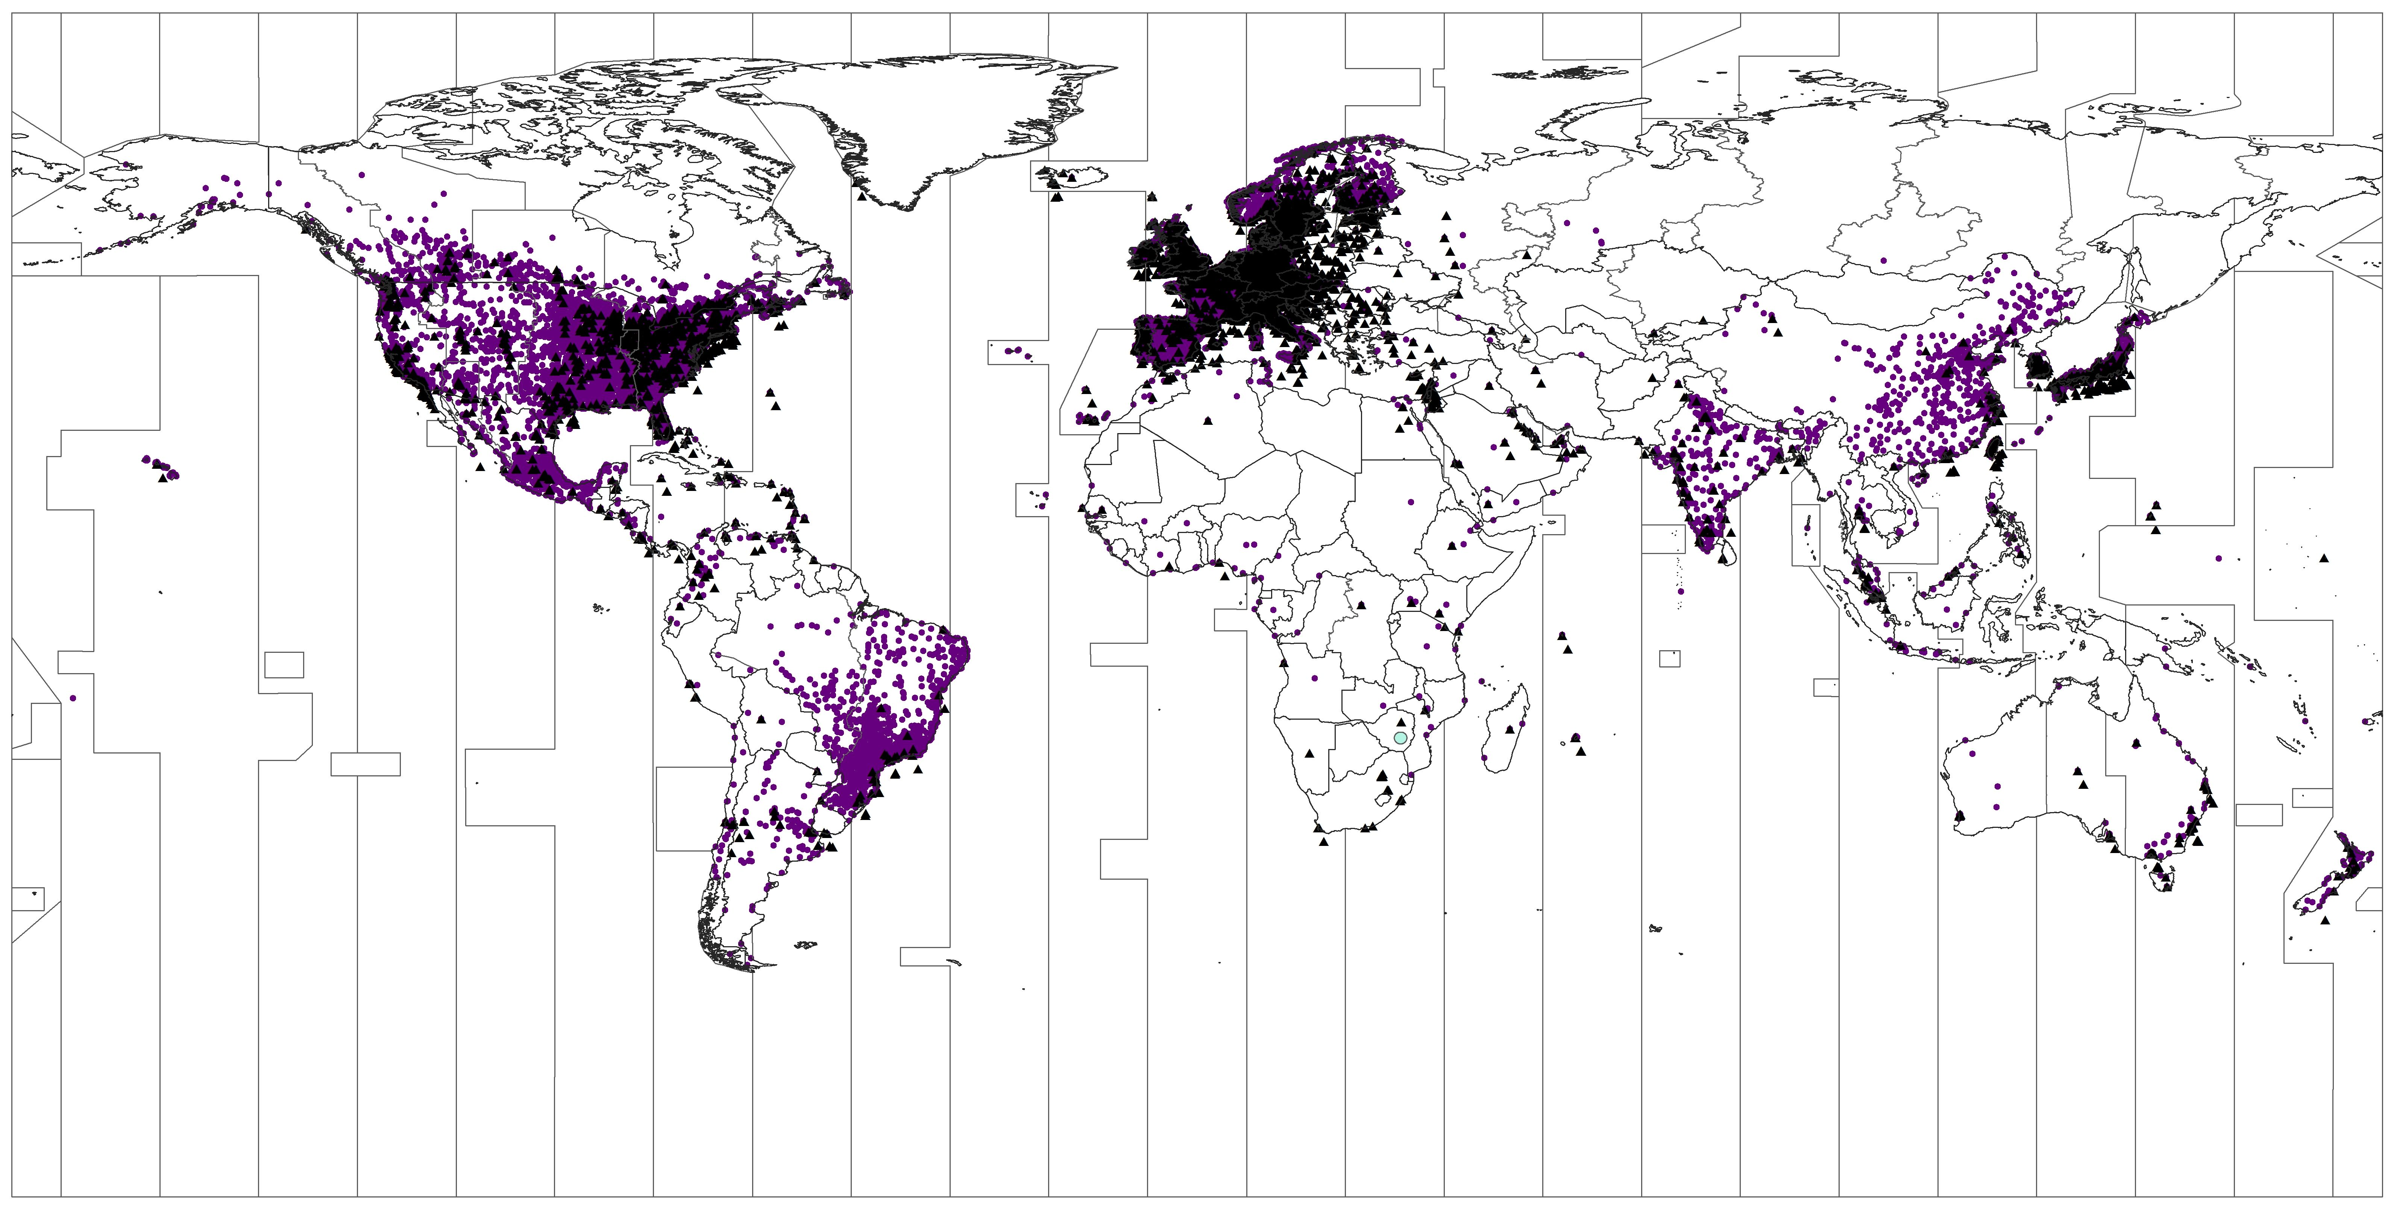
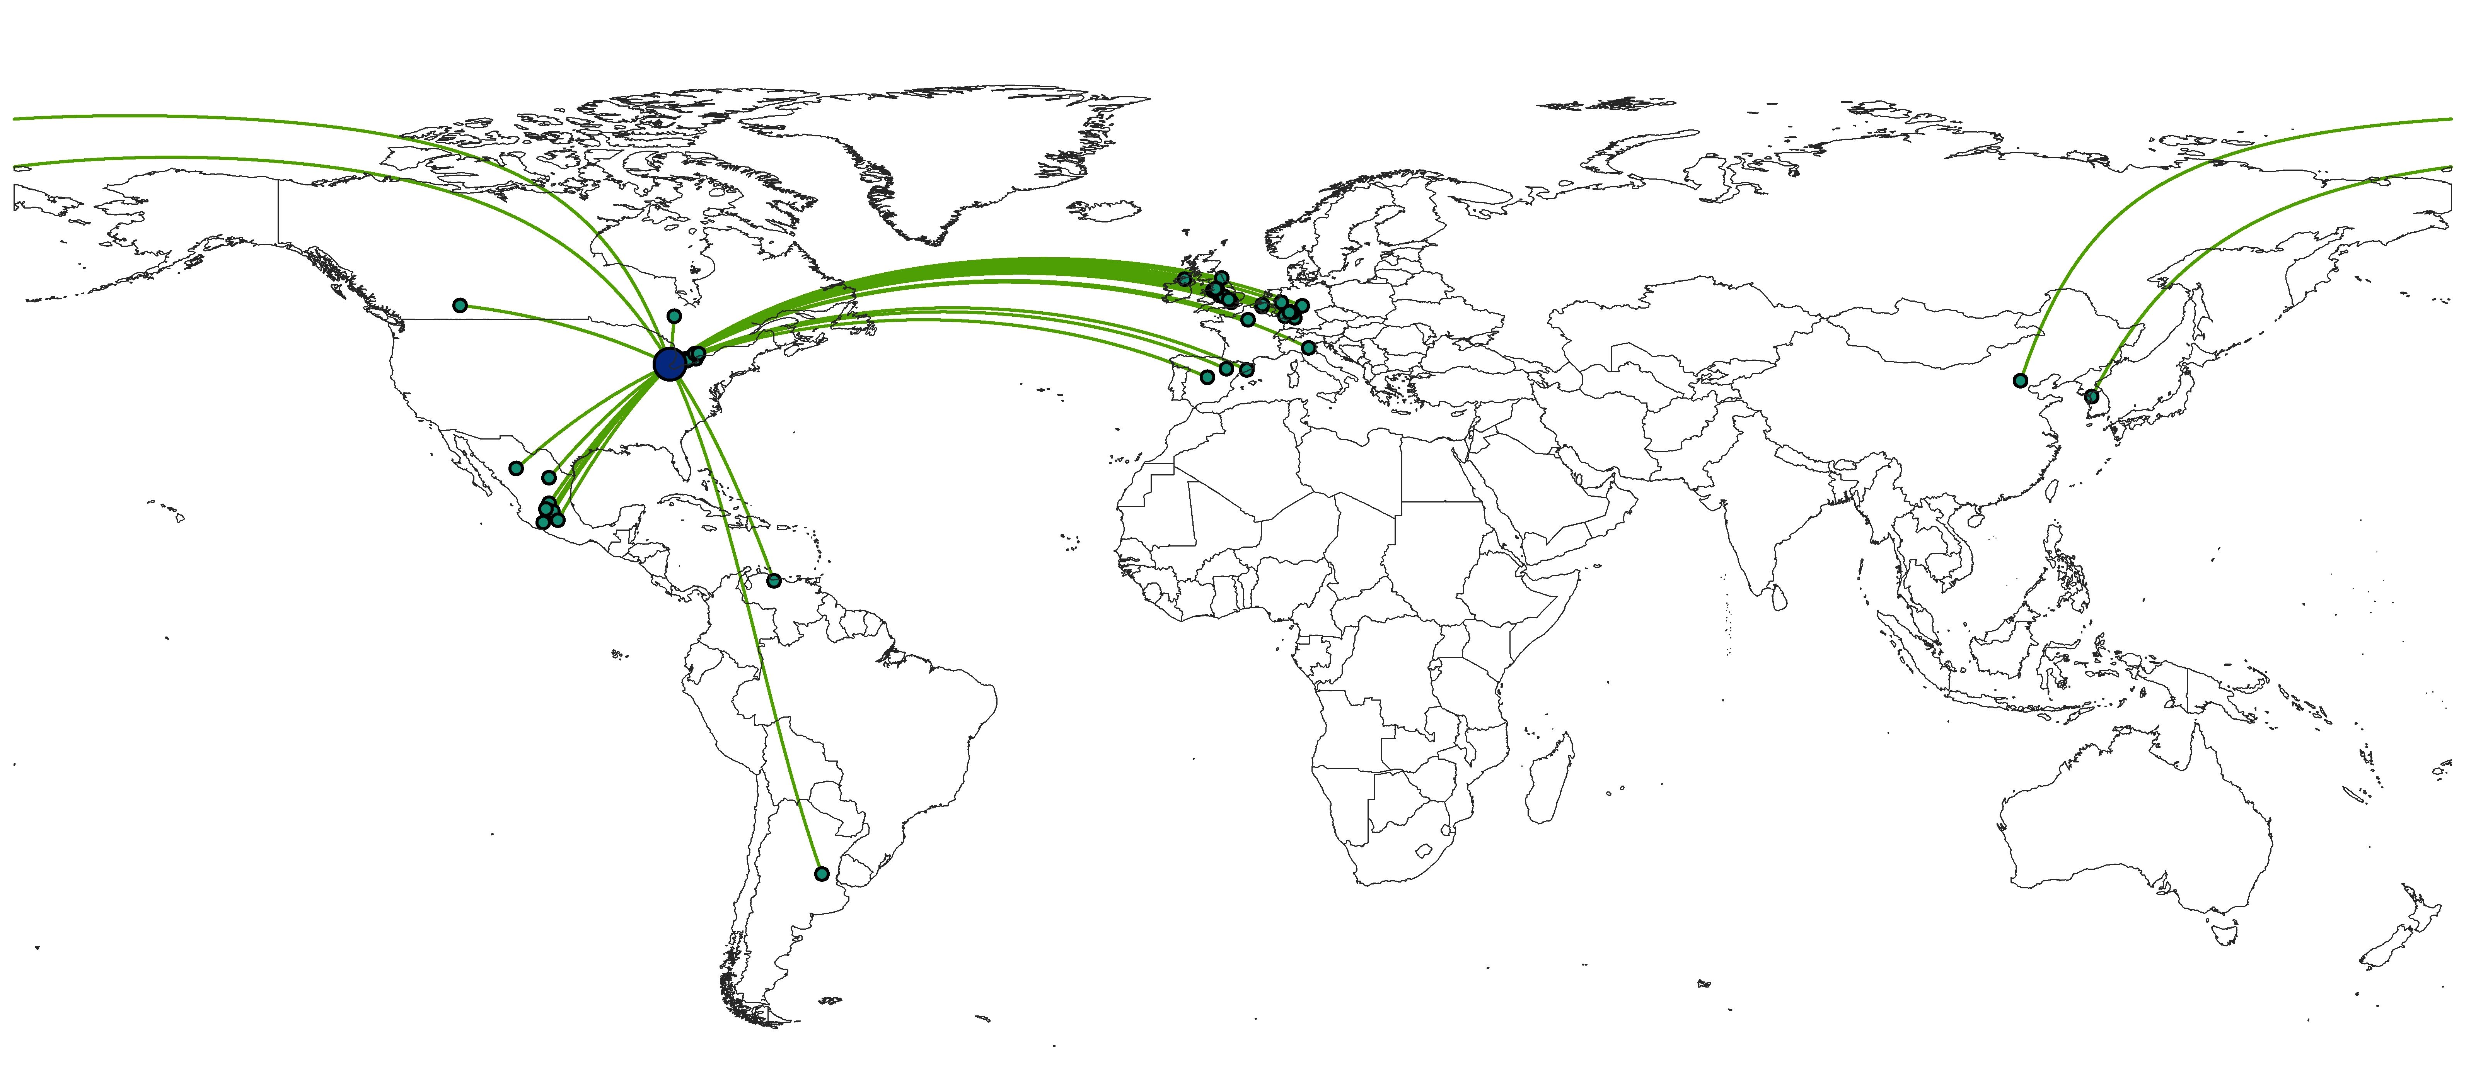
Bahar (2016)
Using Dun and Bradstreet data, test whether MNC are less likely to expand abroad in knowledge intensive activities
Able to geo-locate each headquarters and its branches throughout the globe
@dany_bahar

Slide 26
Bahar (2016)
MNCs are 15% less likely to horizontally expand a sector that is 2X average knowledge intensity
There exists a tradeoff between knowledge intensity and distance between HQ & foreign subsidiaries within MNCs
  A MNC in Houston TX would locate a meat packing subsidiary in Kabul in Afghanistan and a semiconductor plant in Ireland
@dany_bahar

Slide 27
Bahar (2016)
The trade-off weakens when controlling for the ease of communication
  Ability to communicate in real-time, as measured by time zone closeness effectively “reduces” distance between headquarters and subsidiary by about 1/3, or 2000km on average.
  Cost of shipping intermediate goods can’t explain the tradeoff (Keller and Yeaple 2013)
@dany_bahar

Slide 28
If knowledge transmission requires human interaction…
…then the patterns of international knowledge diffusion should follow the patterns of migration
@dany_bahar

Slide 29

Migration, knowledge diffusion and the comparative advantage of nations
Bahar and Rapoport
(The Economic Journal, forthcoming)

Slide 30




Two countries, two products
@dany_bahar

Slide 31

Two countries, two products
@dany_bahar

Slide 32
Two countries, two products
@dany_bahar

Slide 33
Two countries, two products
@dany_bahar

Slide 34
Main Findings
• A 10% increase in the stock of immigrants from countries exporters of product p is associated with a 2% increase in the likelihood of the receiving country exporting p, competitively and from scratch
  The results are being driven by instances where the exporter country is a developing one (non-OECD)
  A skilled immigrant is up to 10 times “more effective” than an unskilled one in this setting
The results are not driven by global demand, or bilateral trade to the countries where the migrants are in/from. An IV approach inspired by Frankel and Romer (1999) suggests results are not driven by endogeneity.
@dany_bahar

Slide 35
Alternative Explanations
Increased migration → preferences shift for home/destination products → demand rise in exports for particular good
  We control for global demand by adding product-year FE; and for aggregate openness shocks by adding country-year FE
Migrant networks → lower transaction costs for bilateral trade → increase in bilateral exports (Rauch, 2002; Aubry, Kugler & Rapoport, 2014)
  We exclude flows to countries where migrants are in or from
Endogeneity → OVB for omission of other flows, or migrants forecast future exports ex-ante
  We add controls for FDI and trade, and instrument for migration using a gravity model estimated figures (Frankel & Romer 1999).
@dany_bahar

Slide 36
Data and sample
Bilateral migration data from Artuc, Docquier, Ozden and Parsons (2015): Total bilateral 25+ foreign born individuals in 1990 and 2000, w/ skill levels
Bilateral FDI positions from the OECD: Tracks FDI from and to OECD members during 1985-2009
Bilateral trade from Feenstra in SITC-4 categorization from 1984 to 2010, with corrections by Hausmann et al. (2011)
The final sample consists of 136 countries (no FSU) and 781 products, with two defined time periods: 1990-2000 and 2000-2010
@dany_bahar

Slide 37
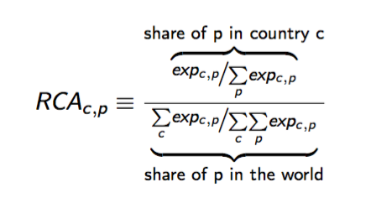
Revealed Comparative Advantage
We use RCA in the left-hand-side and right-hand-side of the specification:
  For example, in the year 2000, soybeans represented 4% of Brazil’s exports, but accounted only for 0.2% of total world trade. Hence, Brazil’s RCA in soybeans for that year was 4/0.2 = 20, indicating that soybeans are 20 times more prevalent in Brazil’s export basket than in that of the world.
@dany_bahar

Slide 38
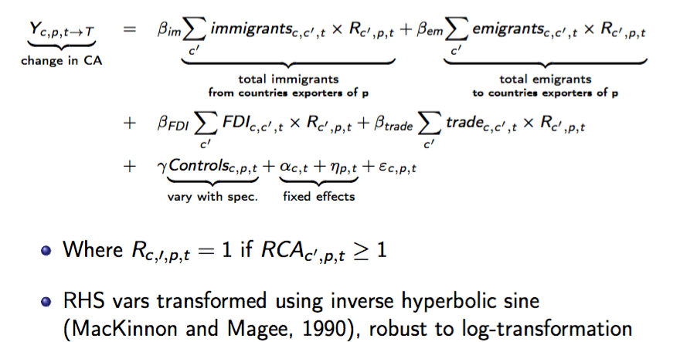
Main Empirical Specification
@dany_bahar

Slide 39
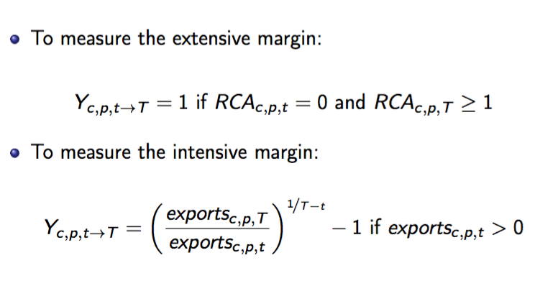
Main Empirical Specification
@dany_bahar

Slide 40
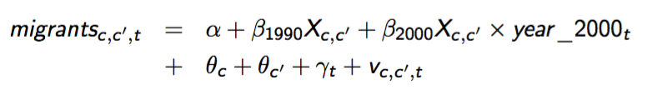
Endogeneity: Instrumental Variable
We follow the methodology devised by Frankel and Romer (1999) and employ a gravity model to create estimates of bilateral migration using only bilateral cultural and historic ties:
  colony/colonizer relationship; same colonizer; same language; same religion
@dany_bahar

Slide 41
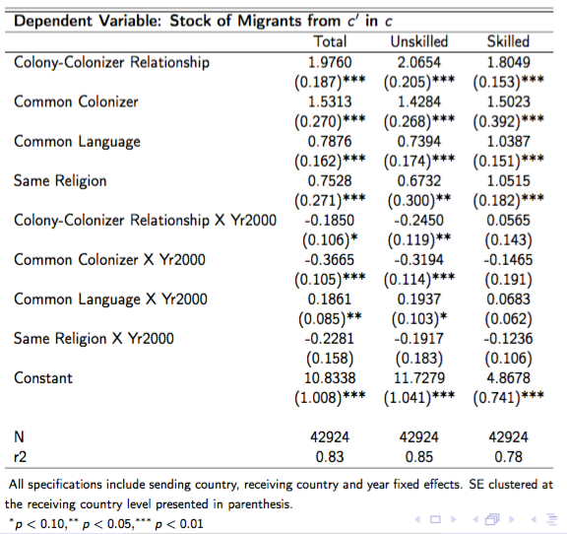
Stage zero: PPML Estimation
We use the predicted value based only in these cultural and historic relationships to instrument for actual migration.
Exclusion restrictions:
  Product-specific exports to the the whole world are not correlated with common bilateral cultural and historic ties with migrants’ countries, in particular after controlling for country-year fixed effects
  Countries do not engage into product specific export-inducing agreements based on their cultural or historical ties which are not captured via FDI or trade
@dany_bahar

Slide 42
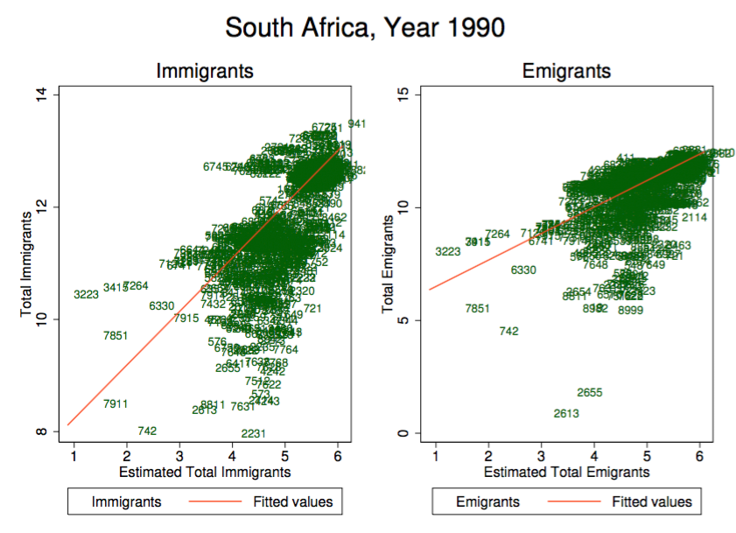
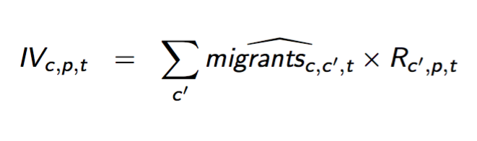
Instrumental variable construction
We construct the IV using the same form as the RHS:
  Note that predicted values are symmetric for sending and receiving countries, so we can only instrument for one endogenous regressor at a time
@dany_bahar

Slide 43
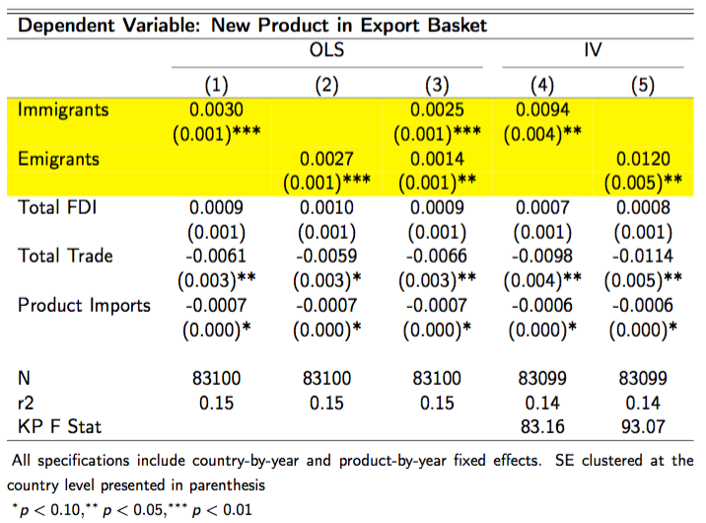
Results: Extensive Margin
Migration can explain the emergence of new sectors:
  A 10% increase in the immigrants or emigrants stock coming from countries exporters of product p, is associated with a ~2% increase in the likelihood country c will export product p with RCA ≥ 1 in 10 years
@dany_bahar

Slide 44
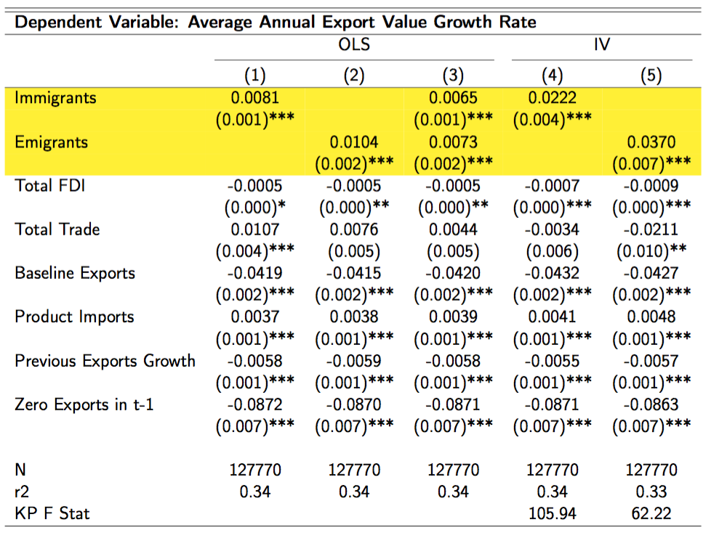
Results: Intensive Margin
A 10% increase in the immigrant/emigrant stock (from p exporters) is associated with higher annual CAGR of 0.06pp/0.07pp in the next 10 year period
@dany_bahar

Slide 45
Main results
A 10% increase in the immigrants or emigrants stock coming from countries exporters of product p, is associated with a ~2% increase in the likelihood country c will export product p with RCA ≥ 1 in 10 years
A 10% increase in the immigrant/emigrant stock (from p exporters) is associated with higher annual CAGR of 0.06pp/0.07pp in the next 10 year period
@dany_bahar

Slide 46
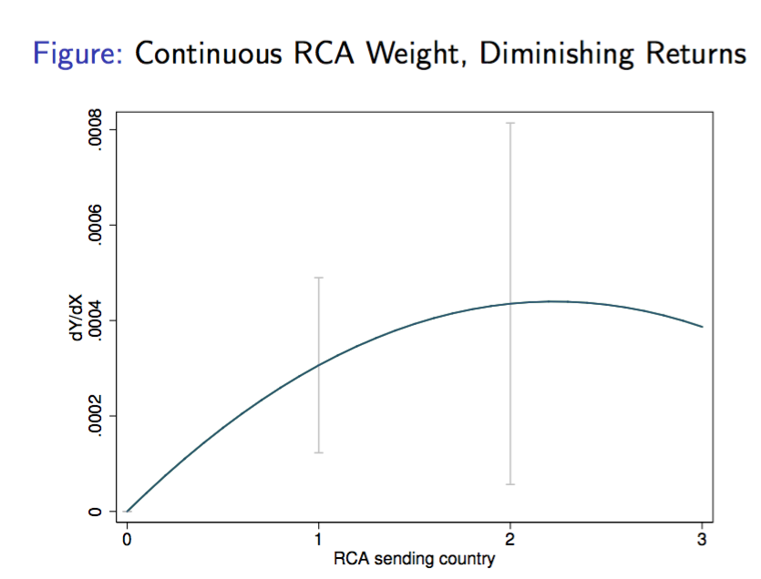
Diminishing returns to RCA
@dany_bahar

Slide 47
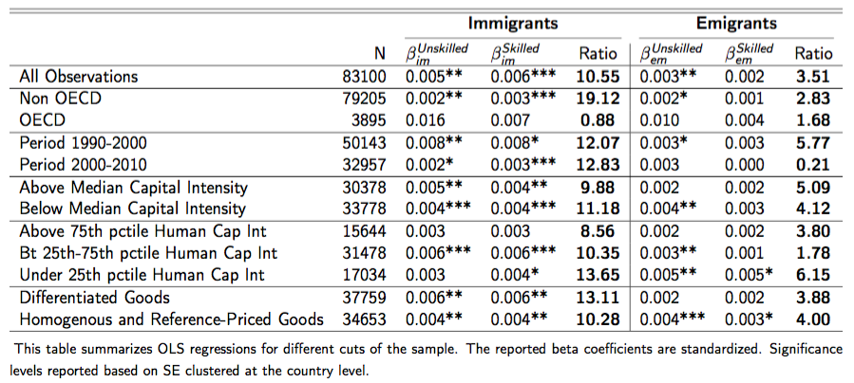
Different cuts of the dataset
@dany_bahar

Slide 48
Diasporas, return migration and comparative advantage: a natural experiment of Yugoslavian refugees in Germany
Bahar et al. (in progress)
@dany_bahar

Slide 49
The former Yugoslavia started to disintegrate in 1991, fueling the largest migration flow in Europe since WWII.
  ~735K migrated out of the country.
Over 350K refugees from the former Yugoslavia (mostly Bosnia) fled to Germany and received temporary protection, allowing them to work.
@dany_bahar

Slide 50
A short stay…
Following the Dayton peace treaty, Germany enacted a repatriation program for Yugoslavians (1996)
  By autumn 1998, ~70% had left Germany, most of them to their home countries
@dany_bahar

Slide 51
Data and sample
Migrant worker data in Germany from Institute of Employment Research (IAB) of the German Federal Emplyoment Agency
  It covers about 80% of workforce. We pull a 40% random draw of foreign nationals.
Bilateral trade data compiled from UN Comtrade by Feenstra et al. (2005) with extensions and corrections suggested by Hausmann et al. (2014).
  We match number of migrant workers in Germany in each SITC 4-digit category by year
Final sample of 123 countries & 4-digit 786 products from 1984 to 2014
@dany_bahar

Slide 52
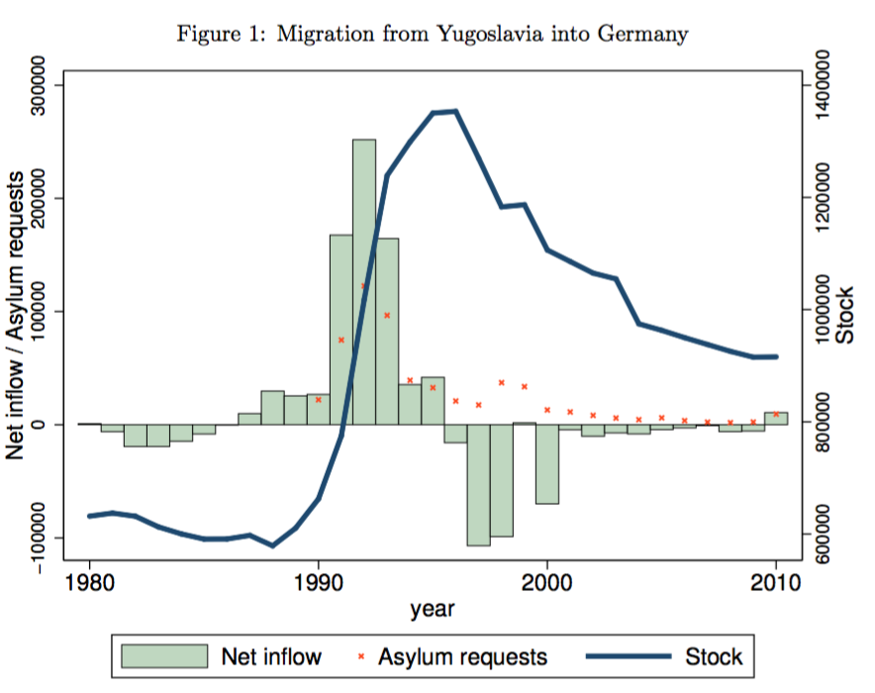
The natural experiment: Yugoslavian refugees
We use a difference-in-difference approach
  Main assumption: exogeneity of arrival and exit of refugees in labor force in particular industries wrt export trends back home
  Peak of migrant stock in 1995 and starts declining since, and all industries "lost" Yugoslavian workers between 1995 and 2000 (our treatment)
We exploit exit of Yugoslavians from German labor force on the export basket of former Yugoslavian countries post 2000
  We aggregate exports of pre-1991 Yugoslavia with post-1991 the republics that emerged from them
  Return migration is one possible reason behind drop, others work against us
@dany_bahar

Slide 53
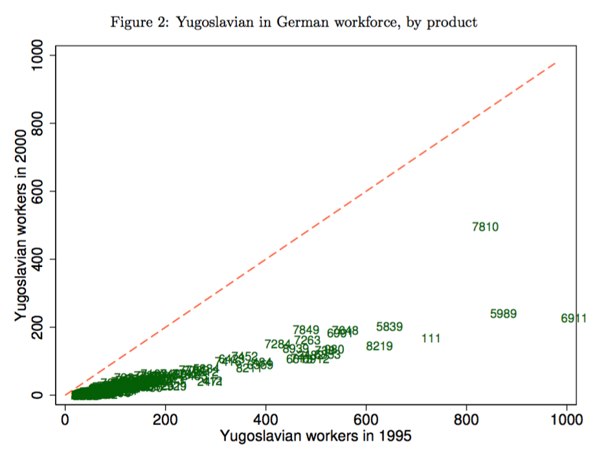
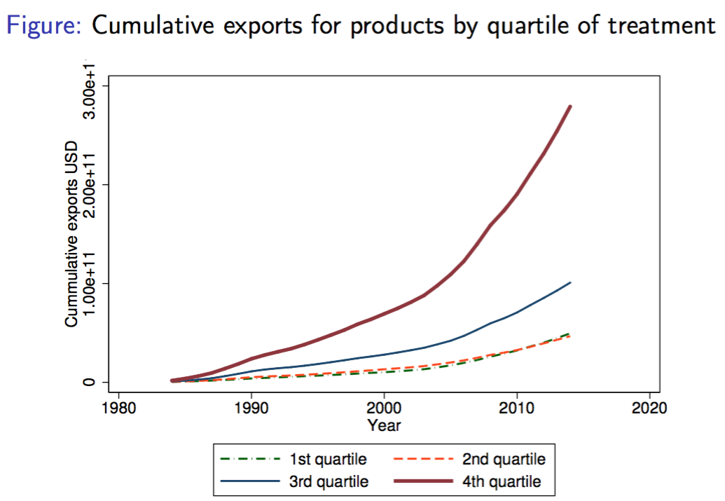
@dany_bahar

Slide 54
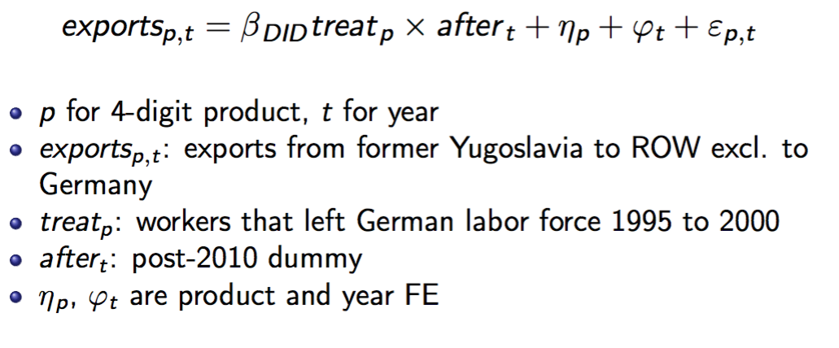
Empirical strategy
We employ a difference-in-difference strategy and estimate:
Our LHS alternates between several monotonic transformations
Standard errors clustered at the product level (Bertrand et al. 2004)
@dany_bahar

Slide 55
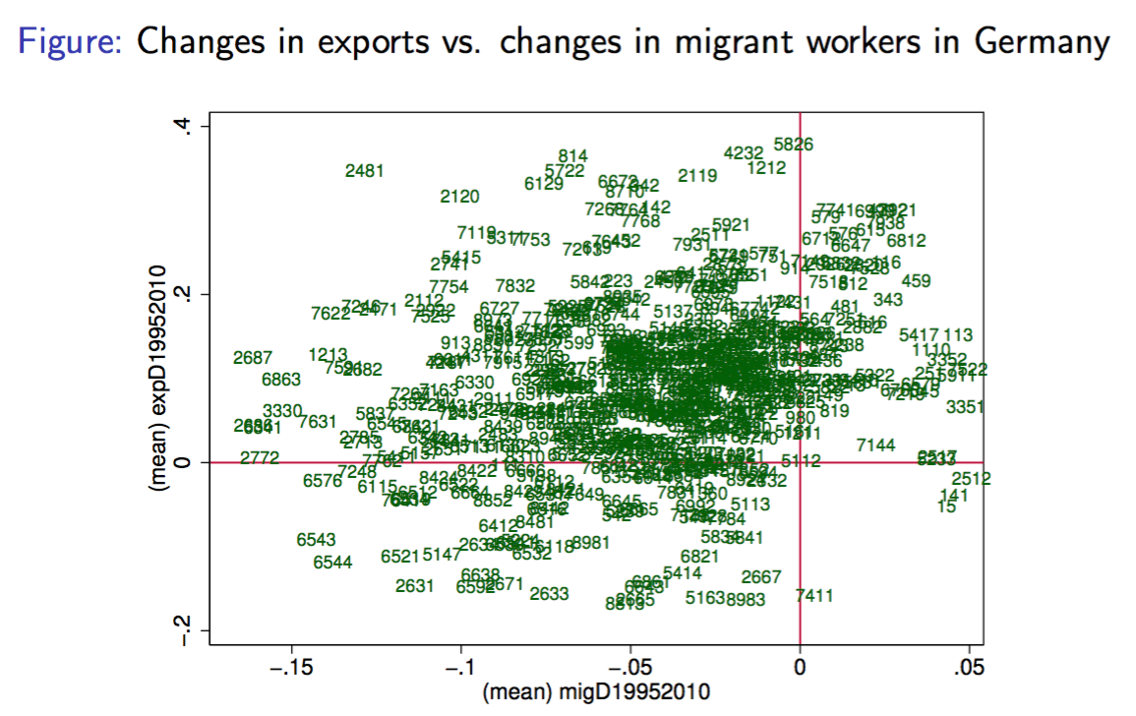
@dany_bahar

Slide 56
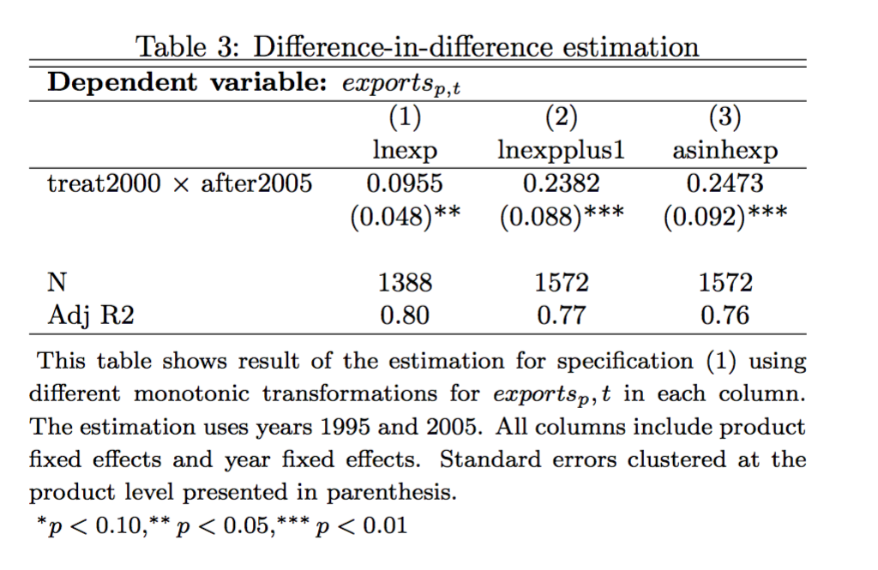
@dany_bahar

Slide 57
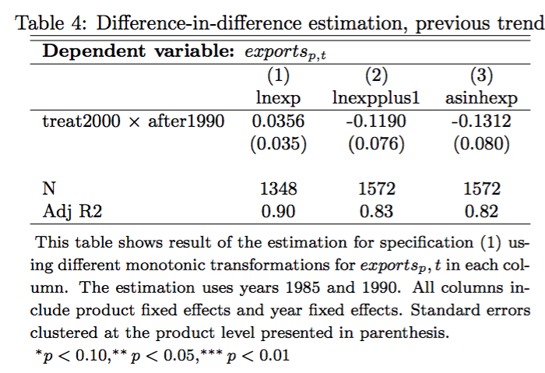
@dany_bahar

Slide 58
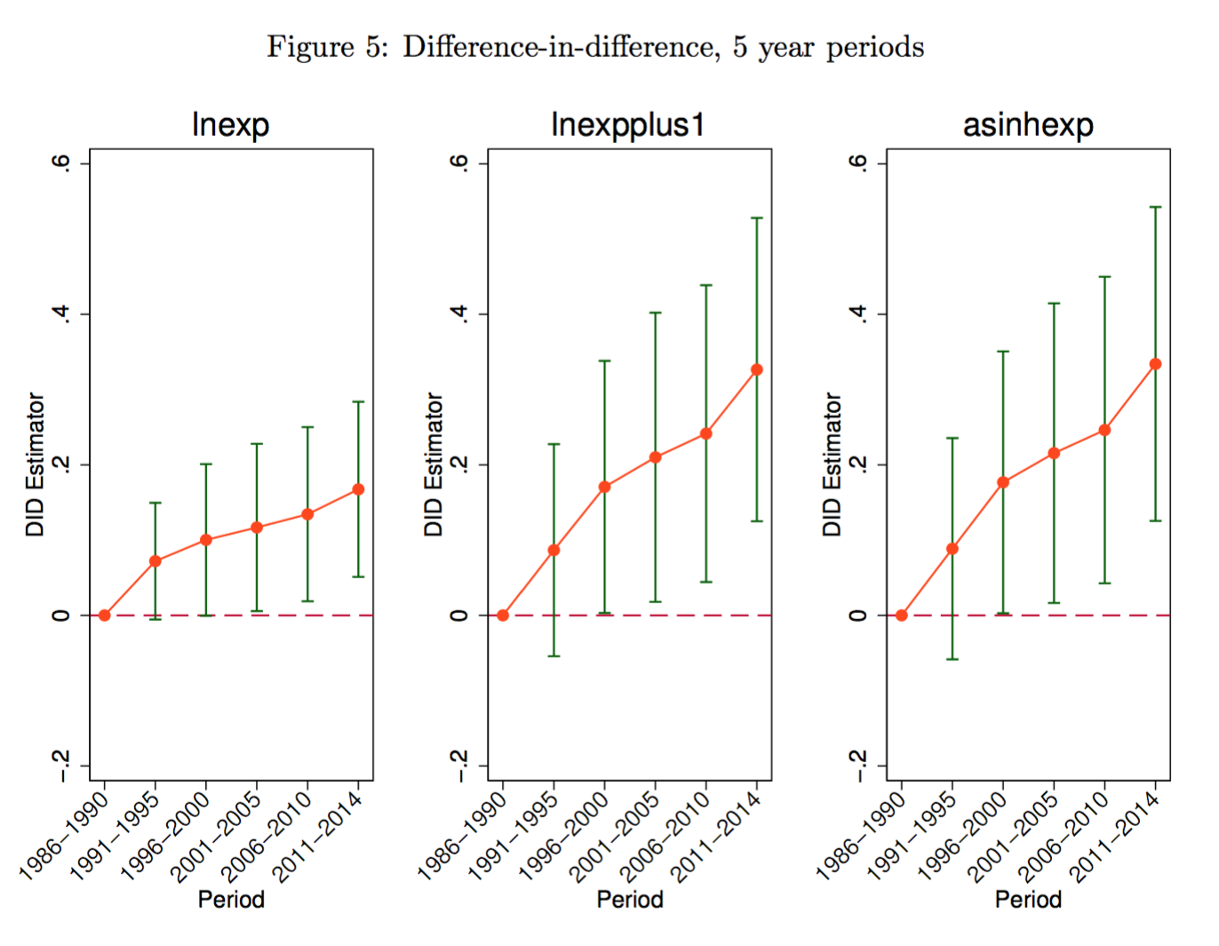
@dany_bahar

Slide 59
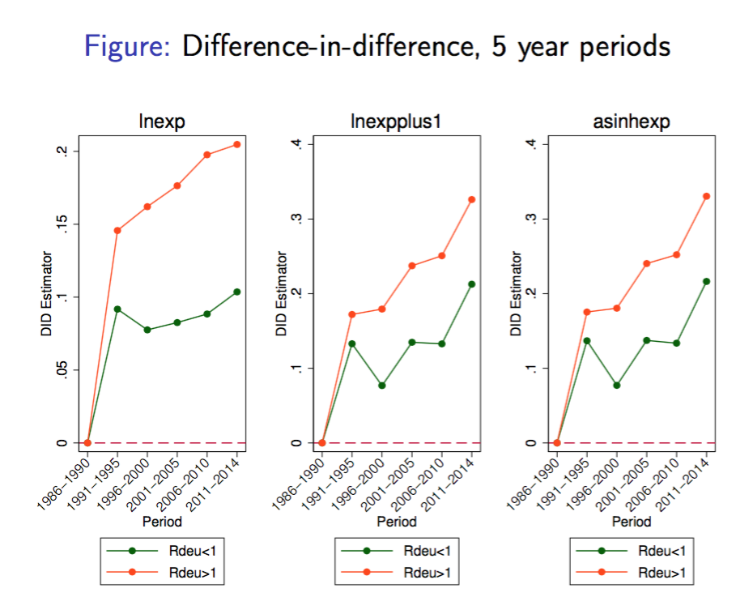
@dany_bahar

Slide 60
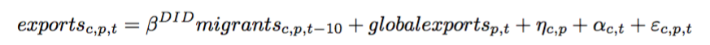
Two more questions…
Are these results externally valid?
Can we attribute this to knowledge diffusion?
To answer, we expand globally and look at differential effects based on occupations of the migrants. Following Besley and Burgees (2004) estimate:
  c stands for country; includes country-product FE and country-year FE, as well as total global exports per product as control
  Estimated for periods 1990-2000 and 2000-2010
@dany_bahar

Slide 61
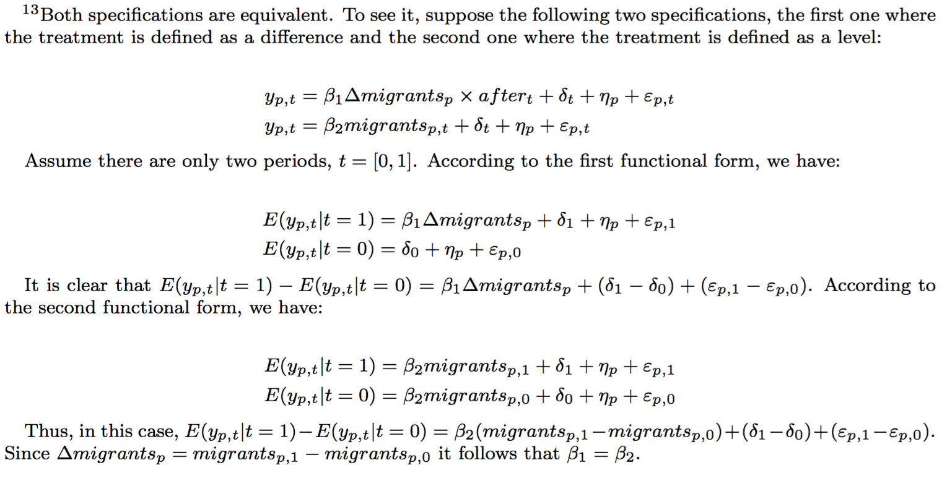
@dany_bahar

Slide 62
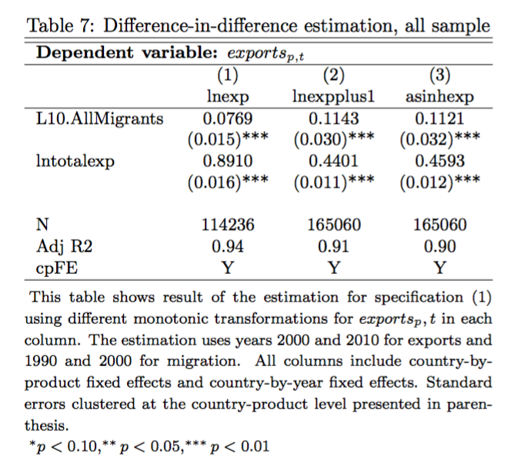
@dany_bahar

Slide 63
Skills and occupations
IAB’s dataset allows us to see the occupation of the migrant. Is the effect stronger for occupations that are more "suitable" for the transmission of knowledge?
  We group migrants by skill levels (diploma or college degree vs. high-school degree or less)
  We group migrant workers by whether their occupation is defined as "white-collar" or not,
  We distinguish migrants with occupations intensive in analytical and cognitive tasks vs. occupations intensive in manual tasks
  We distinguish migrants by the problem-solving content of their occupations (above and below median, given it is a continuous variable).
@dany_bahar

Slide 64
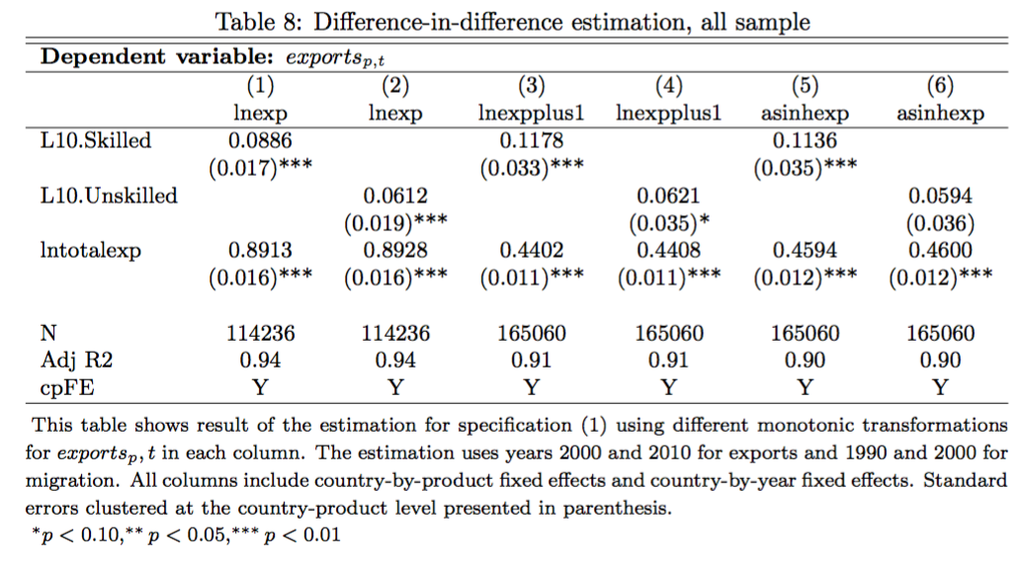
@dany_bahar

Slide 65
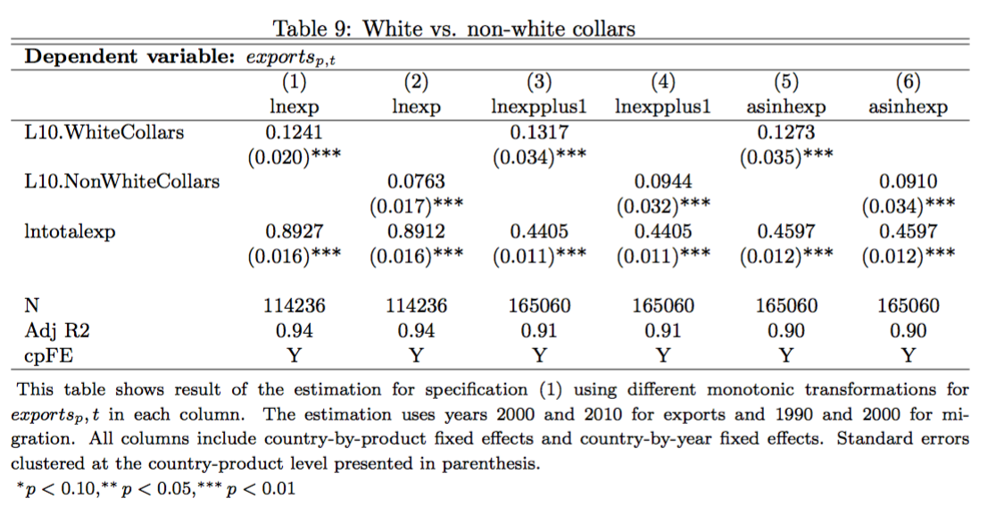
@dany_bahar

Slide 66
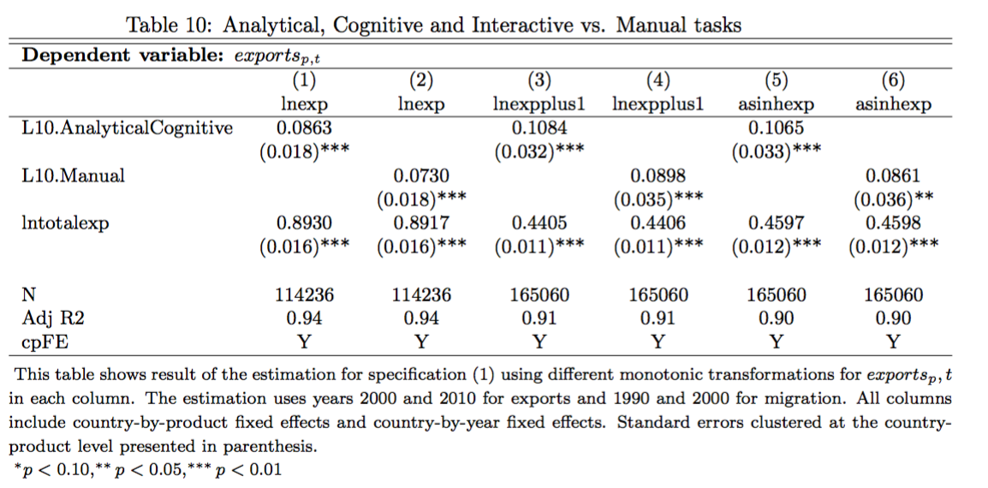
@dany_bahar

Slide 67
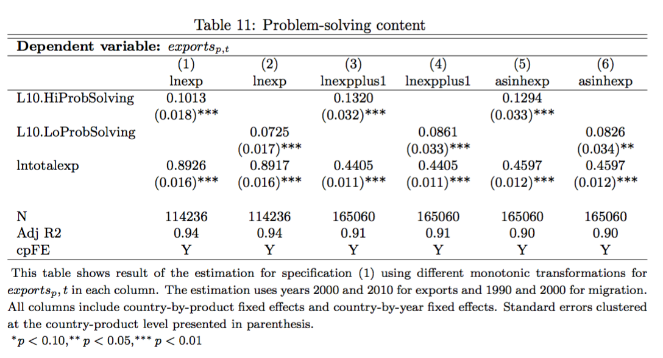
@dany_bahar

Slide 68
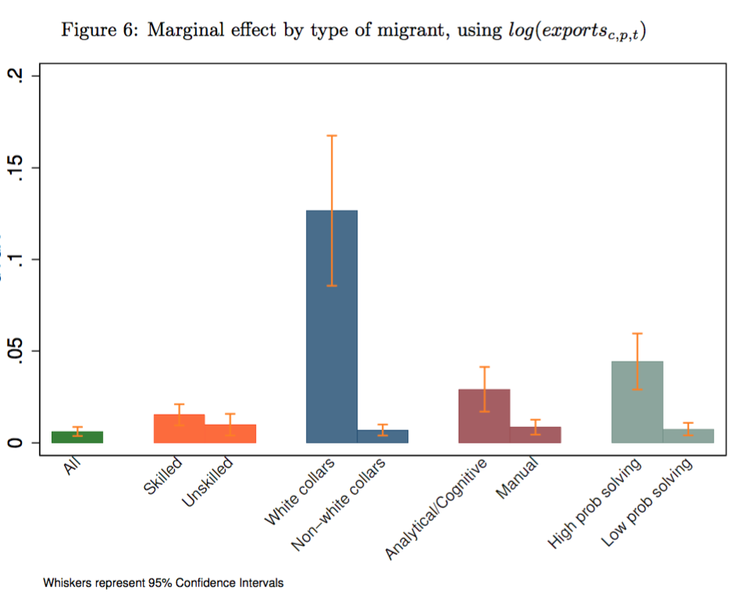
@dany_bahar

Slide 69
Insights on the role of policy
There is vast evidence on positive role of migrants in the economy.
In the era of productivity slowdown, knowledge diffusion is the biggest challenge our economies face
  Its easier to move brains than the knowledge
If temporary migration is good, why firms don’t do it? Externalities!
  It justifies government policy: subsidies for workers’ training abroad
  Diasporas can be activated to assist with placement for trainees
@dany_bahar

Slide 70
@dany_bahar

Slide 71
Thank you!
Email: dbahar@brookings.edu
Twitter: @dany_bahar

