Slide 1
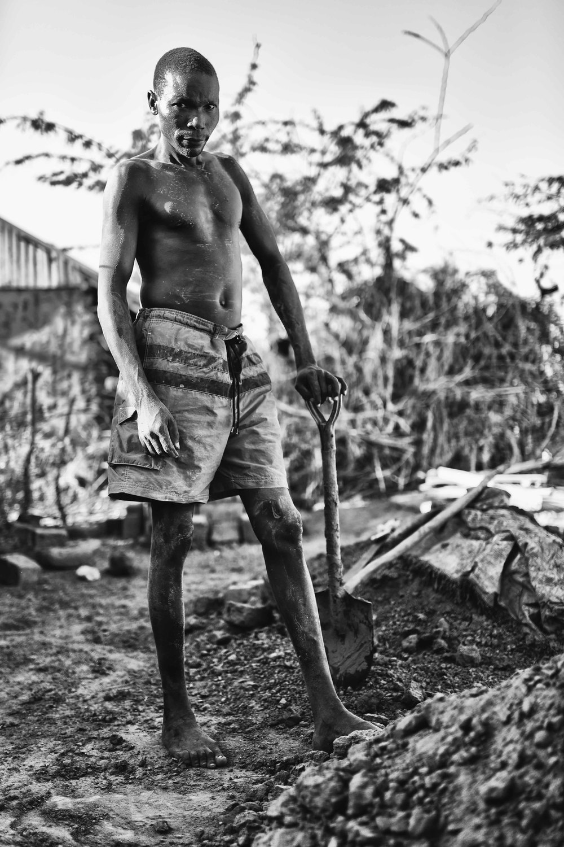

Refugees of Kakuma
Economic Implications for Turkana
Harun Onder (Economics Team Lead, WB)
Apurva Sanghi (Task Team Leader, WB)
Economics Team:
Jennifer Alix-Garcia (UWM), Erhan Artuc (WB),
Anne Bartlett (UNSW), Nazanin Behzadan (RU), Richard Chisik (RU),
Aaditya Mattoo (WB), David Mayom, Sarah Walker (UNSW)
Photo Credit: Alexander Schmidjell

Slide 2
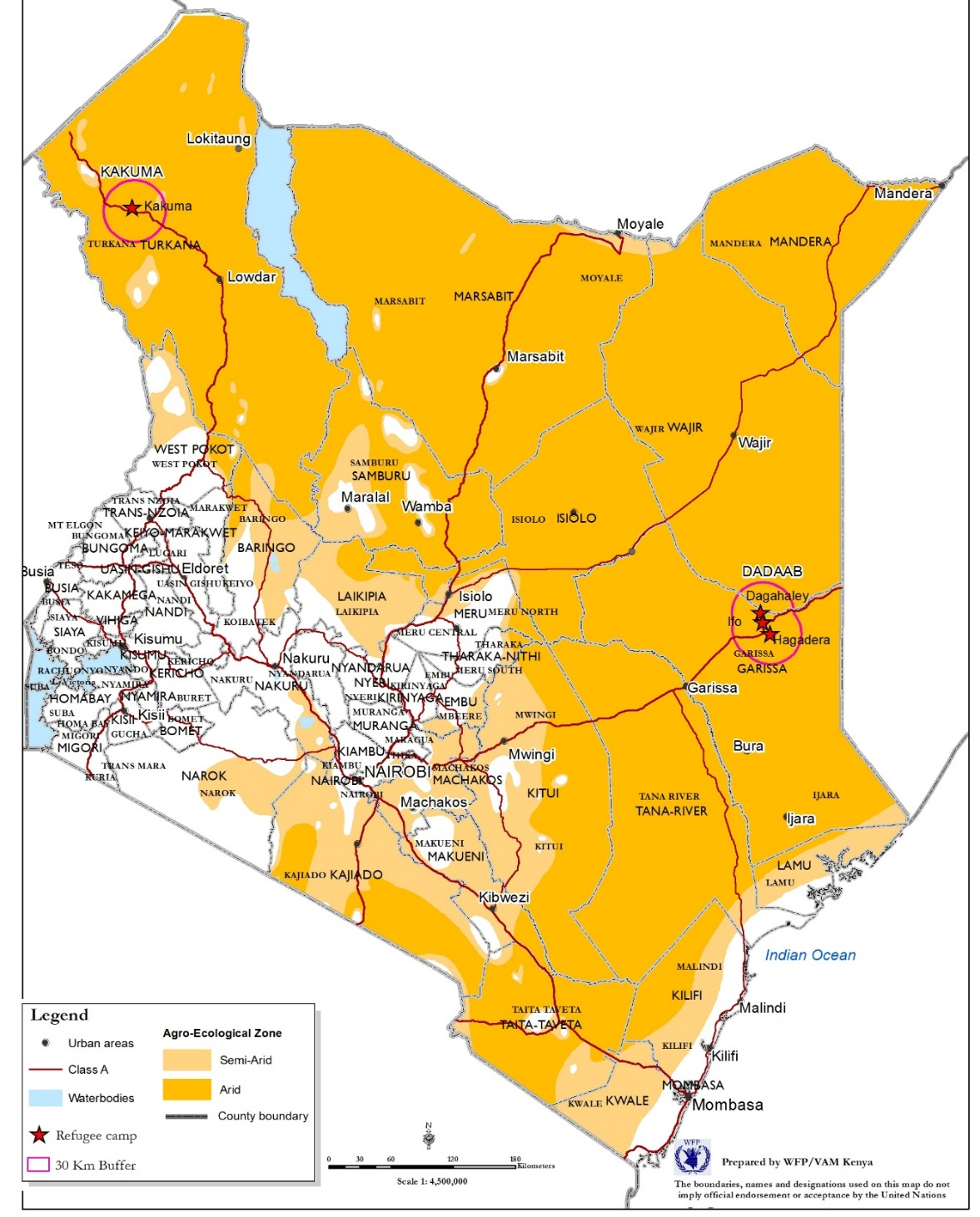
Kenya… Turkana… Kakuma… and refugees
Kakuma Refugee Camp Population
Notes:
Northwest of Kenya, sparsely populated quite poor, the 2005 Kenya HH budget survey assessed that about 95 percent poverty in the region.
In 1991, 7000 Sudanese boys walked into Kenya, and combined with large inflows of Somali’s this created a radical shift in Kenya’s refugee policies. They started encampment. Currently a large share of the camp population is Sudanese, and significant numbers from Ethiopia and Somalia.

Slide 3
Questions
What has been the impact of refugees in Kakuma Camp on host community welfare?
Which factors (or policy choices) have magnified the positive impacts and which factors have augmented the negatives?
Going forward, what are the policy options that can ensure a more positive impact?
Notes:
We started in late 2014 in collaboration with UNHCR.

Slide 4
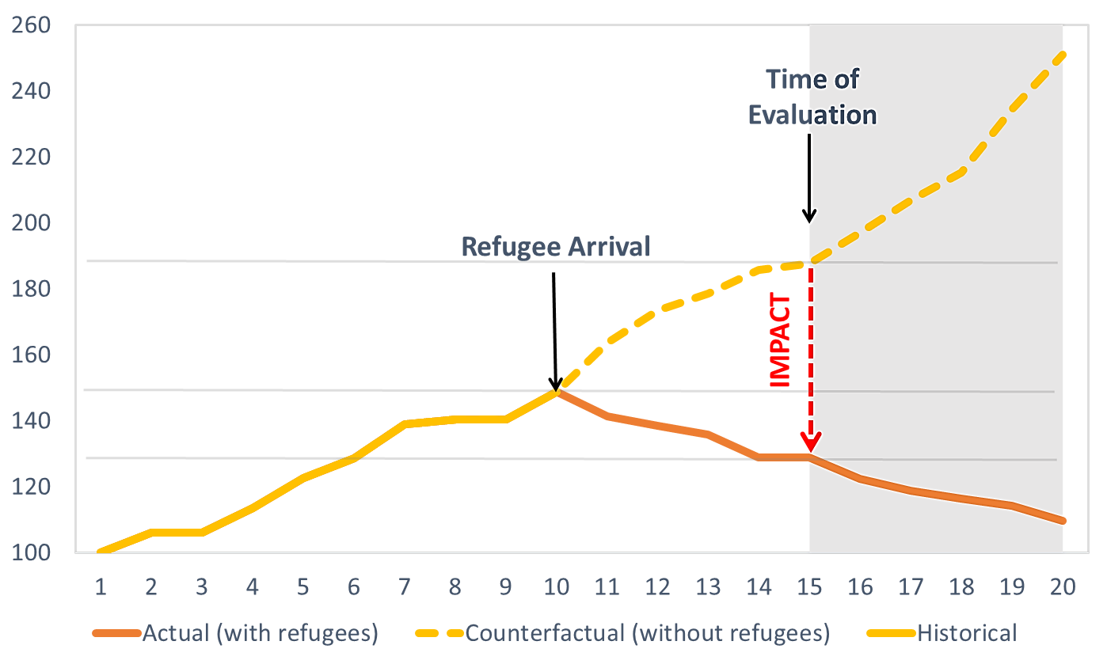
The problem with measuring the impact is…
We need to know how things would be had they not happen as they did.
However, this has proven to be difficult in this case:
No pre-refugee data from Kakuma
No truly valid counterfactual towns

Slide 5
Analytical Strategy
1. Use a variety of summary statistics from different sources of data to generate an empirical base.
2. Run econometric tests when possible/meaningful.
3. Build a simulation model. Use the empirical base to calibrate the model to the extent possible. Simulate the impact.
4. Map the results from econometric analyses and simulations onto each other.
5. Use the model to simulate the possible outcomes of policy actions going forward.

Slide 6
Sources of Existing Data
Kenyan Census: Years 1979, 1989, 1999, and 2009 (GOK, 1989, 1999, 2009).
Registration Census by Hunger Safety Net Program (HSNP): provides data for “proxy means test”; conducted between October 2012 and June 2013.
Famine Early Warning System (FEWSNET): provides monthly price data on agricultural and some livestock goods from 2000 onwards for 11 markets throughout Kenya.
Livestock Information Network Knowledge System (LEWS): bi-monthly livestock prices from 37 markets between 2004 to 2013.
UNHCR refugee counts: surprisingly difficult to find, extracted total numbers in the month of December numbers from 2007 to 2015 from published UNHCR reports published.
WFP Statistics: monthly food deliveries to Kakuma from 2007 on.

Slide 7
Collection of new data: household survey
Two types of surveys (conducted in June-July 2015):
Kakuma Camp Survey
Ethnicity | Number surveyed | Percent of total | Number in camp | Percent in camp
Somali | 40 | 23.4 | 56,178 | 31
Dinka | 50 | 29.4 | 89,973 | 50
Nuba | 11 | 6.5
Darfuri | 20 | 11.8 | 9,785 | 5
Congolese | 20 | 11.8 | 9,045 | 5
Ethiopian | 29 | 17.1 | 7,821 | 4
Turkana Survey
Subsample | Number of households
Kakuma | 111
Lokichar | 116
Lorugum | 103
Lokichoggio | 118
Total | 448
Three Modules:
Demographics: household, past member roster, violent incidents, education and health
Income: economics activities, transfers receives/sent, consumption and assets
Perceptions: risks and perceptions about the future
Notes:
About 170 surveys in Kakuma camp and 450 in Kakuma town and other towns. Distance rings include 0-2 km, 2-8km, 8-10 km. Two villages in each ring were randomly selected. In total, 19 villages were used (when households were not sufficient in small outer villages, additional villages were selected.

Slide 8
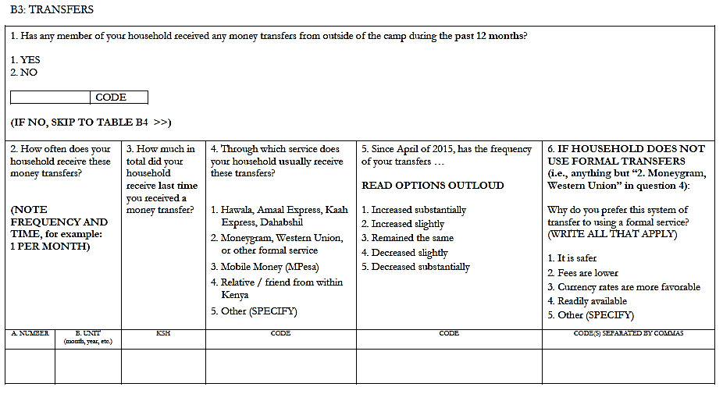
Transfers part of the income module
Notes:
About 170 surveys in Kakuma camp and 450 in Kakuma town and other towns. Distance rings include 0-2 km, 2-8km, 8-10 km. Two villages in each ring were randomly selected. In total, 19 villages were used (when households were not sufficient in small outer villages, additional villages were selected.

Slide 9
Empirical Methods Used
Summary Statistics Comparison:
Spatially Stratified Differences:
 | Mean Kakuma | Mean Non-Kakuma | P-value diff | Obs Kakuma | Obs Non-Kakuma
Cash income per capita | 12771.446 | 6450.240 | 0.056* | 111 | 219
Owned house 2005 | 0.541 | 0.530 | 0.852 | 111 | 219
Owned car 2005 | 0.000 | 0.000 | . | 111 | 219
Owned moto 2005 | 0.027 | 0.014 | 0.393 | 111 | 219
Owned bicycle 2005 | 0.117 | 0.027 | 0.001*** | 111 | 219
Owned refrigerator 2005 | 0.000 | 0.000 | . | 111 | 219
Owned television 2005 | 0.009 | 0.005 | 0.624 | 111 | 219
Owned radio 2005 | 0.117 | 0.082 | 0.306 | 111 | 219
Owned cell phone 2005 | 0.198 | 0.192 | 0.890 | 111 | 219
Owned generator 2005 | 0.000 | 0.000 | . | 111 | 219
Owned computer 2005 | 0.000 | 0.005 | 0.477 | 111 | 219
Owned camera 2005 | 0.000 | 0.005 | 0.477 | 111 | 219
Sum of assets 2005 | 1.009 | 0.858 | 0.186 | 111 | 219
Change assets 2005-2015 | 0.117 | 0.082 | 0.674 | 111 | 219
 | (1) Has animals | (2) Ln(livestock cared for) | (3) Ln(livestock owned)
a. Difference across subsamples
In Kakuma subsample | 0.0527 | 0.6547 | 0.1122
 | (0.0876) | (0.4732) | (0.4272)
N | 330 | 154 | 154
r2 | 0.001 | 0.007 | 0
b. Averages by distance band and subsamples
Less than 2 km to town | 0.2674*** | 1.5027*** | 2.5987***
 | (0.0441) | (0.2398) | (0.3860)
Between 2 and 8 km from town | 0.4443*** | 2.9126*** | 3.7280***
 | (0.0678) | (0.0102) | (0.1033)
Less than 2 km to Kakuma | 0.1018 | 1.0797*** | 0.5379
 | (0.0708) | (0.3316) | (0.4438)
Between 2 and 8 km to Kakuma | 0.0172 | 0.2715* | -0.2589**
 | (0.1178) | (0.1330) | (0.1057)
N | 330 | 154 | 154
r2 | 0.419 | 0.661 | 0.814
Empirical slides with orange side bar from now on
Notes:
In panel b, the covariates show the additional effect of being far from town (the baseline is being in tow). The Kakuma related ones show the additional effect of being in the Kakuma subsample.

Slide 10
Simulation Model
Artuc, Mattoo, and Onder (2016) builds on Artuc et.al. (AER, 2010)
Spatial structure:
  40 identical regions, based on Turkana’s population share in Kenya
Households:
  Two types of origin (local, refugee), two types of skill (skilled, unskilled)
  Individuals change sector and/or location based on wage differentials
Production and Markets:
  Competitive labor and goods markets
  Production uses both skilled and unskilled labor (imperfect substitutes)
  Refugees and locals perfect substitutes
Policy space:
  Encampment/free mobility of refugees (skill-based decision possible)
  Labor force participation of refugees (skill-based decision possible)
Channels/indicators of impact:
  Prices, wages, user fees, and lifetime income
Time composition:
  Dynamics can separate between short and medium term effects
Simulation slides with blue side bars from now on

Slide 11
PRELIMINARY FINDINGS:

Slide 12
Refugee presence should boost the prices of non-tradables
Prices in tradable sectors should not be affected
In the medium-term a large positive effect on non-tradable prices in Turkana and, to a lesser extent, elsewhere,
In the long-term some of this tapers off, but a large part remains permanently.
What do we expect? Price effects
Notes:
Refugee arrivals create a demand shock (if they have purchasing power). In the very short term, supply is inelastic, leading to a hike in prices, which partially tapers off in the long run as workers move into the sector and from other regions.

Slide 13
No data on effects on rental prices, but signs abound
Summary statistics from household survey, housing
 | Mean Kakuma | Mean Non-Kakuma | P-value diff | Obs Kakuma | Obs Non-Kakuma
Non-traditional roof | 0.171 | 0.256 | 0.084 | 111 | 219
More than one room in house | 0.198 | 0.315 | 0.025* | 111 | 219
Brick or metal walls | 0.036 | 0.110 | 0.023* | 111 | 219
Receive water from pipe | 0.135 | 0.265 | 0.007** | 111 | 219
Owns home | 0.991 | 0.932 | 0.017* | 111 | 219
Monthly rent for home | 1500.000 | 2233.333 | N/A | 1 | 15
Year house built | 2004.624 | 2005.410 | 0.465 | 109 | 212
Date household head began living in current location | 1995 | 1990 | 0.027* | 71 | 203
Land Prices
Size in meters | Price in KS
20 x 50 | 50,000
100 x 50 | 70,000
100 x 100 | 200,000
300 x 300 | 270-280,000
400 x 400 | 380,000
500 x 500 | 500,000
Source: Kakuma Turkana chief clerk, June 2015
What do we observe? Price effects

Slide 14
Cannot detect effect on corn; livestock prices increase with aid
Corn Prices and Refugee Population
Correlation between livestock prices and aid
Cattle | Male | Male | Female | Female
Ln(aid) x 1/(km to Kakuma) | 1.6659*** | 1.7102*** | 0.8163*** | 0.7615***
 | (0.2495) | (0.2510) | (0.1985) | (0.1997)
Ln(volume sold) | 0.0774*** |  | 0.0880***
 | (0.0114) |  | (0.0091)
N | 2981 | 2986 | 6874 | 6885
r2 | 0.21 | 0.197 | 0.216 | 0.205
Goats
Ln(aid) x 1/(km to Kakuma) | 0.0898* | 0.0744 | 0.1777** | 0.1662**
 | (0.0540) | (0.0545) | (0.0694) | (0.0694)
Ln(volume sold) | 0.0767*** |  | 0.0419***
 | (0.0118) |  | (0.0121)
N | 2027 | 2028 | 3042 | 3042
r2 | 0.54 | 0.53 | 0.362 | 0.359
Dependent variable: ln(price in shillings). Regressions include fixed effects at market and year/month level. Data is biweekly prices. Standard errors clustered at market level from 26 markets. *p<.10, **p<.05, *** p< .01.
What do we observe? Price effects
Notes:
The livestock price and aid regression has the log of price on the left hand side. On the right hand side we have time fixed effects (which also subsumes aid), number of cattle sold, and the interaction between the aid and the proximity to the camp. The higher the proximity, the higher the impact of aid on livestock prices. Prices are monthly, so we cannot separate the refugee number effects from the aid (refugee numbers are annual).

Slide 15
What do we expect? Wage simulations
Wage effects should be different across sectors
Notes:
In the long-term, the proportional increase in wages of skilled workers is greater than that of the unskilled workers in Turkana non-tradable sectors (0.8 percent to 0.4 percent). The short-term jump is identical between the two (5.6 percent); however, the unskilled wage decreases faster than the skilled wage. Also because the fixed
Similarly, the proportional drop in tradable sector wages is identical for skilled and unskilled worker. However, the skilled worker wages recover more rapidly.

Slide 16
Total income
What do we expect? Income simulations

Slide 17
Closer to the camp, higher the consumption
 | Mean Kakuma Town | Mean Non-Kakuma | P-value diff (one-sided) | Refugee value
Purchased sugar April | 0.631 | 0.680 | 0.184 | 0.965
Purchased water April | 0.108 | 0.018 | 1.000*** | NA
Purchased tea April | 0.568 | 0.607 | 0.244 | 0.918
Purchased milk April | 0.297 | 0.297 | 0.504 | 0.553
Purchased meat April | 0.207 | 0.242 | 0.240 | 0.818
Purchased fish April | 0.054 | 0.009 | 0.994* | 0.371
Purchased coffee April | 0.009 | 0.005 | 0.688 | 0.300
Purchased home brewed alcohol April | 0.045 | 0.032 | 0.725 | 0.012
Purchased factory produced alcohol April | 0.009 | 0.009 | 0.496 | 0.047
Purchased tobacco April | 0.243 | 0.187 | 0.882 | 0.106
Purchased khat April | 0.000 | 0.014 | 0.108 | 0.024
Purchased incense April | 0.018 | 0.027 | 0.301 | 0.159
Purchased phone cards April | 0.180 | 0.201 | 0.327 | 0.929
Purchased clothing April | 0.180 | 0.128 | 0.898 | 0.312
Number of food items purchased April | 1.874 | 1.858 | 0.534 | 4.918
Number of luxury items purchased April | 0.676 | 0.598 | 0.783 | 2.788
Per Capita Consumption and Distance to Camp
What do we observe? Income effects

Slide 18
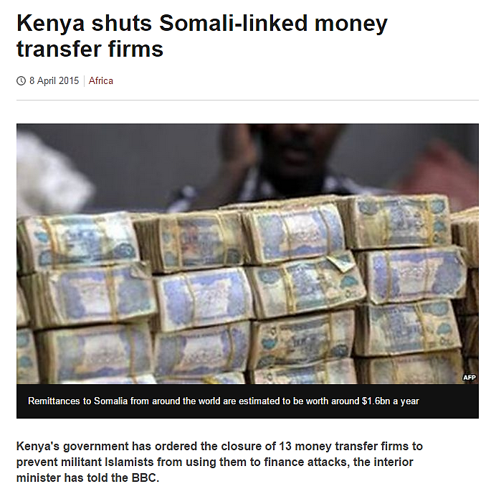
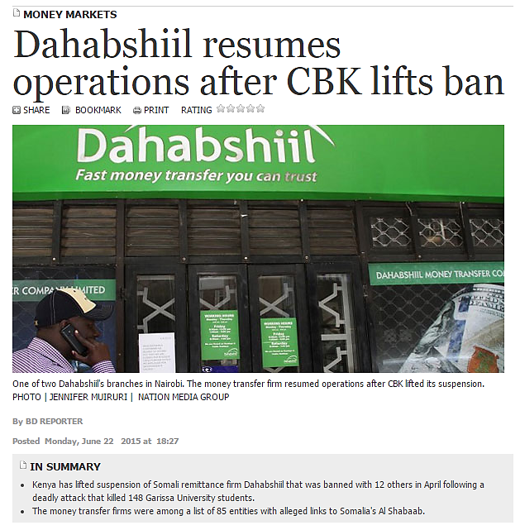
A tragic event turned to a natural experiment
What do we observe? Income effects

Slide 19
Remittances before the Garissa massacre
Refugee transfers
 | Mean | SD | Obs
Received transfer in past 12 months | 0.612 | 0.489 | 170
Receives transfers through a formal service | 0.212 | 0.410 | 104
Transfers have decreased since April | 0.452 | 0.500 | 104
What do we observe? Income effects
Transfer behavior, Turkana households
 | Mean Kakuma Town | Mean Non-Kakuma | P-value diff | Obs Kakuma | Obs Non-Kakuma
Cash transfers received | 0.144 | 0.082 | 0.081* | 111 | 219
Uses informal transfers | 0.062 | 0.000 | 0.296 | 16 | 18
Transfers have decreased | 0.250 | 0.056 | 0.117 | 16 | 18
Amount of last transfer | 7700.000 | 1239.056 | 0.004** | 16 | 18
Notes:
The remittances amount could be about 3 million dollars per year total through the informal channels (or 15 dollars per person per year); but it is difficult to confirm this number.

Slide 20
Refugees’ purchasing power has a direct effect on Turkana income
Consumption change regressions, household survey
 | Sugar | Tea | Meat | Number of food items | Number of luxury items
a. Purchase good (0/1)
In Kakuma town subsample | -0.1129* | -0.1466** | -0.0876* | -0.4299** | 0.0225
 | (0.0587) | (0.0587) | (0.0496) | (0.1754) | (0.0892)
N | 330 | 330 | 330 | 330 | 330
r2 | 0.005 | 0.008 | 0.004 | 0.009 | 0
What do we observe? Income effects
Notes:
We know that Turkana people do not get remittances, so the effect is mainly through the decrease in remittances to refugees between April and June

Slide 21
Conclusions / take away points:
Refugee camps create ripple effects in space-time that resemble the gravitational waves (and we found this before physicists):
  Spatial gradient of economic impacts
  Dynamic overshooting in market-determined outcomes
Concentrating the refugees (mass/energy) in refugee camps (dark holes)
  Magnify the effects of remittances, but
  These effects are largely localized.

Slide 22

Thank you! honder@worldbank.org

